Slide 1

Peer Instruction:
An Instructional Strategy

Slide 2


=
Use this…
… to develop this

Slide 3
“Learning how to learn cannot be left to the students. It must be taught.” *
*Tools for Learning: A Guide to Teaching Study Skills (ASCD 1990)

Slide 4
What is Peer Instruction?
A structured questioning process that involves the participation of every student

Slide 5
How does Peer Instruction work?
Let’s do one together!
You will need…
A set of flash cards
A set of “good” questions
A firm belief that all students like to think!

Slide 6
The Process…
Pose the Question (1 minute)
Give students time to think (1-2 minutes)
Neighbouring students discuss answer
(2-3 minutes)
Students report answers with flash cards and tally of answers (30 seconds)
Student(s) explain how they know they are right and teacher explanation (2+ minutes)
Total Time…. 6 to 10 minutes per question

Slide 7
The script…
Pose the problem (overhead or data projector)
Read the problem to the class
“Silently to yourself, you have one minute to figure out the best answer. Try not to guess. Remember, if you can explain it, you understand it” (and no “table talk”)
“Time’s up! Turn to your partner. The person with the short hair will explain their answer to the long haired person. Long hair will listen and, if he/she agrees, will paraphrase back the answer they just heard or will disagree and argue accordingly. Try to reach consensus if you can. You have one minute.”
“OK, flash me! Show me what you got!”

Slide 8
Warm up!
Think about something you are really good at. It could be a skill you are proud of especially if it has advanced your career. Which best describes how you became good at it?
Trial and error
Apprenticeship
Lectures
Family and friends
Practicing

Slide 9
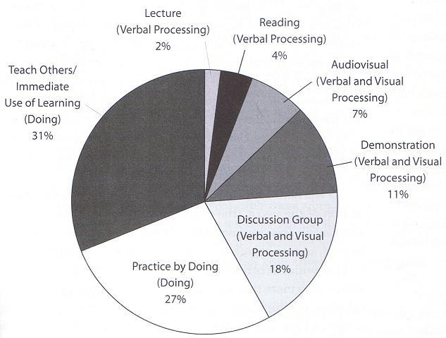
Average Retention Rate from Different Teaching Methods*
*D.A. Sousa, How the Brain Learns, p. 95 (2006)
Peer Instruction
Peer Instruction
Ranking Tasks

Slide 10
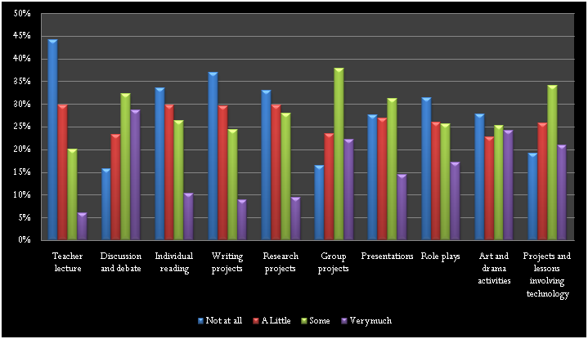
HSSSE 2009 Respondents’ Views on Degree of Excitement/Engagement of Various Pedagogical Methods (N = 42,754)

Slide 11
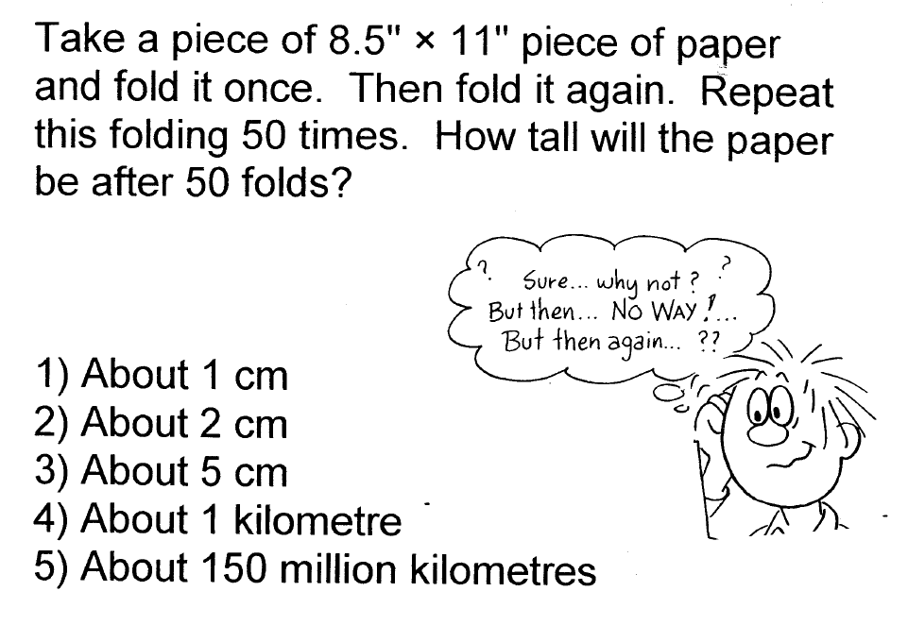
Introducing a concept…

Slide 12
Retrieval practise and feedback…
Imagine you just started a new sales job. Your boss tells you that you have a choice on how to be paid
A $120,000/year salary with no commissions
A $70,000/salary with commissions that might result in more than $120,000/year
A penny on the first day, 2 on the second day, 4 on the third day, 8 on the fourth day, and so on for a full year
How would you choose to be paid?

Slide 13
There is no ‘perfect’ concept question, but each question should*…
Focus on a single important concept, ideally corresponding to a common student difficulty
Require thought, not just plugging numbers into equations
Provide plausible incorrect answers
Be unambiguously worded
Be neither too easy or too difficult
* From ‘Peer Instruction: Engaging Students One-on-One, All at Once’

Slide 14
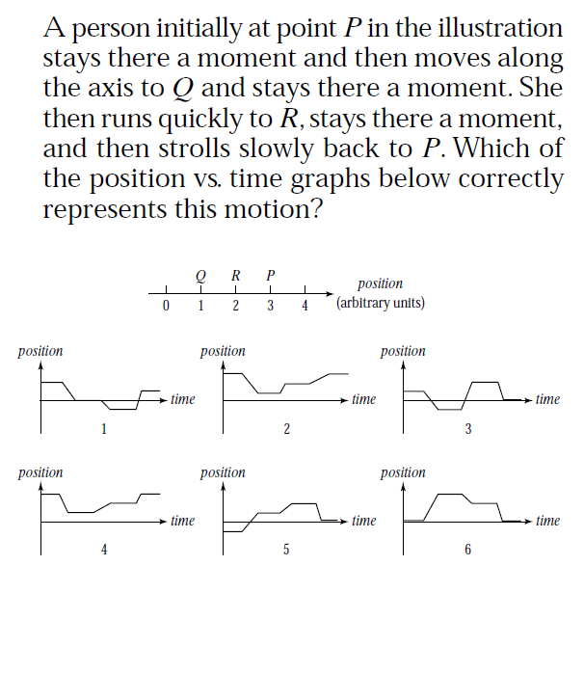

Slide 15
A poor concept question….
Which of the following is the correct unit for energy?
m/s
kg m/s
kg m/s²
kg m²/s²

Slide 16
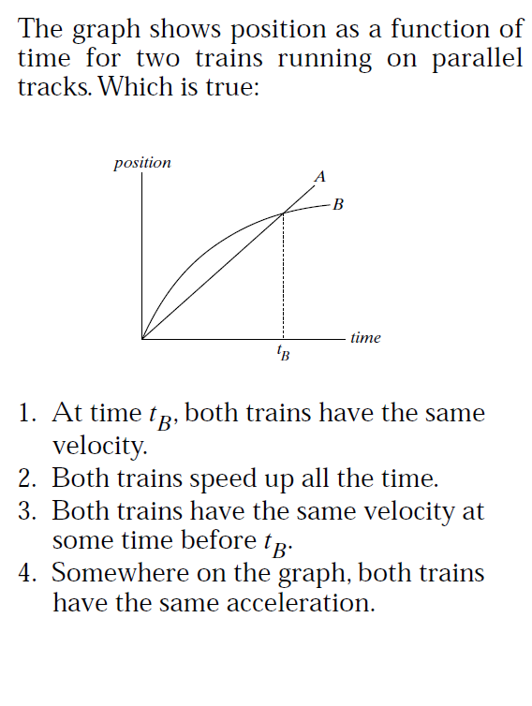

Slide 17
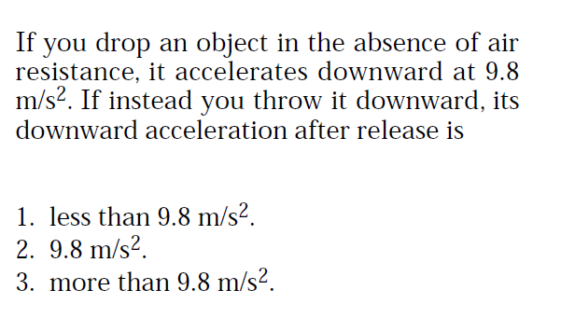

Slide 18
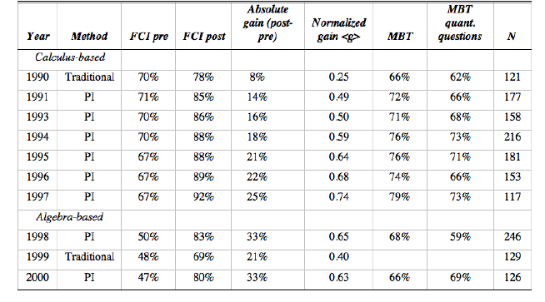
“Why Bother?”
Does Peer Instruction Improve Learning?

Slide 19
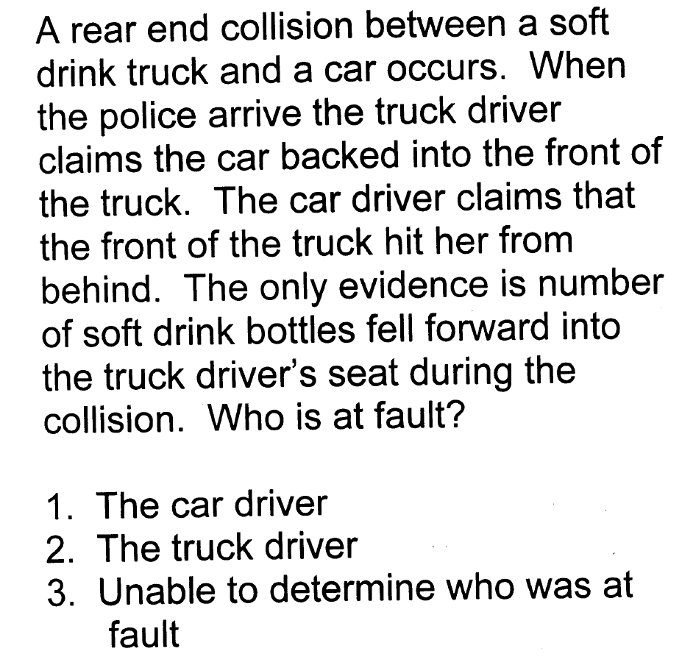

Slide 20
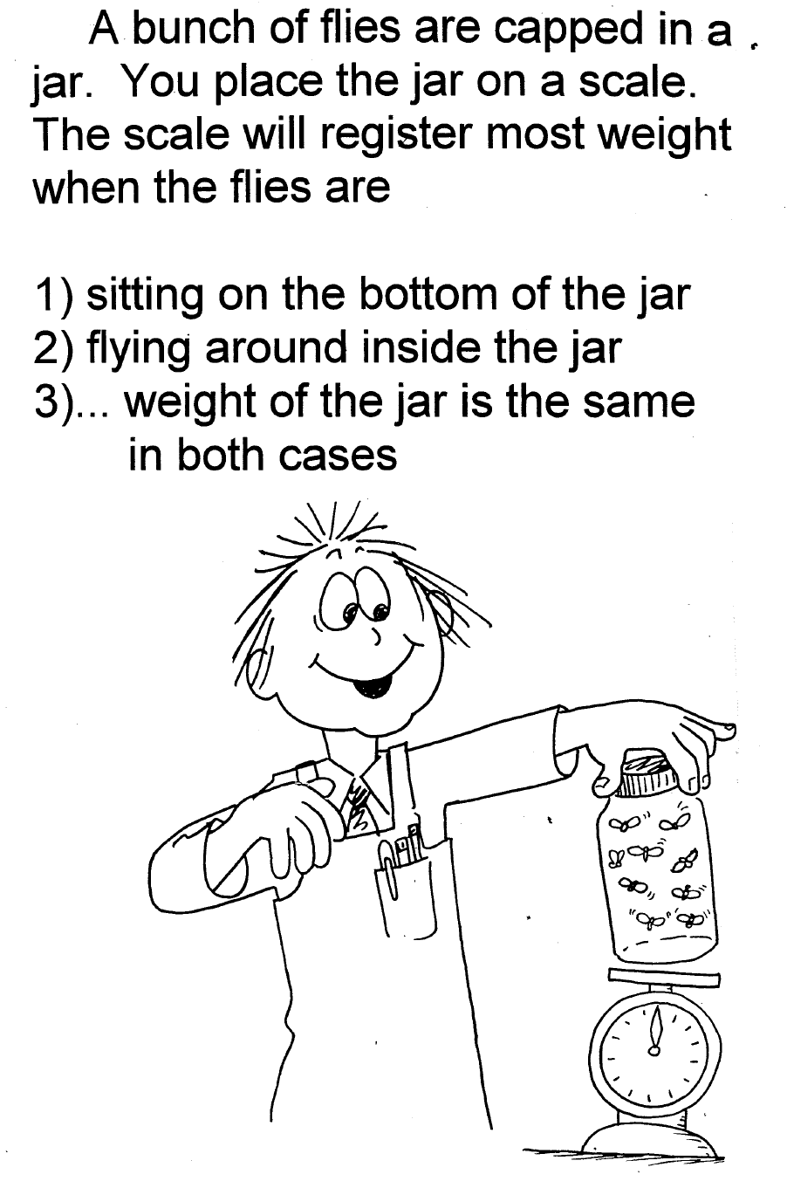

Slide 21
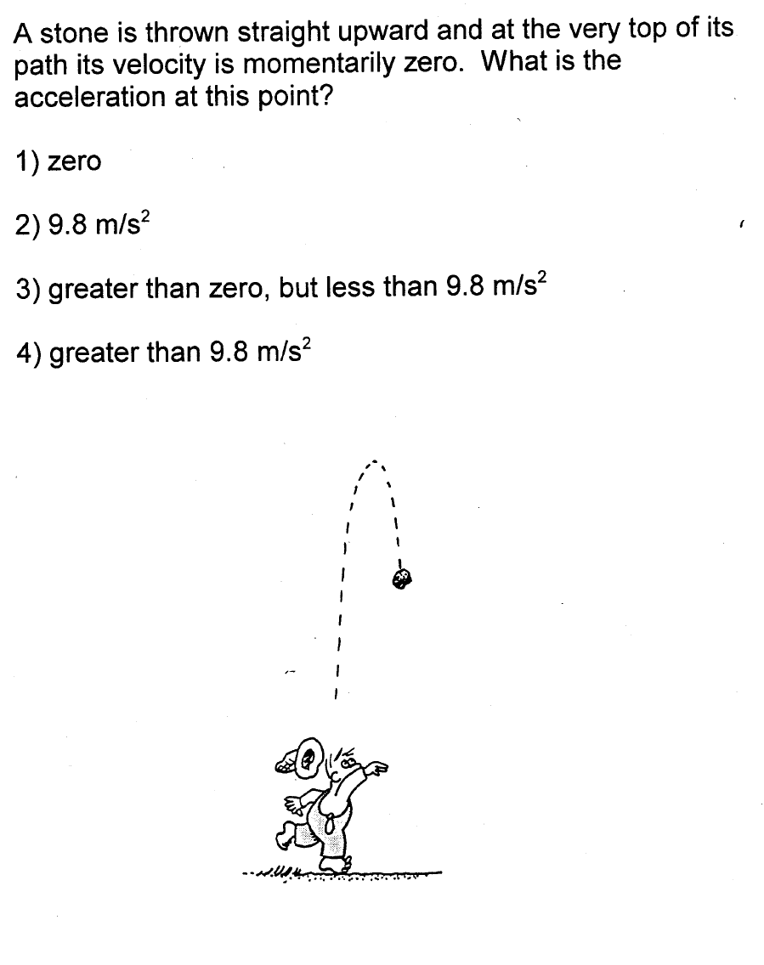
Introducing the concept…

Slide 22
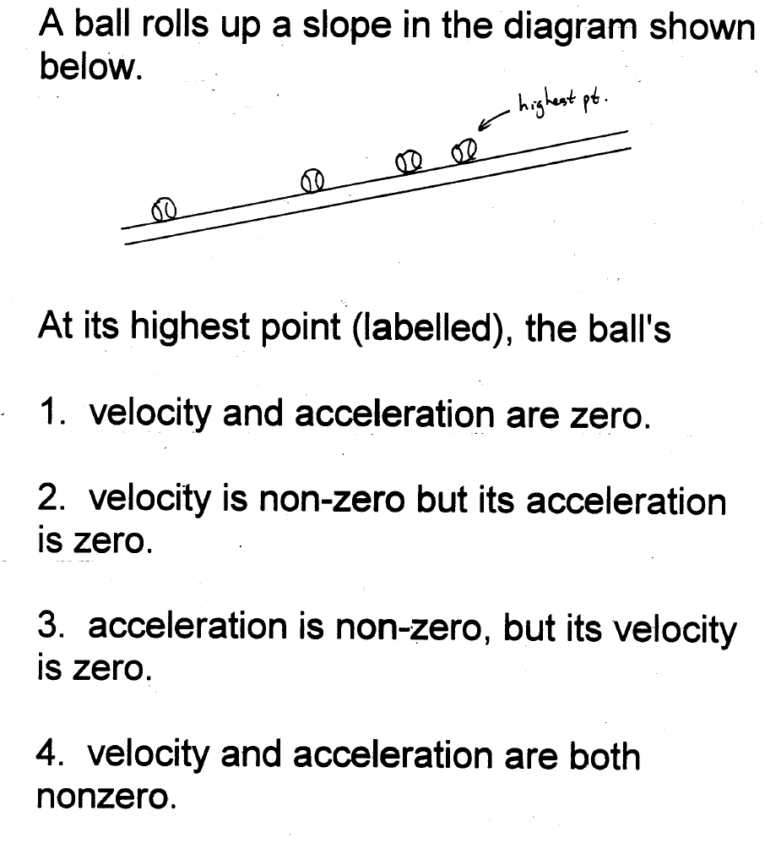
Retrieval practice and feedback….

Slide 23
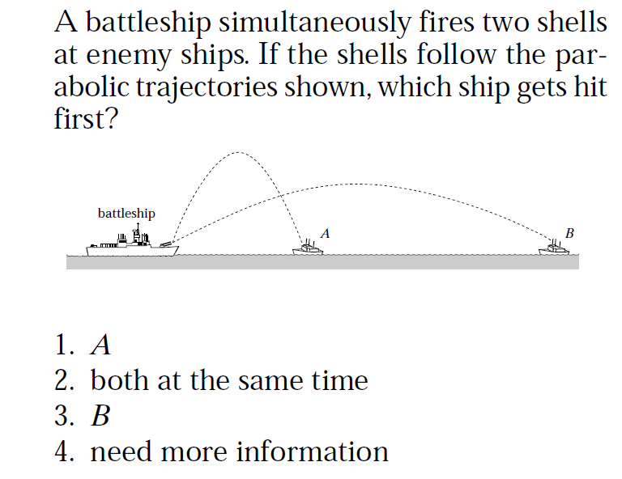

Slide 24
Your Turn!
Making a Concept Question
Work with a partner
Take a question from the handout provided and develop a Concept Question on Newton’s 3rd Law
Be prepared to present it to another group for fun and feedback!

Slide 25

Ranking Tasks in Physics:
An Instructional Tactic

Slide 26


Slide 27
What are Ranking Tasks?
Retrieval practise and feedback for the kids
Invokes comparing and classifying, two VERY powerful instructional strategies*
Time required: 5-10 minutes/question
*R. Marzano, “Classroom Instruction that Works” (ASCD, 2001)

Slide 28
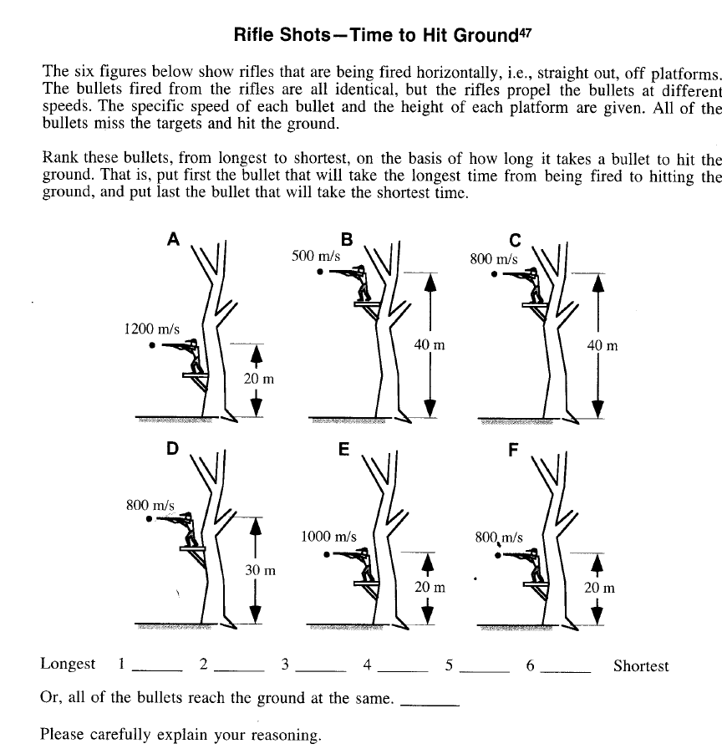
Introducing the Concept

Slide 29
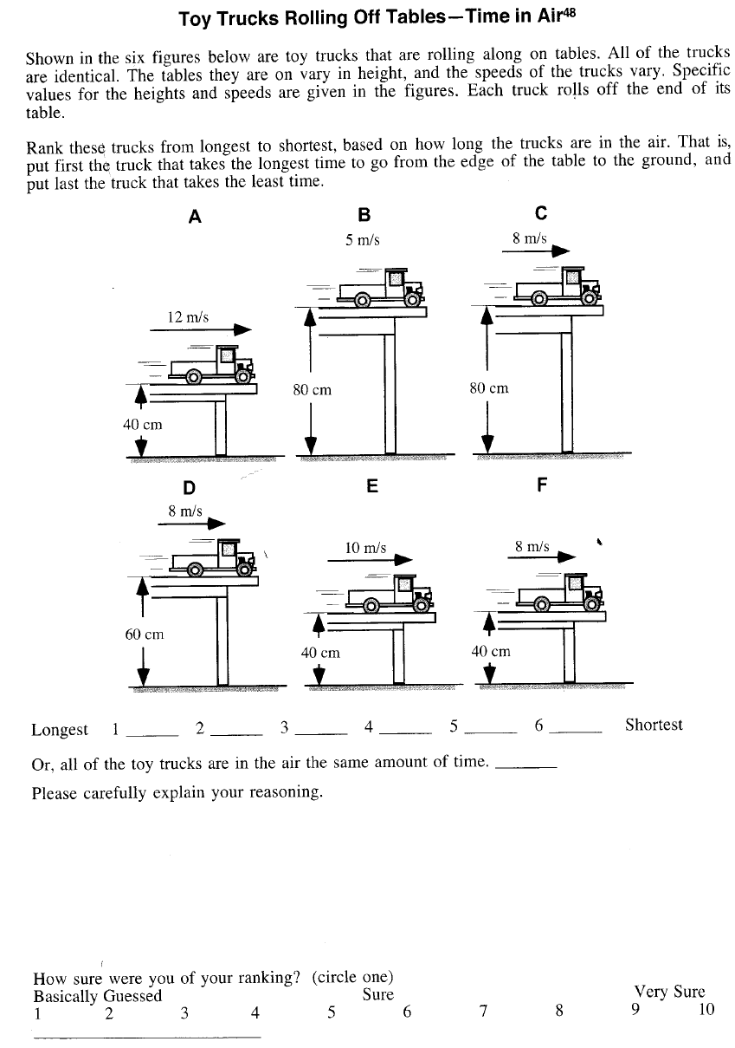
Retrieval Practise and feedback

Slide 30
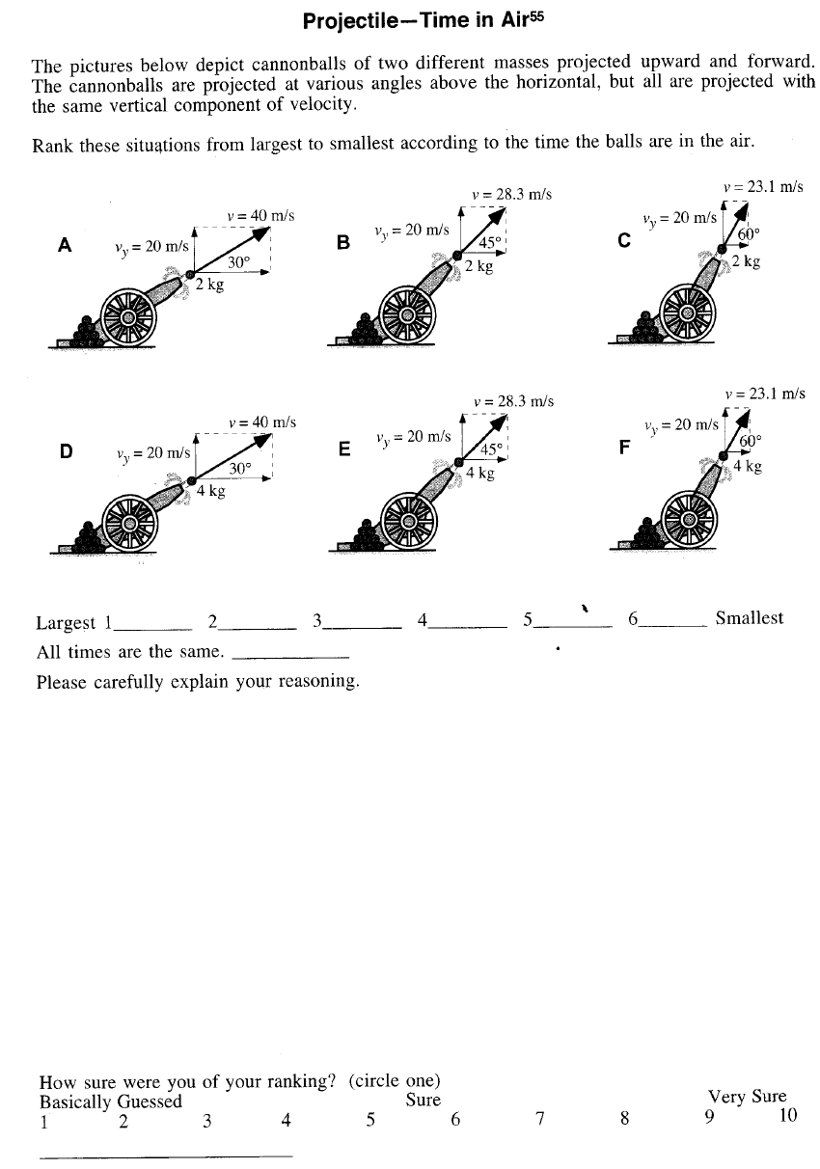

Slide 31
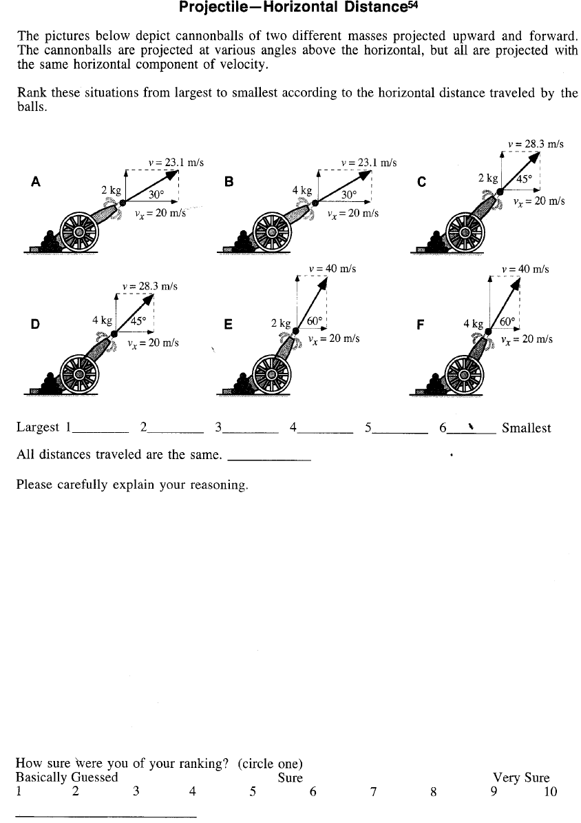

Slide 32
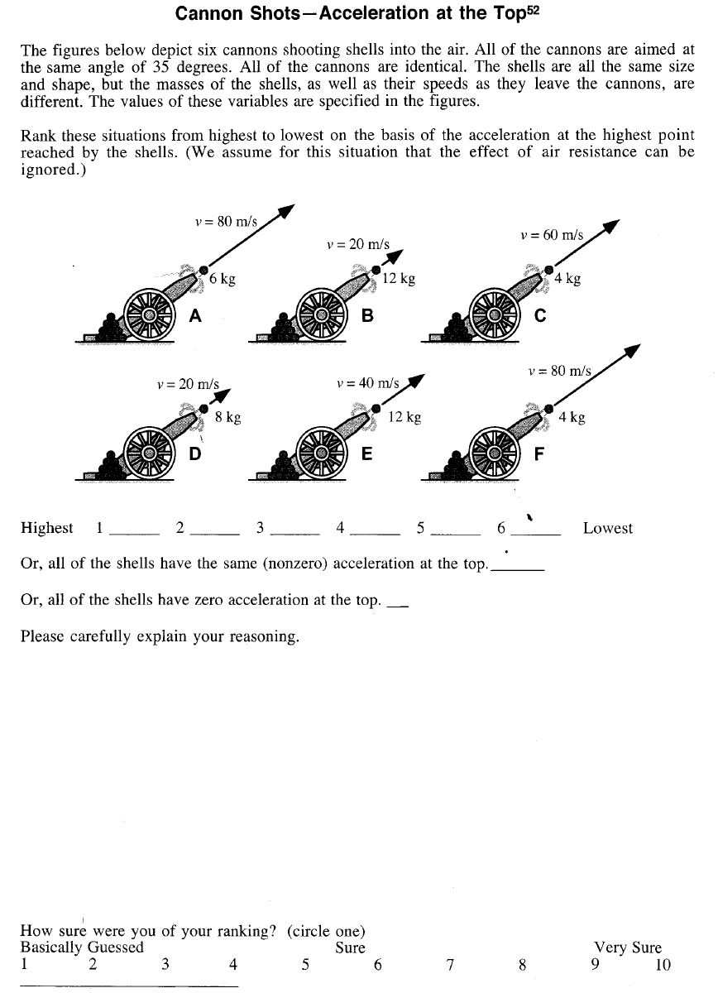
Retrieval Practise

Slide 33
Remember…
“ Memory is a residue of thinking”

