Slide 1
Particle Models

Slide 2
As students go through the high school curriculum they learn about many different models of matter. List as many as you can on the whiteboard.

Slide 3
Grade 9 (Review): The Particle Model of Matter The particle model uses differences in separation and speed to explain the properties of solids, liquids and gases.

Slide 4
Draw the position and speeds of five particles to show how they differ for the three different states.

Slide 5
Make a set of three tableaux that clearly how the differences between a solid, liquid and gas. Note: A tableaux is static and does not involve words. You may use props.

Slide 6
Explore the three provided materials. Which one best demonstrates the formation of crystals, viscosity or ductility? Which has the highest melting point?

Slide 7
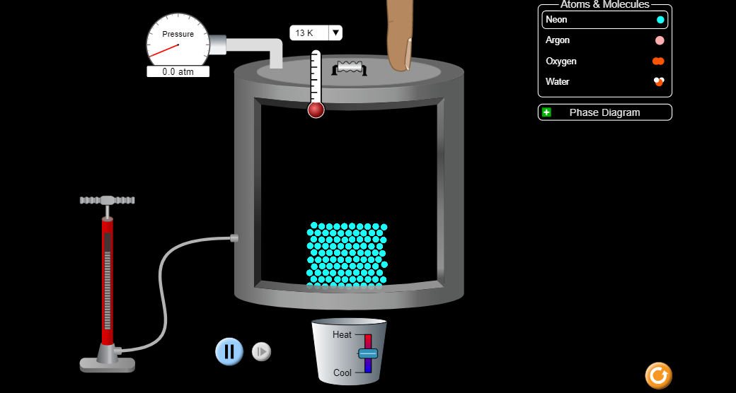
Explore phet.colorado.edu/en/simulation/states-of-matter-basics Why do the substances have different boiling/melting points?

Slide 8
Grade 9 or 10: The Lego (Atomic) Model of Matter The particle model is able to explain physical properties and changes. However, it doesn’t explain what happens in a chemical reaction. The Lego model can explain three laws of chemical reactions.

Slide 9
Conservation of Mass: Weigh your Lego particles. Separate them into large and small pieces and weigh the two piles. How does the mass of the reactant compare to the mass of the products?

Slide 10
Constant Proportions: Divide the mass of the large pieces by the mass of the small ones. Record your results on the board. Which groups have the same particles? How are compounds different from mixtures?

Slide 11
Multiple Proportions: Compare compound A to the others by dividing the larger ratio by the smaller one. Repeat for compound D. Which values are very close to a whole number? Why?

Slide 12
Sample | big + little | big pieces | little pieces | big/little | A vs.__ | C vs.__ | compound
A | 46 | 34 | 12 | 2.83 | 1.00 ~ 1 | 2.32 | 15 (8B + 2B)
B | 56 | 27 | 29 | 0.931 | 3.04 ~3 | 2.50 | 12(8B + 3x2B)
C | 40 | 22 | 18 | 1.22 | 2.32 | 1.00 ~ 1 | 10 (8B + 6B)
D | 71 | 27 | 44 | 0.614 | 4.63 | 1.99 ~ 2 | 12 (8B + 2x6B)
E | 91 | 45 | 16 | 2.81 | 1.01 ~ 1 | 2.30 | 20 (8B + 2B)
F | 91 | 38 | 53 | 0.717 | 3.95 ~ 4 | 3.24 | 16(8B + 4x2B)
G | 68 | 20 | 48 | 0.417 | 6.79 | 2.93 ~ 3 | 9 (8B + 3x6B)
H | 70 | 41 | 29 | 1.41 | 2.01 ~ 2 | 1.16 | 13 (8B + 2x2B)
I | 63 | 24 | 39 | 0.615 | 4.60 | 1.98 ~ 2 | 11 (8B + 2x6B)
J | 41 | 30 | 11 | 2.73 | 1.04 ~ 1 | 2.24 | 13 (8B + 2B)

Slide 13
Grade 9 or 12 Rutherford’s gold foil experiment: Rutherford shot small positive particles – called alpha particles - at a thin gold foil. Most went through. About 1 in 8,000 came back.

Slide 14
Model the experiment by releasing a ball on a track that is > 30 cm away from the curved base of a wine glass. Try to get the ball to come straight back onto the track.

Slide 15
What did you have to do to succeed? What aspects of the challenge were like Rutherford’s experiment? What aspects of the challenge were very different from Rutherford’s experiment?

Slide 16
Make a set of three tableaux that show the very different behaviours of alpha particles with identical velocities heading toward a gold nucleus. Show the particles when they are very far from the nucleus, at their closest position and a short distance after this.

Slide 17
Sketch the paths of three alpha particles. Include arrows to indicate their speeds at various points. Make sure that energy is conserved.

Slide 18
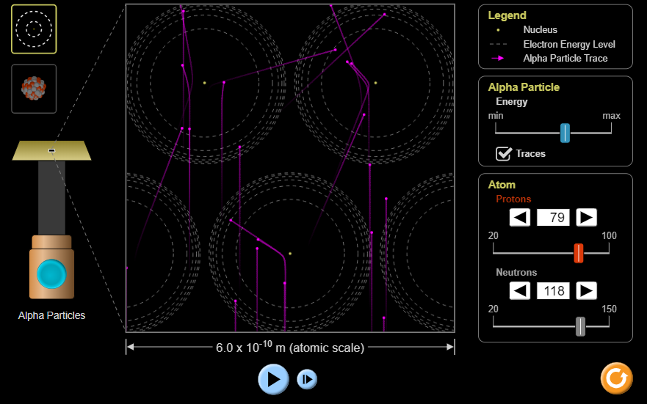
Check your diagram using phet.colorado.edu/en/simulation/rutherford-scattering

Slide 19
Grade 9: Molecular Bonds The non-metal elements just need a few extra electrons to become stable. The way they do this is by ‘sharing’ electrons.

Slide 20
Imagine that you and your fellow students are hydrogen atoms. You each have a pen in your right hand to represent your one electron. Each student wants one more electron so it will be like helium.

Slide 21
Turn to a neighbour and grab their ‘electron’ with your left hand without letting go of your one electron. What happens?

Slide 22
How would you act out the formation of molecular bonds between atoms of Cl, O or N?

Slide 23
How would you act out the formation of molecular bonds between atoms of Cl, O or N?

Slide 24
Molecular bonds are very strong but molecules have very low boiling points. Explain why by silently acting out what happens when these compounds boil.

Slide 25
Grade 9 Ionic Bonds: These form between metals that want to lose electrons and non-metals that want to gain electrons.

Slide 26
You are going to model the formation of sodium chloride. Each student will be randomly assigned to be either sodium or chlorine.

Slide 27
Sodium atoms have an electron card that they want to get rid of and chlorine atoms want to get one of these. Find someone to react with and transfer the electron.

Slide 28
Now the sodium students are positive and want to surround themselves with four chlorine students. The chlorine students are negative and want to surround themselves with four sodium students. What happens?

Slide 29
Draw the 2-D arrangement of sodium and chlorine ions in a solid. How will the 3-D version be different?

Slide 30
Sodium chloride forms crystals with flat faces and sharp edges. Why?

Slide 31
Ionic compounds will not conduct electricity unless they are melted or dissolved in water. Why?

Slide 32
Ionic compounds have much higher melting points than molecular compounds. Why?

Slide 33
Ionic compounds are very brittle. Why?

Slide 34
Grade 12 Quantum Physics Wave-Particle Duality: The Challenge of Quantum Reality (PI Resource)

Slide 35
Grade 12 Quantum Physics The Quark Model: Taming the Particle Zoo (PI Resource)

Slide 36
Grade 12 Quantum Physics The Randomness of Particle Decay: Radioactive decay was discovered over a century ago. It is a quantum process.

Slide 37
Suppose you have 100 new computers and you graph how many are still working each following year. What will the graph look like? A B C D

Slide 38
Suppose you have 100 grade 12 students and you graph how many are still alive each following year. What will the graph look like? A B C D

Slide 39
Suppose you have 100 radioactive atoms and you graph how many are still undecayed each following year. What will the graph look like? A B C D

Slide 40
The pattern of radioactive decay is very different because the decay is not a result of the atoms wearing down in some way. Instead, the process is completely random. That is why we know it is a quantum process.

Slide 41
You will simulate radioactive decay with 100 dice. When the dice are rolled, a ‘one’ means that it has decayed and is removed. Predict how many undecayed dice you will have after each round. What is its half-life?

Slide 42
Roll the dice. Explain the differences between your predictions and the results. How is this randomness different from the randomness of radioactive decay? How is this like the double slit experiment?

Slide 43
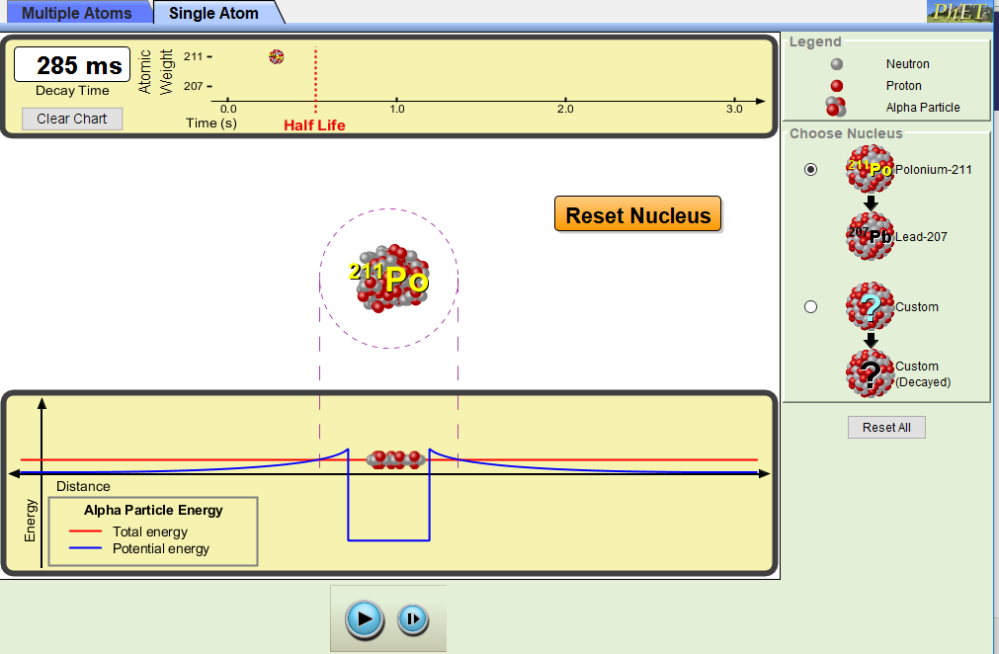
Explore the randomness and quantum tunneling of alpha decay. http://phet.colorado.edu/en/simulation/alpha-decay

