Slide 1
Climate Change
Part 1: The evidence for global warming
Part 2: The cause of global warming
Part 3: Other effects of climate change
Part 4: Ways to reduce climate change

Slide 2
Part 1: What is the evidence for global warming?

Slide 3
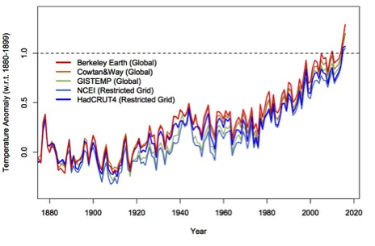
Atmospheric temperature
PI: Determining temperature on a global scale requires averaging thousands of local measurements. Each model uses slightly different data sets and methodologies.

Slide 4
Atmospheric temperature
Is this data convincing? Explain.

Slide 5
Atmospheric temperature
In what year would you have been convinced?
A) 1950 B) 1970 C) 1990 D) 2010

Slide 6
Atmospheric temperature
We need to use data that is up-to-date.

Slide 7
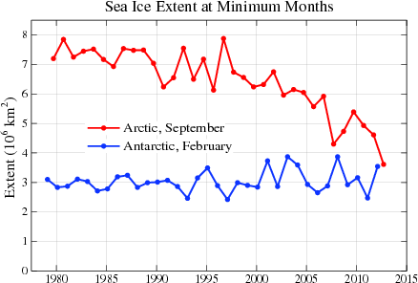
Is this evidence for global warming? Explain.
https://nca2014.globalchange.gov/report/our-changing-climate/melting-ice#intro-section-2

Slide 8
We need to use data that is global.
https://nca2014.globalchange.gov/report/our-changing-climate/melting-ice#intro-section-2

Slide 9
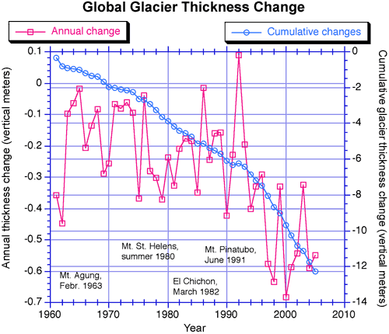
Which display of the data is more convincing?
Image courtesy of Mark Dyurgerov, Institute of Arctic and Alpine Research, University of Colorado, Boulder.

Slide 10
The data should be displayed as clearly as possible.
Image courtesy of Mark Dyurgerov, Institute of Arctic and Alpine Research, University of Colorado, Boulder.

Slide 11
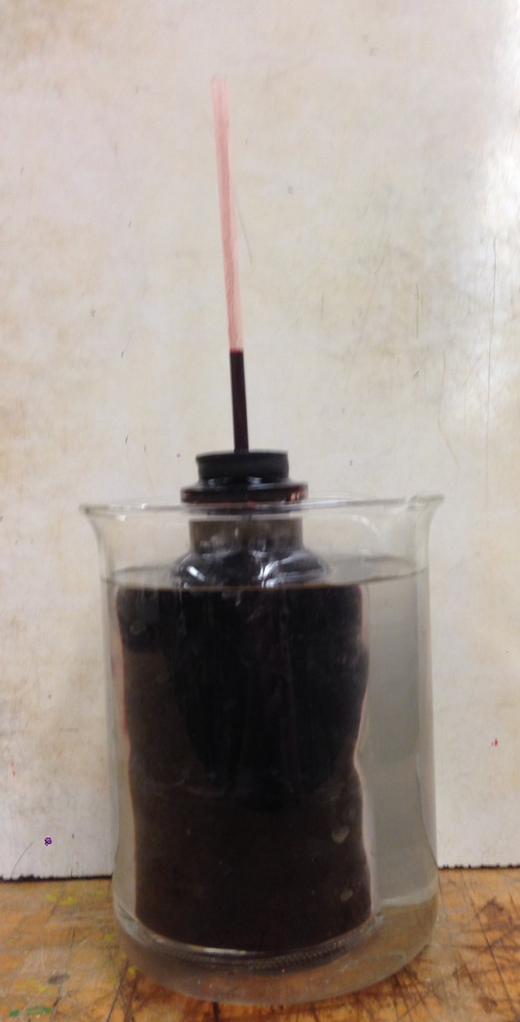
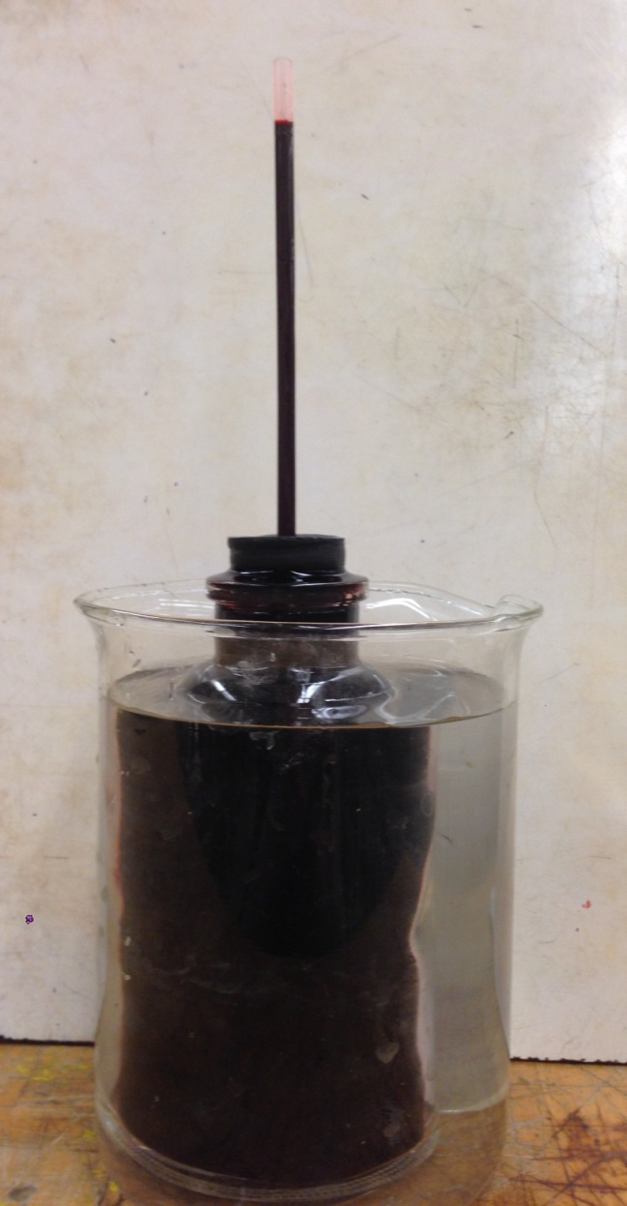
PI: The container of red water is placed in much hotter water. What will happen? Why?

Slide 12
PI: How will global warming affect the oceans?

Slide 13
PI: Ice, water and rocks are placed in two cups. What happens to the water levels as the ice melts?
A) both rise equally B) right rises more
C) only left rises D) only right rises

Slide 14
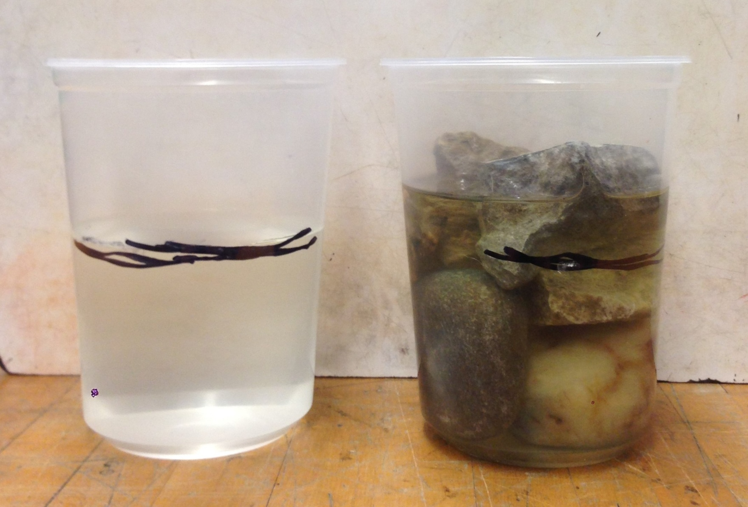
PI: What melting will affect sea levels?
icebergs, ice sheets B) glaciers, icebergs
C) glaciers, ice sheets D) all three

Slide 15
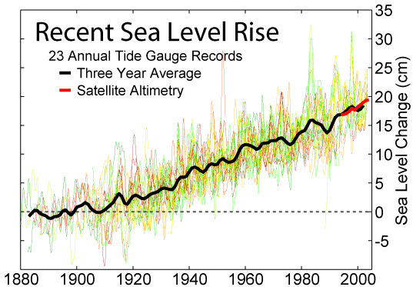
How are the black line, red line and many
thin coloured lines related?

Slide 16
Alaska has been experiencing a decrease in sea level over the last decade. Does that disprove global warming? Explain.

Slide 17

PI: The balloon on the right is ¼ water.
What will happen if a flame is put under each?
the right bursts first B) the left burst first
C) only the right bursts D) only the left bursts

Slide 18
PI: Water has a huge heat capacity and the ocean is very deep and wide. How has this affected global warming? It has
made it worse
reduced the effect
had no effect
Explain.

Slide 19
Part 2: What is causing global warming?

Slide 20
The Earth and the Moon are about the same distance from the Sun, but their temperatures are very different. The Moon ranges from
100º C in the day to -170 Cº at night!
Certain gases make our climate more comfortable through the greenhouse effect.

Slide 21
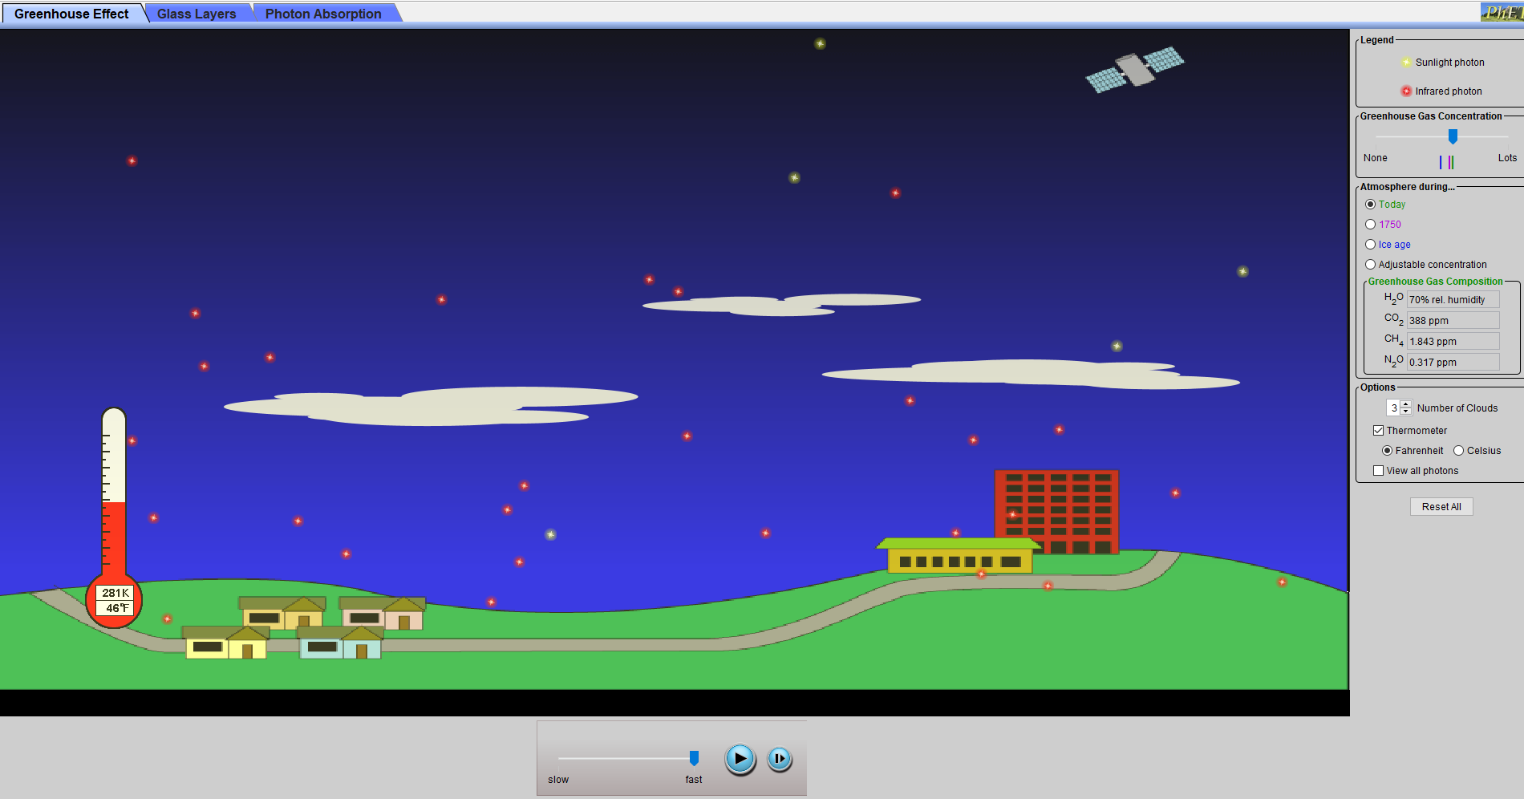
Record the present temperature, humidity,
and the concentrations of the three gases.
https://phet.colorado.edu/en/simulation/legacy/greenhouse

Slide 22
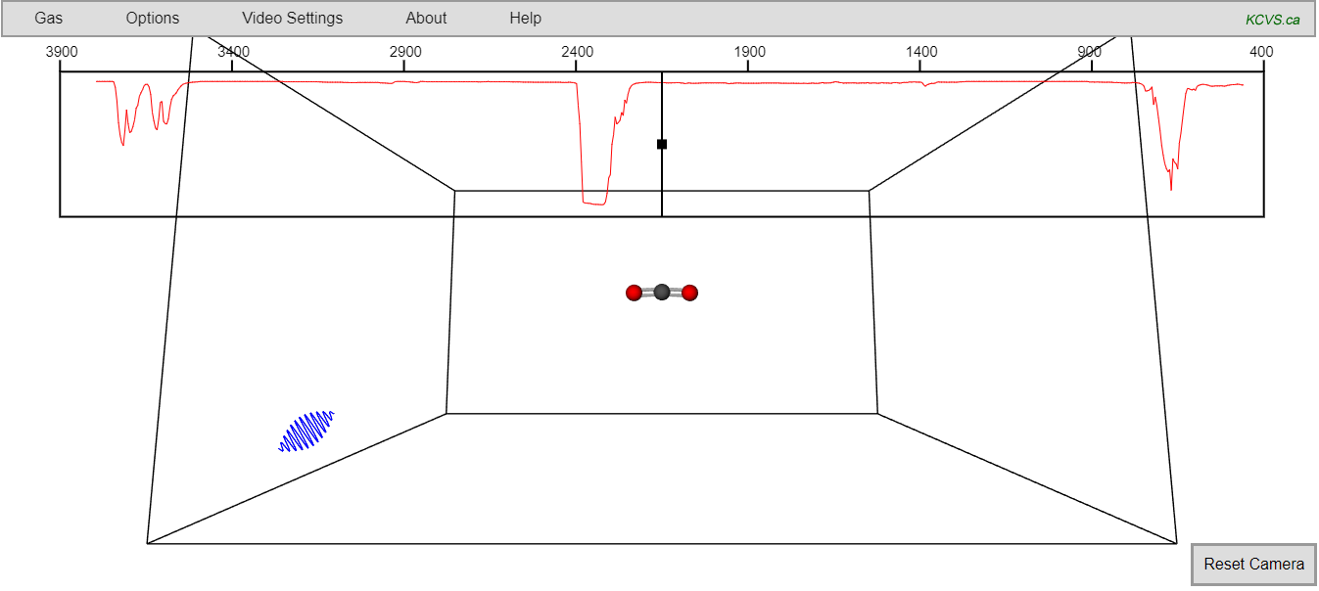
http://kcvs.ca/site/projects/JS_files/Collisional_Heating/CollisionalHeating.html

Slide 23
Many causes of global warming have been suggested. Each can be tested by making a computer model to calculate how it will alter temperatures.
PI: Your group will examine one variable.
Be prepared to present the following:
Why would your variable affect temperature?
What does the model predict?

Slide 24
Ozone decrease and greenhouse gases increase both produce an increase in temperature. Which of these should we be concerned about?
mostly greenhouse gases
B) mostly ozone
C) greenhouse gases and ozone equally
Explain your choice.
A nice summary https://www.bloomberg.com/graphics/2015-whats-warming-the-world

Slide 25
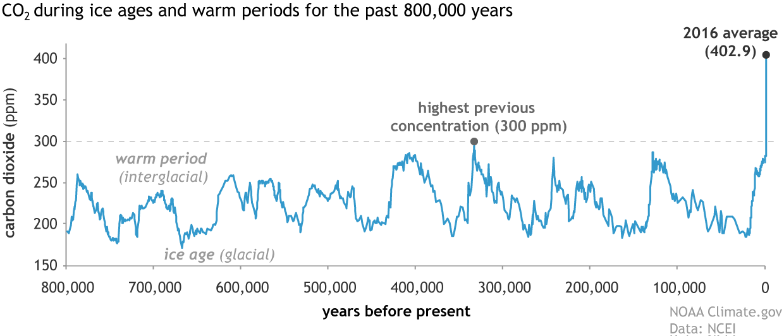
Carbon dioxide levels have fluctuated naturally in the past. Are the recent increases normal?

Slide 26
How can you measure carbon dioxide in the atmosphere 800,000 years ago?

Slide 27
Should the vertical axis be changed? Explain.

Slide 28
Where is the carbon dioxide coming from?
Carbon moves around the Earth in different forms, but the total amount of carbon on the Earth does not change.

Slide 29
Carbon spends time in the atmosphere as carbon dioxide, in the biosphere as organic matter, in the hydrosphere as carbonates and carbonic acid, and in the lithosphere as fossil fuels.
Most of the carbon is stored in the lithosphere.

Slide 30
Where is carbon decreasing?
    atmosphere
    biosphere
    lithosphere
    hydrosphere

Slide 31
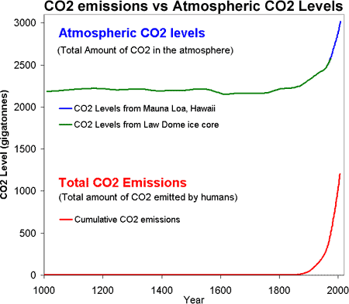
Does this show causation or correlation? Explain.

Slide 32
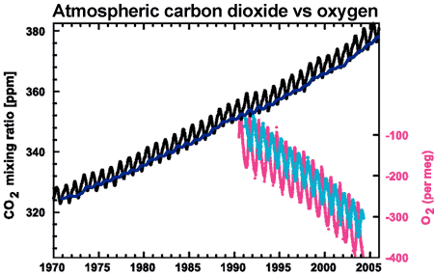
What does the decrease in oxygen suggest?
CO₂ concentrations from Mauna Loa, Hawaii and Baring Head, New Zealand (long line)and atmospheric oxygen measurements from Alert, Canada and Cape Grim, Australia (short lines) (IPCC AR4 2.3.1 adapted from Manning 2006).

Slide 33
Watch UQx DENIAL101x 1.2.1.1 Consensus of Evidence
Many lines of evidence show that greenhouse gases are causing global warming. What data shows that this is caused by humans?
https://www.youtube.com/watch?time_continue=306&v=5LvaGAEwxYs

Slide 34
A B
C D

Slide 35
Part 3: What are the effects of climate change?

Slide 36
Global warming, caused by the greenhouse effect is expected to do much more than just raise temperatures. This is why scientists prefer to call the problem climate change.

Slide 37
Rising Sea Levels:
Scientists expect the global sea level to rise by 0.50 to 1.65 m by 2100. Why will local effects vary greatly from this average?

Slide 38
The same rise in global sea level can have very different effects locally. Why?

Slide 39
Go to https://ss2.climatecentral.org/
What will happen if global sea levels rise by
1.5 m in Toronto? In Vancouver?
What cities outside of Canada will be most affected? Explain.

Slide 40
Extreme Weather:
Warmer temperatures will increase the evaporation of water. The atmosphere already holds 4% more water than it did 40 years ago. The increased evaporation will increase the frequency and intensity of
A) droughts B) fires
C) snowfall D) rainfall

Slide 41
Extreme Weather:
Storm surges are the temporary raising of water level caused by low pressures during a storm. There is going to be more damage from storm surges and flooding because of
higher sea levels B) stronger winds
C) heavier rainfall D) all three

Slide 42
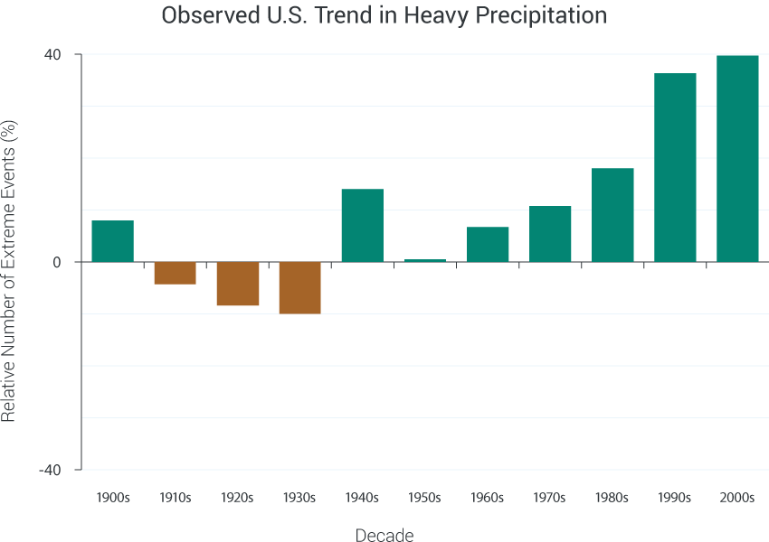
Does this graph show more extreme weather?

Slide 43
Many effects form feedback loops that can accelerate or decelerate climate change. Which of the following will not speed up climate change?
A) Melting permafrost releases methane.
B) Melting snow and ice decreases reflection.
C) Warmer air causes more evaporation.
D) The oceans dissolve more carbon.

Slide 44
Warmer oceans dissolve more carbon. This becomes carbonic acid.
PI: Blow into bromothymol blue.
Place calcium carbonate (chalk) in vinegar.
How will more carbonic acid affect the ocean ecosystems?

Slide 45
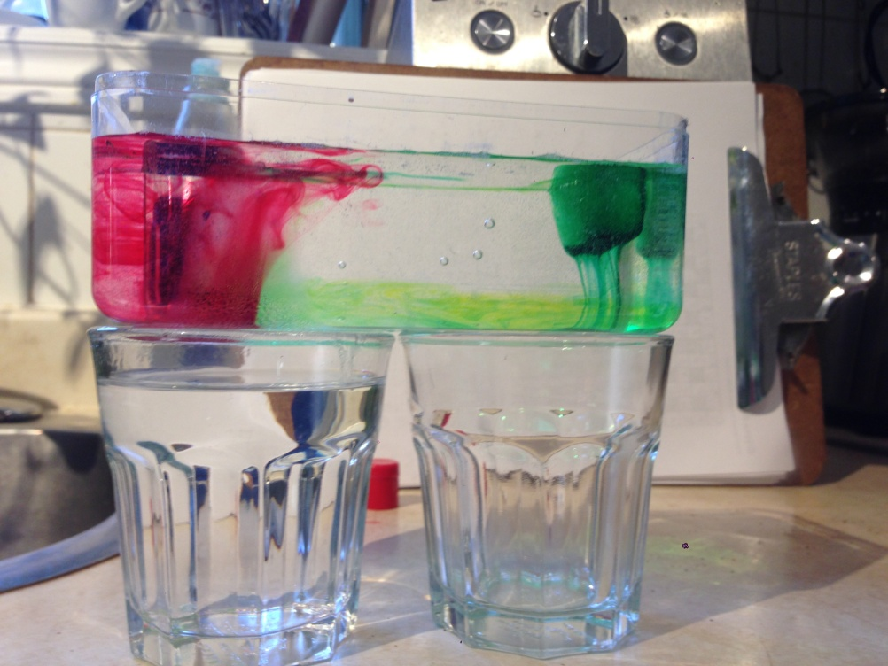
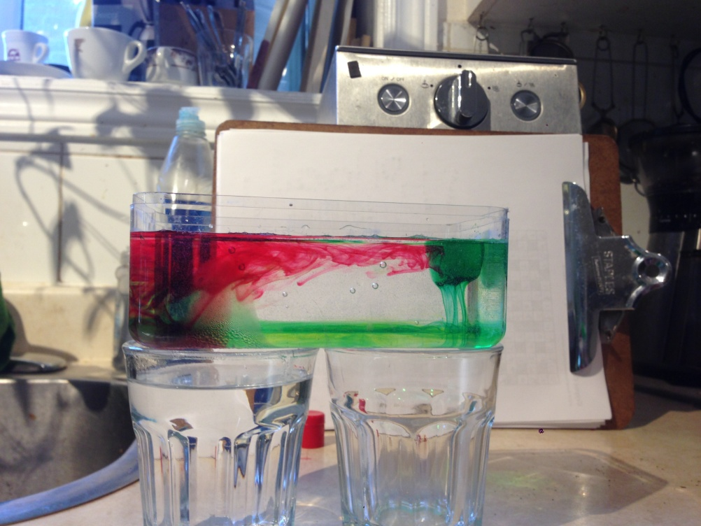
A container of water was placed over a glass of hot water (left) and an empty glass (right). Red food colouring was added at the bottom left with a dropper and a green ice cube was put on the top right. What happens and why?
What drives the ocean currents?
A) cold water sinking B) hot water rising C) both

Slide 46
Warmer ocean surfaces reduce upwelling. Why?
The warmer water is less dense and a greater push is needed to bring the colder water up.
Less upwelling means less nutrients coming to the surface and less phytoplankton which are responsible for over half of the earth’s photosynthesis.
Does this form a feedback loop?

Slide 47
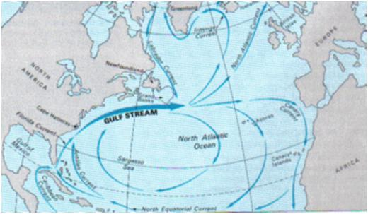
How much of Europe is further north than Toronto?
The Gulf Stream is driven by cold salty water sinking in the Arctic. What will change?
http://www.robinsonlibrary.com/geography/oceanography/dynamics/gulf.htm

Slide 48
Part 4: How can we slow climate change?

Slide 49
There have been other global environmental problems in the past. Describe how each of these problems have been solved (mostly);
Acid precipitation
2) Depletion of ozone in the upper atmosphere
https://www.telegraph.co.uk/science/2018/01/05/hole-ozone-layer-has-shrunk-thanks-ban-cfcs-nasa-confirms/
3) Population Explosion https://www.ted.com/talks/hans_rosling_religions_and_babies/transcript?language=en

Slide 50
In the next 50 years, the carbon emitted into the atmosphere is expected to double. What would it take to stop this growth?
www.explainingclimatechange.ca/Climate%20Change/javascript/Stabilization%20Wedges/stabilizationWedges.html

Slide 51
Vehicle Efficiency and Use
Which has the greatest impact by itself?
What is the greatest combined reduction?
What causes the realistic limits?
Buildings
Which has the greatest impact by itself?
What is the greatest combined reduction?
How do you make a building more efficient?
Decarbonization of Power
Which techniques are unfamiliar?
Which will have the greatest impact by itself?
What is the greatest combined reduction?
Agriculture
Why are biofuels better than fossil fuels? What are the problem with biofuels? What are the alternatives?
What is conservation tillage? How can you reduce the eight wedges to zero?

Slide 52
PI: Transportation and trees
Transportation represents over 20% of Canada’s greenhouse gas emissions. An average car emits 250 g of carbon dioxide per kilometre. Suppose you travel 400 kilometres by car each week with another person in the car. How much carbon are you emitting per week?
An average tree absorbs 50 g of carbon dioxide each week. How many trees are required to absorb this carbon dioxide?

Slide 53
PI: Transportation and trees
The effect of a trip by airplane is similar to driving it in a medium sized car alone. It is 4500 km from Toronto to Vancouver. How does one round trip compare to a week of driving 40 km with a passenger?
What would it cost to offset this? https://sustainabletravel.org/utilities/carbon-calculator/

Slide 54
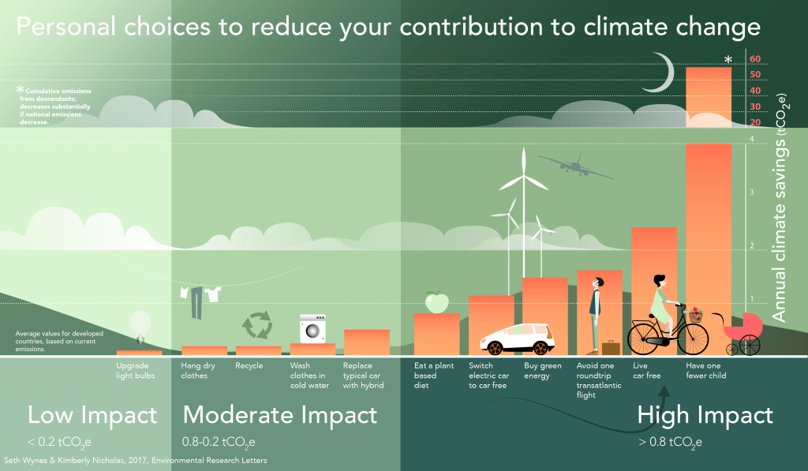

Slide 55
Possibly, the most important thing we can do is to help people understand climate change.
Over 97% of published scientists agree that climate change is due to increased greenhouse gases from human activity.
Why do many people not accept this result? What would convince them?

Slide 56
Climate Change possibly is the greatest challenge facing the world.
It is a unit in grade 10 science but should be included in other courses. Where else can aspects of climate change be included?

Slide 57
Grade 9 Science: Electricity, Ecosystems, Chemistry, Astronomy (satellite observations)
Grade 10 Science: Climate Change, Light, Chemistry
Grade 11 Physics: Energy and Society, Electricity and Magnetism
Grade 12U Physics: Energy and Momentum?, Quantum (LED’s),
Grade 12C Physics: Energy Transformations,

