Slide 1
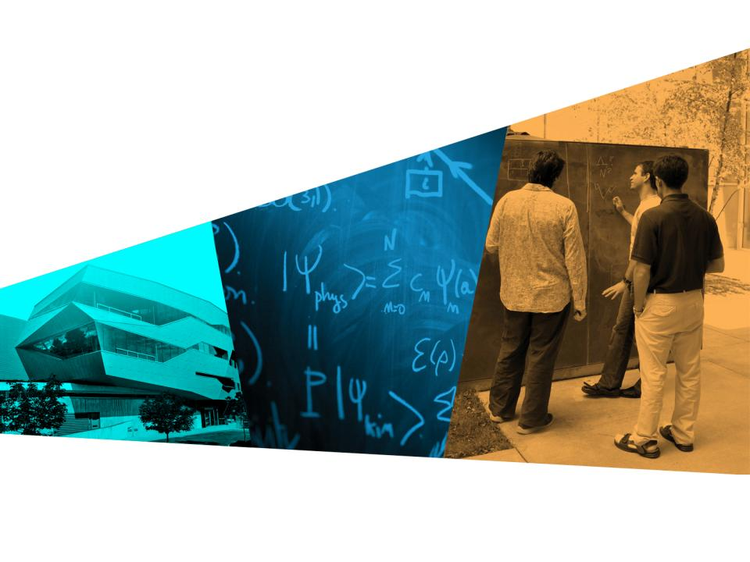
Waves:

Slide 2
A summary
This resource is aimed at grade 11 physics but has applications to grade 9 and 10 science and grade 12 physics

Slide 3
Agenda
Activity 1 wave properties
Activity 2 applications of sound waves

Slide 4
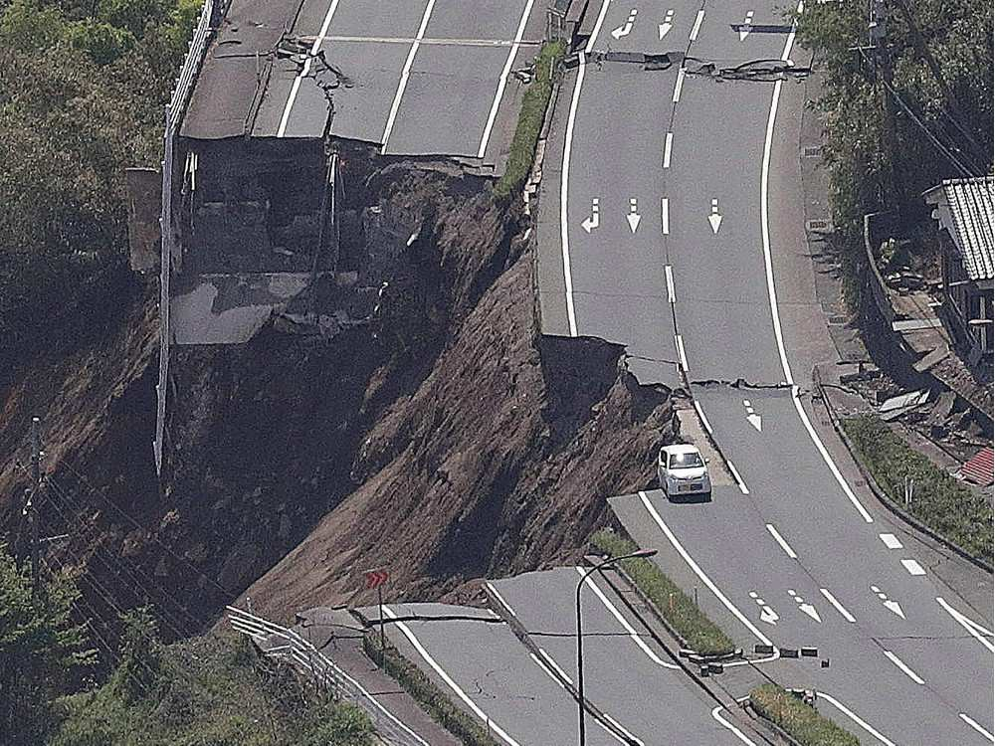
Summary of other activities
Activity 3 investigating earthquakes
Involves modelling P ( primary/ pressure waves) and S ( secondary/shear waves)
Quick demo

Slide 5
Activity 4: How do we hear
Modelling ear canal using acoustic resonance
Explains why we are most sensitive to about 3600 Hz based on length of ear canal
Examines resonance and inner ear
Examines the effect of outer ear shape on hearing

Slide 6
Activity 5: Exploring Gravitational Waves
Models gravitational waves using onion net bags or fruit foam nets
Models interferometry using transparencies from activity 1
Shows how small disturbances like those caused by gravitational waves can be amplified

Slide 7
Modelling waves
Organise cards in the following order
0,+1,0,-1,0,+1,0,-1,0
In groups of 9
1st student passes

Slide 8
rules
0 card stays at waist
+1 at head
-1 at knees
+2 card over head
-2 card at toes

Slide 9
First time
Card is handed to first of 9 people each standing about 1 m apart
The pass to person 2 and the first person receives the next card and acts accordingly
Continues until 8th person has card
The first person then sketches what they see and determines wavelength and amplitude

Slide 10
Reflection from a fixed end
The last person becomes a fixed end
The first person becomes the 9 person and passes the last person what they need
A +1 reflects as a -1
A 0 reflects as a 0
A -1 reflects as a +1
When the waves meet you must sum

Slide 11
Reflection from a free end
A + 1 stays as a +1
A -1 stays as a -1
A 0 stays as a zero

