Slide 1
Building a successful classroom

Slide 2
The class needs to be welcoming
Students arrive in my class the first day only to find their names on tent cards on desks
This repeats for the first 2 weeks ( different desks each day)
This means new or shy students do not need to worry about where to seat
It also means that everyone gets to know and work with everyone in the class

Slide 3
The class needs to be inclusive
This needs to be established early on
The teacher needs to recognize their position of power
As my experiences are very different from my students I need to ensure that they are included and that my tests do not have cultural or gender biases.

Slide 4
Ice breakers are great first day events
A short 20 minute activity on the first day begins to create a positive atmosphere
Ensure students are working in groups of 3 to 4

Slide 5
ICE BREAKER #1
10 things in common
In a group of 3 of 4 you must come up with 10 things that you all have in common
You cannot use obvious things like being human
An example might be liking french fries from the cafeteria
Group then shares with the entire class ( it’s safe because the whole group shares the 10)

Slide 6
ICE BREAKER #2
Cup stacking
Students use strings attached to an elastic to stack cups
They cannot touch the cups or the elastic with their hands
They must hold the ends of the string

Slide 7
ICE BREAKER #3
Two truths one lie
Each student must think about two true things about themselves that might be surprising ( i.e. the others will think are lies)
They must also think of a lie that the others might believe
Other members must discuss and come to consensus before lie is revealed

Slide 8
ICE BREAKER #4
This one’s called
Atomic Waste

Slide 9
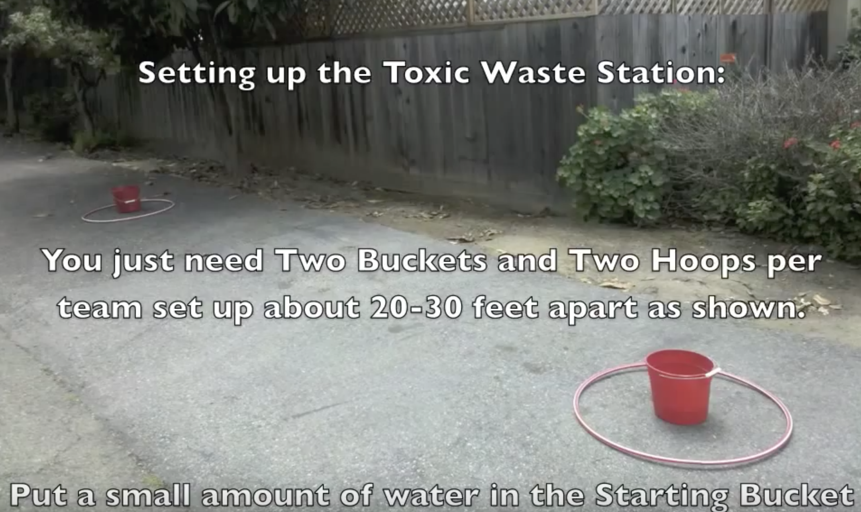
The objective is to move all the balls ( or water) from one bucket to the next without dropping a ball(or spilling the water)

Slide 10
Rules
The hula hoops represent the toxic zone
Any team member with a body part entering the toxic zone is deemed dead and can no longer participate
Each team is given a set of materials ( ropes bungee cords etc.)
Only these materials can enter the toxic zone
First team to complete the task wins a small prize ( students love prizes)

Slide 11
Questions, Questions Questions
Students need to feel comfortable asking questions both of the teacher and each other
I establish this using multiple choice concept questions
Students are asked to respond to multiple choice questions using answer cards ( they need to be comfortable NOT having the best answer)

Slide 12
Questions,Questions Questions?
After holding up the cards so that ONLY the teacher can see the answers the students are invited to find someone with a different answer and discuss
This process continues until consensus is reached ( it may take several rounds)

Slide 13
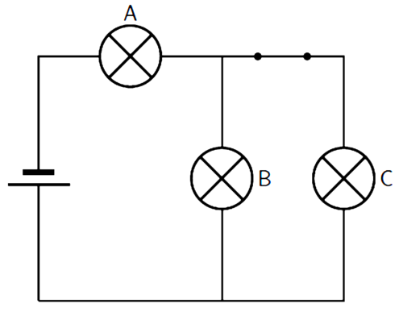
If the switch in the circuit is opened, the brightness of bulb A will
increase.
decrease.
stay the same.

