Slide 1
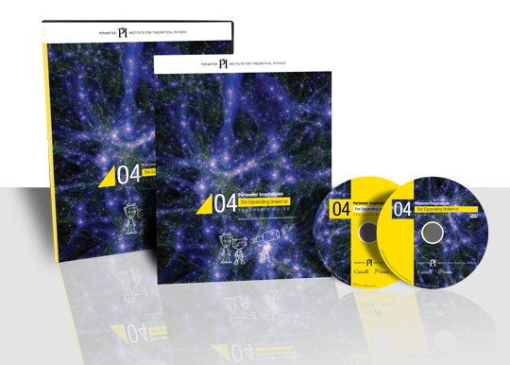
The Expanding Universe
Cosmology Resource by Perimeter Institute

Slide 2

Perimeter Institute
Perimeter Institute for Theoretical Physics is an independent, resident-based research institute devoted to foundational issues in theoretical physics at the highest levels of international excellence
Excellent outreach program
  Teachers, Students, General public

Slide 3
Agenda
Activity 2: the signature of stars
Predict Observe Explain (POE): Galactic Redshift
Activity 3: the expansion of space
11+ more activities, video, extensions, …
(there is enough material for 3 days)

Slide 4
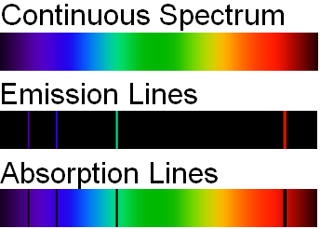
The Signature of Stars
Spectroscope has a diffraction grating
Each element has its own “signature” spectrum

Slide 5
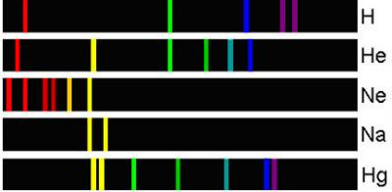
The Signature of Stars

Slide 6
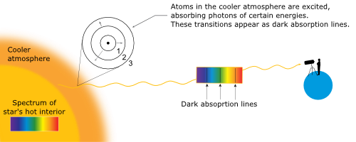
The Signature of Stars

Slide 7
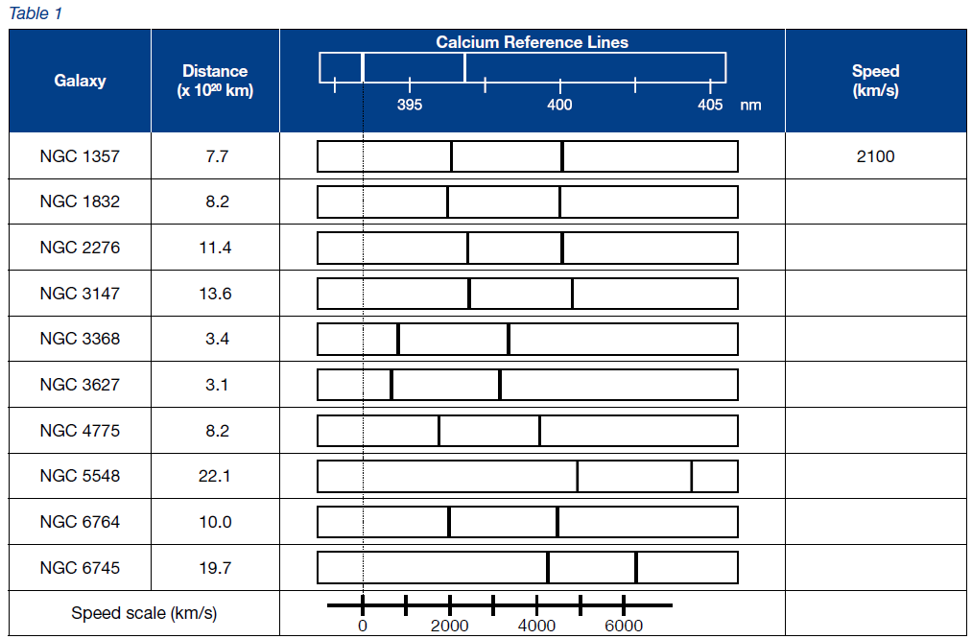
The Signature of Stars

Slide 8
The Signature of Stars
Modifications:
  Use spectroscopes to look at various gasses
  Spectral lines
  Graph (switched dependent and independent variables)
  Changed questions to make more gr.9 level appropriate
  Included how to calculate slope and unit conversion

Slide 9
Galactic Redshift
Predict – Observe – Explain (part 1)
Note: Hubble’s Redshift idea only works for nearby galaxies; Space is expanding which explains why galaxies are moving away from us at rate proportional to the distance between us
  Both light waves and space are being stretched! (cosmological redshift)
Minute Physics “Do we expand with the Universe?” https://www.youtube.com/watch?v=th_9ZR2I0_w
Amplitude?

Slide 10
Expansion of Space
Used different size washers
Used different elastic bands (all the same thickness)
Good numeracy activity
All groups get the same answer

Slide 11
Arts & Crafts
Make your own expanding universe
Galaxies:
  Washers
  Paperclips
Elastic bands

Slide 12
Thank You!

