Slide 1
Concept Questions
July 2016

Slide 2
Outline
Concept Inventories Questions
Next Step Questions
OAPT Peer Review Questions
OAPT Contest Questions

Slide 3
What does FCI stand for?
Free Cheese Institute
Force Concept Inventory
Force Controls Inquiry
File Concept Inventory
None of the above

Slide 4
What does FCI stand for?
Free Cheese Institute
Force Concept Inventory
Force Controls Inquiry
File Concept Inventory
None of the above

Slide 5
A Concept Inventory (CI) is designed to measure…
the relative ability of a student compared to other students
how quickly a student retains new material
whether a student has mastered a specific set of concepts
All of the above

Slide 6
A Concept Inventory (CI) is designed to measure…
the relative ability of a student compared to other students
how quickly a student retains new material
whether a student has mastered a specific set of concepts
All of the above

Slide 7
What is a ‘Concept Inventory’?
A criterion-reference test, designed to evaluate whether a student has gained mastery over a specific set of concepts
Not norm-referenced (i.e. the test does not compare one student’s results to another’s when giving a final score)
Questions are based on intuitive comprehension, independent of knowledge of the terminology or numerical modeling – rooted in research
Generally multiple-choice, with “distractors” (incorrect or irrelevant answers) that are based on commonly held misconceptions

Slide 8
Why Use a CI?
It is intended for pre-and post-testing
Tool to measure student’s understanding
Research mandates a result of minimum 80% on a CI for a student to be deemed to have mastered a concept
Tool to measure student’s gain in understanding
To identify students’ misconceptions
To evaluate effectiveness of teaching methods
To evaluate whether a student is prepared to move on to other concepts

Slide 9
Who has used the Force Concept Inventory?
If you HAVE used the FCI → point at James ☺
Alternatives:
Kinematics Graphing
Electricity
If you HAVE NOT used the FCI, great!

Slide 10
The Force Concept Inventory (FCI)
According to Harvard University, nearly 80% of physics students can state Newton's 3rd law at the beginning of their course, but Force CI data showed that less than 15% of them fully understood the concept – even at the course’s conclusion.
Created in 1992 by David Hestenes, Gregg Swackhammer, Malcolm Wells (updated 1995)
30 multiple-choice Qs based on Newtonian physics
Available at http://modeling.asu.edu/R&E/Research.html as a password protected file (you can email to get the password)

Slide 11
Let’s try it!
Time to work!

Slide 12
FCI Answer Key. How Did You Do?

Slide 13
How Teaching Styles can affect Student Achievement
In 1998, Richard Hake published results from over 6500 students in 62 introductory physics courses from high school to university
He wanted to determine if ‘Interactive Engagement’ style courses (hands-on, peer discussion and immediate feedback) produced better results than ‘conventional’ methods
Formulae:

Slide 14
Chart from:
“Interactive-engagement vs traditional methods: A six-thousand-student survey of mechanics test data for introductory physics courses” – Richard R. Hake, American Journal of Physics

Slide 15
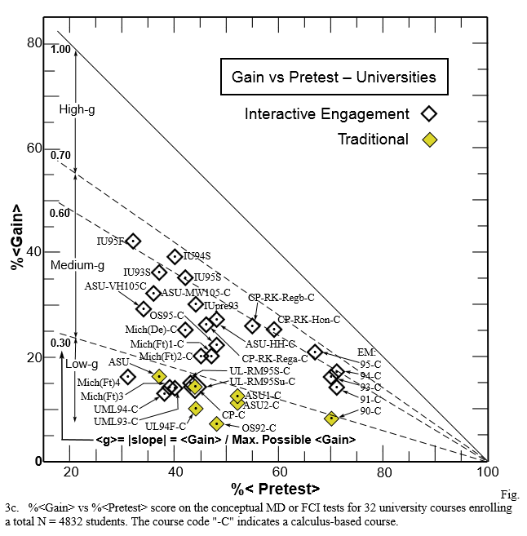
Chart from:
“Interactive-engagement vs traditional methods: A six-thousand-student survey of mechanics test data for introductory physics courses” – Richard R. Hake, American Journal of Physics

Slide 16
Interactive Engagement.. A success!
‘Traditional’ courses had average <g> = 0.23
‘Interactive Engagement’ courses had average <g> = 0.48
Recall:

Slide 17
Your Classroom
Track your own pre- and post data
Measure gain in understanding
ID misconceptions
Evaluate effectiveness of teachings
Use as Assessment tool
SPH3U0 – graphing test: assessment OF learning
SPH4U0 – FCI pre-test: assessment FOR learning
SPH4U0 – FCI post-test: assessment OF learning

Slide 18
There Are Other Inventories Out There!
For example,
Kinematics Graphing Test
Electricity CI
Lawson’s Classroom Test of Scientific Reasoning
Mechanics Baseline Test (MBT)
And many many more!
http://www.ncsu.edu/per/TestInfo.html
Has plenty listed….

Slide 19
Next Time Questions
Conceptual Questions by Paul G. Hewitt

Slide 20
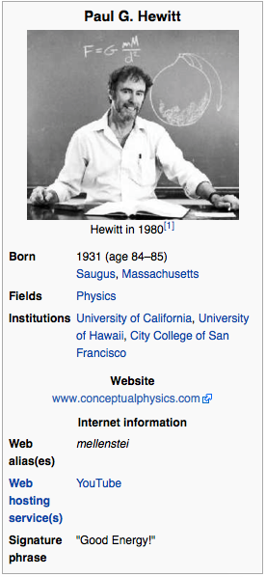
Which statement about Paul G. Hewitt is incorrect?
Paul Hewitt is famous for his clear, witty, down-to-earth style of presenting hard-core physics.
Author of Conceptual Physics (12th edition)
He uses cartoon-style artwork to engage and delight both students and teachers alike.
He has a Youtube channel
All statements are true!

Slide 21
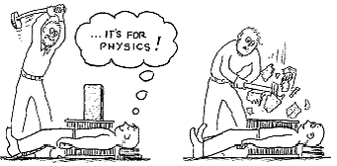
Which statement about Paul G. Hewitt is incorrect?
Paul Hewitt is famous for his clear, witty, down-to-earth style of presenting hard-core physics.
Author of Conceptual Physics (12th edition)
c. He uses cartoon-style artwork to engage and delight both students and teachers alike.
D. He has a Youtube channel
E. All statements are true!

Slide 22
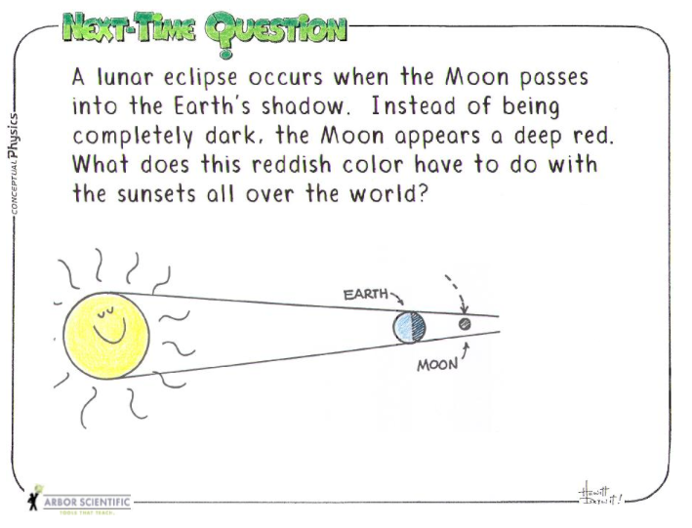
What are “Next Time Questions”?
Hewitt’s favorite insightful Qs embellished with cartoons
Their intention is to elicit student thinking.
Where can you find these Qs?
Posted outside his lecture hall
In The Physics Teacher magazine
in ancillaries to my Conceptual Physics textbooks, and physical science textbooks
http://www.arborsci.com/next-time-questions

Slide 23
Instructions on how to use them
Copyrighted – but teachers are free to download them to share with students
DO NOT show the answers to these in the same class period where the question is posed!!!
NOT for quickie quizzes with short wait times in your lecture – this misses your opportunity for increased student learning to occur
Allow for students to discuss / argue – that’s how the learning takes place!
1 or 2 Qs projected at the end of class or use as review Qs
The answer is given “next time” the class meets — or at some interval where wait time is at least a day.

Slide 24
Let’s try some “Next Time Qs”!
Topic: Momentum
Discuss answers in groups of 3-4
Answers will be given “Next Time”
i.e. in 10 minutes
On the next slide…

Slide 31
Topics for Next Time Qs
Science – linear motion
Heat
Newton’s 1st and 2nd Law
Thermodynamics and Thermal Expansion
Newton’s 3rd Law
Change of Phase
Vectors
Vibrations, Waves, and Sound
Momentum
Light Properties
Energy
Reflection of Light
Rotational Motion
Refraction of Light
Gravity
Electrostatics
Projectiles and Satellite Motion
Electric Current
Atoms and Solids
Magnetism
Liquids
Nuclear Physics
Gasses
Special and General Relativity
Exponential Growth

Slide 32
Concept Questions for Peer Instruction

Slide 33
Peer Instruction
http://www.oapt.ca/resources/conceptquestions.html
SPH4U0 units: GEM Fields, Light, Quantum, Relativity
Word or PDF
One of the easiest and most effective teaching techniques to come out of Physics Education Research.
Students discuss answers in small groups (2-4)
Assessment as learning
Use white boards, multiple choice cards
Assessment for learning
For more detail on how to implement this technique you should check out Eric Mazur's group at http://mazur.harvard.edu/research/detailspage.php?ed=1&rowid=8 or read his book Peer Instruction.

Slide 34
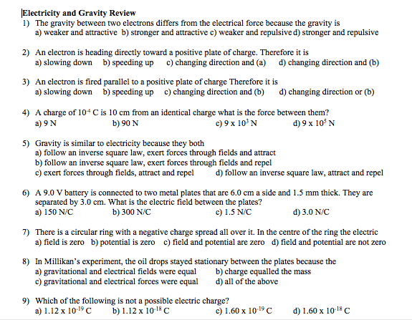
(Partial) Screenshot of Peer Instruction Qs

Slide 35
OAPT Contest Questions

Slide 36
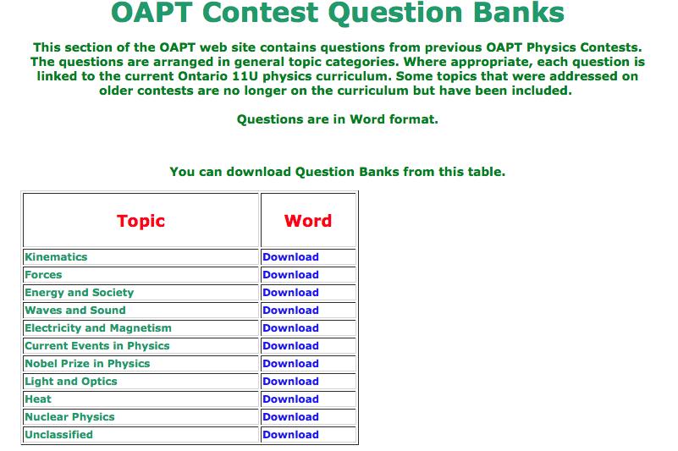
OAPT Contest Qs
Qs used in OAPT grade 11 physics contest
Question Bank
http://www.oapt.ca/resources/contestQB.html
Previous tests
http://oapt.ece.utoronto.ca

Slide 38
How could you use the OAPT Contest Qs?
Peer instruction
Review
Inspiration for teachers creating assessments
All of the above

Slide 39
Your turn
Explore some Peer instruction Questions (online)
Try some OAPT concept Qs (HOs)
Q bank put into ppts
No more Qs please ☺

Slide 40
The End.
Thank you for participating.

