Slide 1
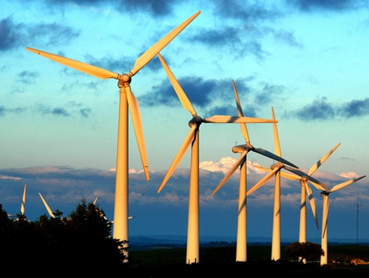
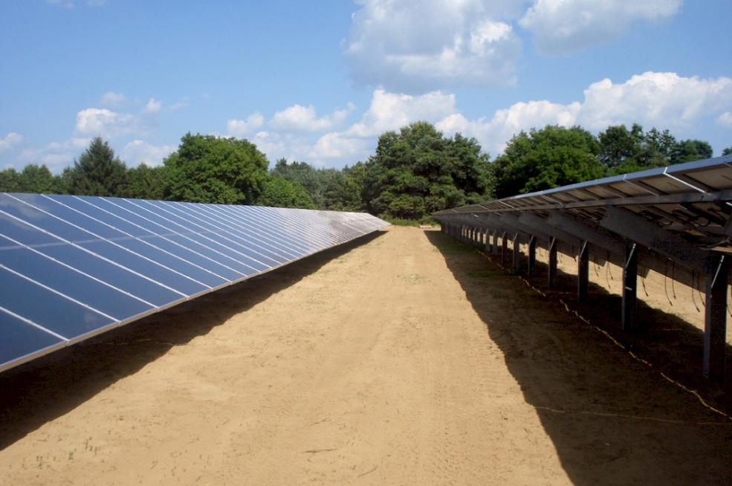
Generating Solutions to Electrical Energy Production

Slide 2
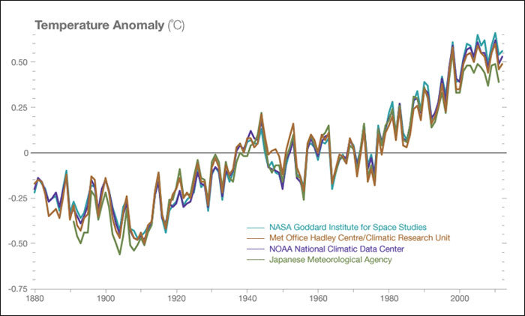
Climate Change is a Fact
http://climate.nasa.gov/scientific-consensus/

Slide 3
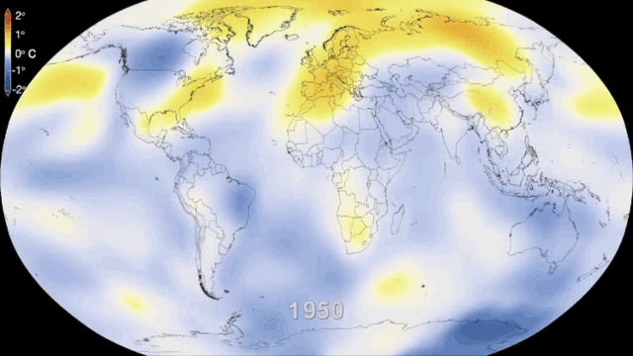
http://cdn.bgr.com/2014/01/climate-change-33.gif

Slide 4
Climate Change by human activity is a ‘Fact’
“In science, 'fact' can only mean 'confirmed to such a degree that it would be perverse to withhold provisional assent.'
I suppose that apples might start to rise tomorrow, but the possibility does not merit equal time in physics classrooms.”
Stephen Jay Gould

Slide 5
Climate Change by human activity is a ‘Fact’
“97% of actively publishing scientists agree: Climate-warming trends over the past century are extremely likely due to human activities.
In addition, most of the leading scientific organizations worldwide have issued public statements endorsing this position.”
http://climate.nasa.gov/scientific-consensus/

Slide 6
The solution will come from ...
Hope
Science
Technology
Politics
Education
Economics

Slide 7
‘Alternative’ Energy Sources
Wolfe Island Simcoe Ontario
What do you see?
noise, bird deaths, ugliness, loss of farmland
elegance, hope, progress
hippy pipe dreams, economic impossibility

Slide 8
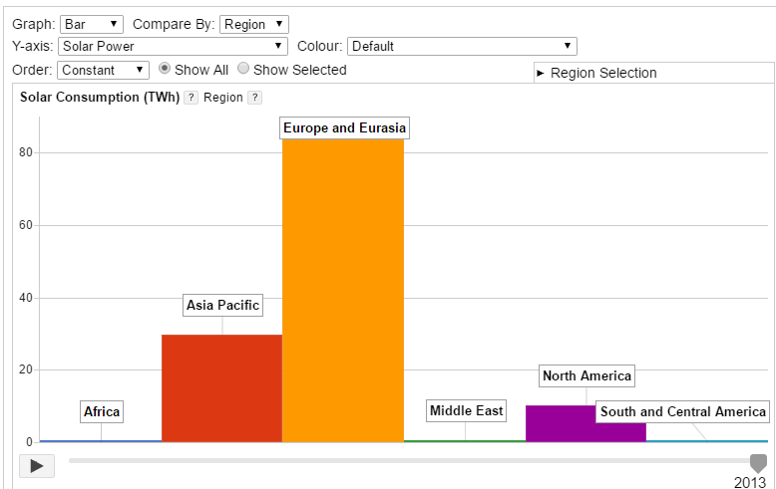
Things are changing fast!
http://energyeducation.ca/encyclopedia/Electricity

Slide 9
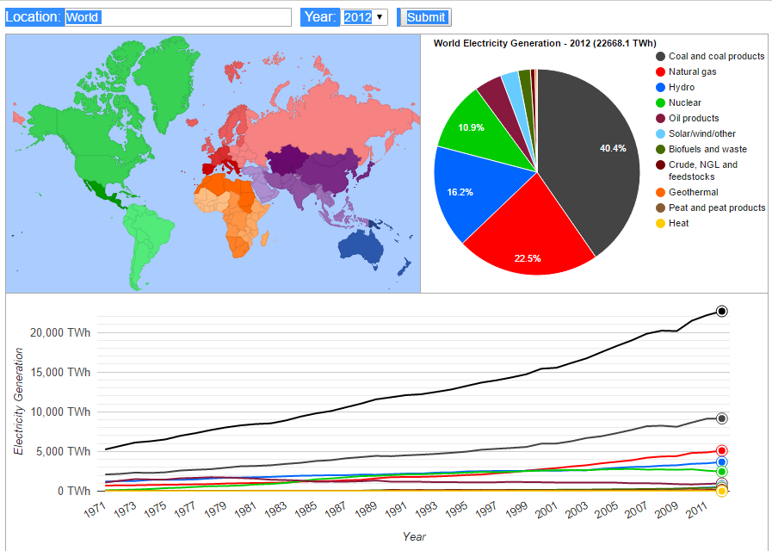
Where are things changing most?
http://energyeducation.ca/encyclopedia/Electrical_generation

Slide 10
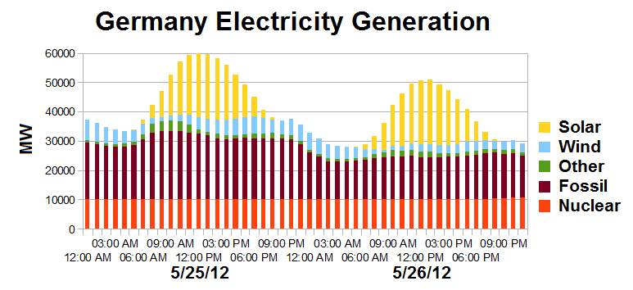
Wind and Solar Energy Need Storage
https://en.wikipedia.org/wiki/Solar_power_in_Germany

Slide 11
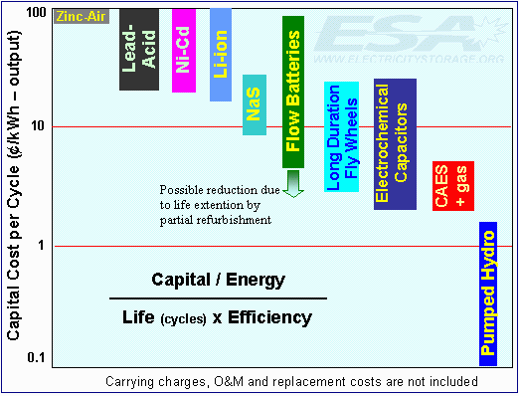
How to Store Electrical Energy
http://www.awea.org/Issues/Content.aspx?ItemNumber=5452

Slide 12
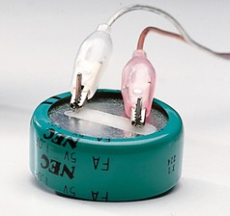
Demonstrating Energy Storage
1 F, 5 V
Arbor Scientific $25 US
Sargent Welch.ca $69

Slide 13
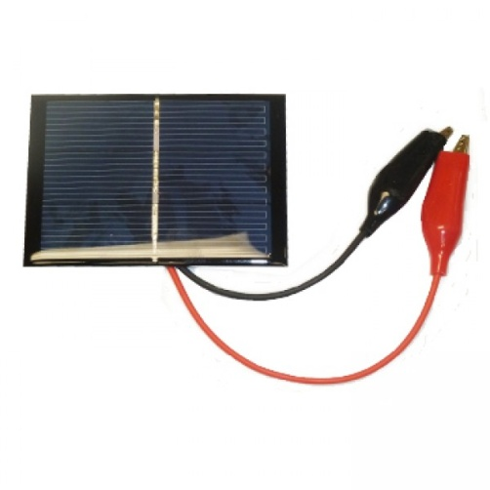
Demonstrating Solar Power
1.5 V, 200 mA $16 Kidder (53 $/W)
0.45 V, 200 mA, $19 Boreal (211 $/W)

Slide 14
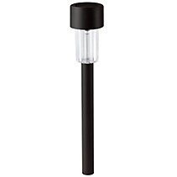
Demonstrating Solar Power
$1.29 Solar Powered Garden Light

Slide 15
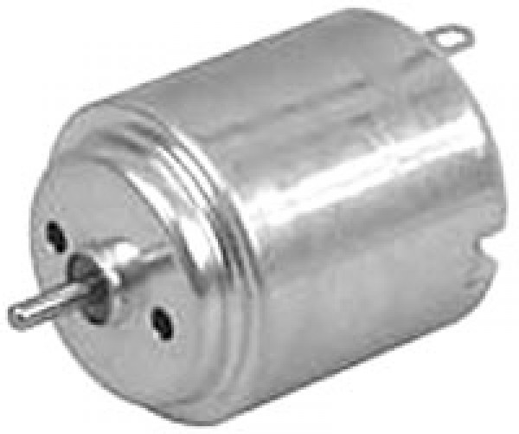
Demonstrating EM Generation
The faster the axle spins, the more energy. This is hard to do with a simple hobby motor. It is much easier if the motor is geared.

Slide 16
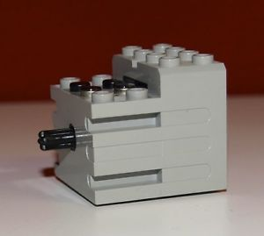
Demonstrating EM Generation
These motors were part of the Lego Mindstorm robotic kits in the 90’s, eBay $15 to $100!

Slide 17
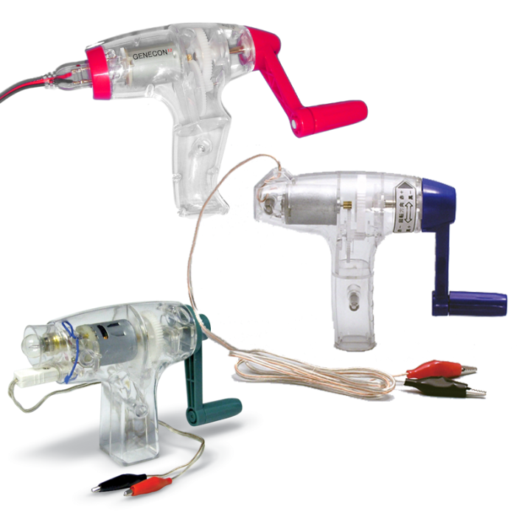
Demonstrating EM Generation
Don’t buy the cheap versions!
Genecon $61 US, Arborscience, $100 Boreal

Slide 18

Demonstrating EM Generation
$6 Dynamo flashlight

Slide 19

A Great Online Resource
Visualizing and Understanding the Science of Climate Change
http://www.explainingclimatechange.ca/index.html

Slide 20
Time to play!

