Slide 1
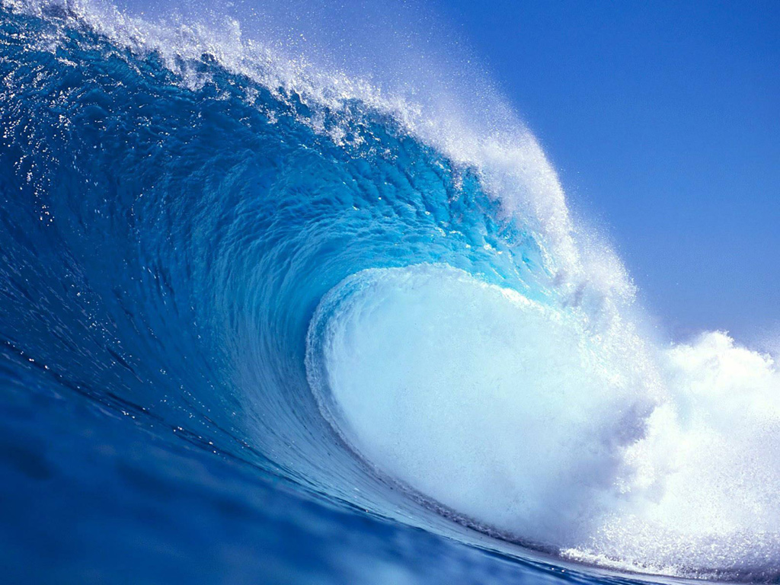
Improved understanding through modelling
Group demonstrations allow students to examine and experience both wave characteristics and wave behaviour.

Slide 2

A beautiful demonstration of vibrations and waves

Slide 3
Students Can Model Basic Wave Characteristics
They can examine wave characteristics like
Wavelength
Frequency or period
speed

Slide 4
They can also model wave behaviour
Some behaviours that can be modelled are
Refraction
Interference
Doppler effect
Dispersion? Diffraction? Polarization?

Slide 5

Metre sticks
wavelength
Counter/timer

Slide 6
An increase in wavelength

Slide 7

Refraction

Slide 8
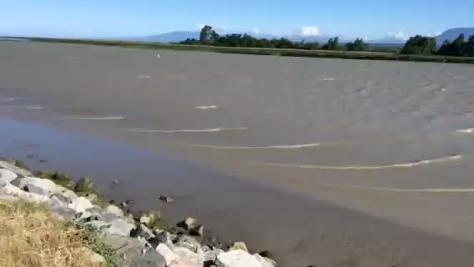
Refraction in the real world

Slide 9
Refraction on the field

Slide 10
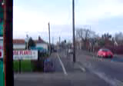
Doppler Effect
The Doppler effect is the apparent shift in the frequency of a wave as a result of the motion of the source or the observer

Slide 11

Sheldon Explains It!

