Slide 1
Reaction Times

Slide 2
Examining Reaction Times – Where Can It Take Us?
Kinematics to measure reaction times
Kinematics to measure how fast nerve signals travel
Biophysics (electrical impulses) to explain how nerves work
And some ‘deep thinking’ about perception of time in general!

Slide 3
Let’s See How Fast We React!
Reaction Time Lab

Slide 4
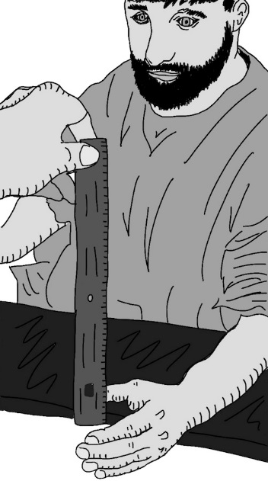
Visual Test
Subject A dangles dominant hand off the edge of a table.
Subject B holds a 30 centimeter ruler between two fingers at the 30 cm mark, having the 0 mark touching Subject A’s index finger.
Subject B tells Subject A to grab the ruler as fast as possible, when they SEE it being released.
Record the centimeter measurement.
Repeat this three times, for a total of four measurements.

Slide 5
Auditory Test
Subject A is blindfolded before dangling dominant hand off the edge of a table.
Subject B holds a 30 centimeter ruler between two fingers at the 30 cm mark, having the 0 mark touching Subject A’s index finger.
Subject B tells Subject A to grab the ruler as fast as possible, when they HEAR the word “GO” being said.
Subject B simultaneously says “GO” and lets go of the ruler. Record the centimeter measurement.
Repeat this three times, for a total of four measurements.

Slide 6
Tactile Test
Subject A is blindfolded before dangling dominant hand off the edge of a table.
Subject B holds a 30 centimeter ruler between two fingers at the 30 cm mark, having the 0 mark touching Subject A’s index finger.
Subject B tells Subject A to grab the ruler as fast as possible, when they FEEL their non-dominant shoulder being touched.
Subject B simultaneously touches the shoulder and lets go of the ruler. Record the centimeter measurement.
Repeat this three times, for a total of four measurements.

Slide 7
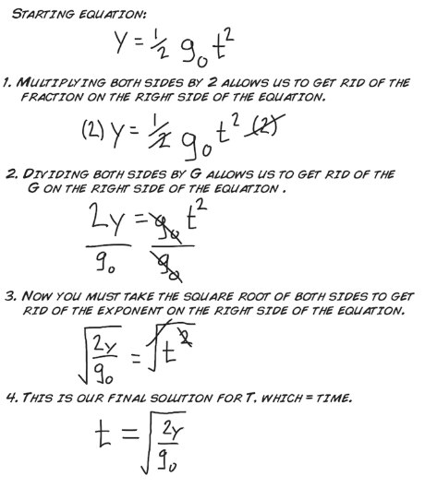
Calculate the reaction time for each of the visual, auditory and tactile drops.
Note that g_{o} = 981 cm/s²
and y = distance dropped (in cm)
Here’s the kinematics!

Slide 8
How’d We Do?

Slide 9
Lab Averages
From Backyard Brains, the folks who provided the lab:
https://backyardbrains.com/experiments/reactiontime
“The average reaction time for humans is
0.25 seconds to a visual stimulus
0.17 seconds for an audio stimulus
0.15 seconds for a touch stimulus”

Slide 10
Whether you’re fast or slow, there’s one thing for sure….

Slide 11
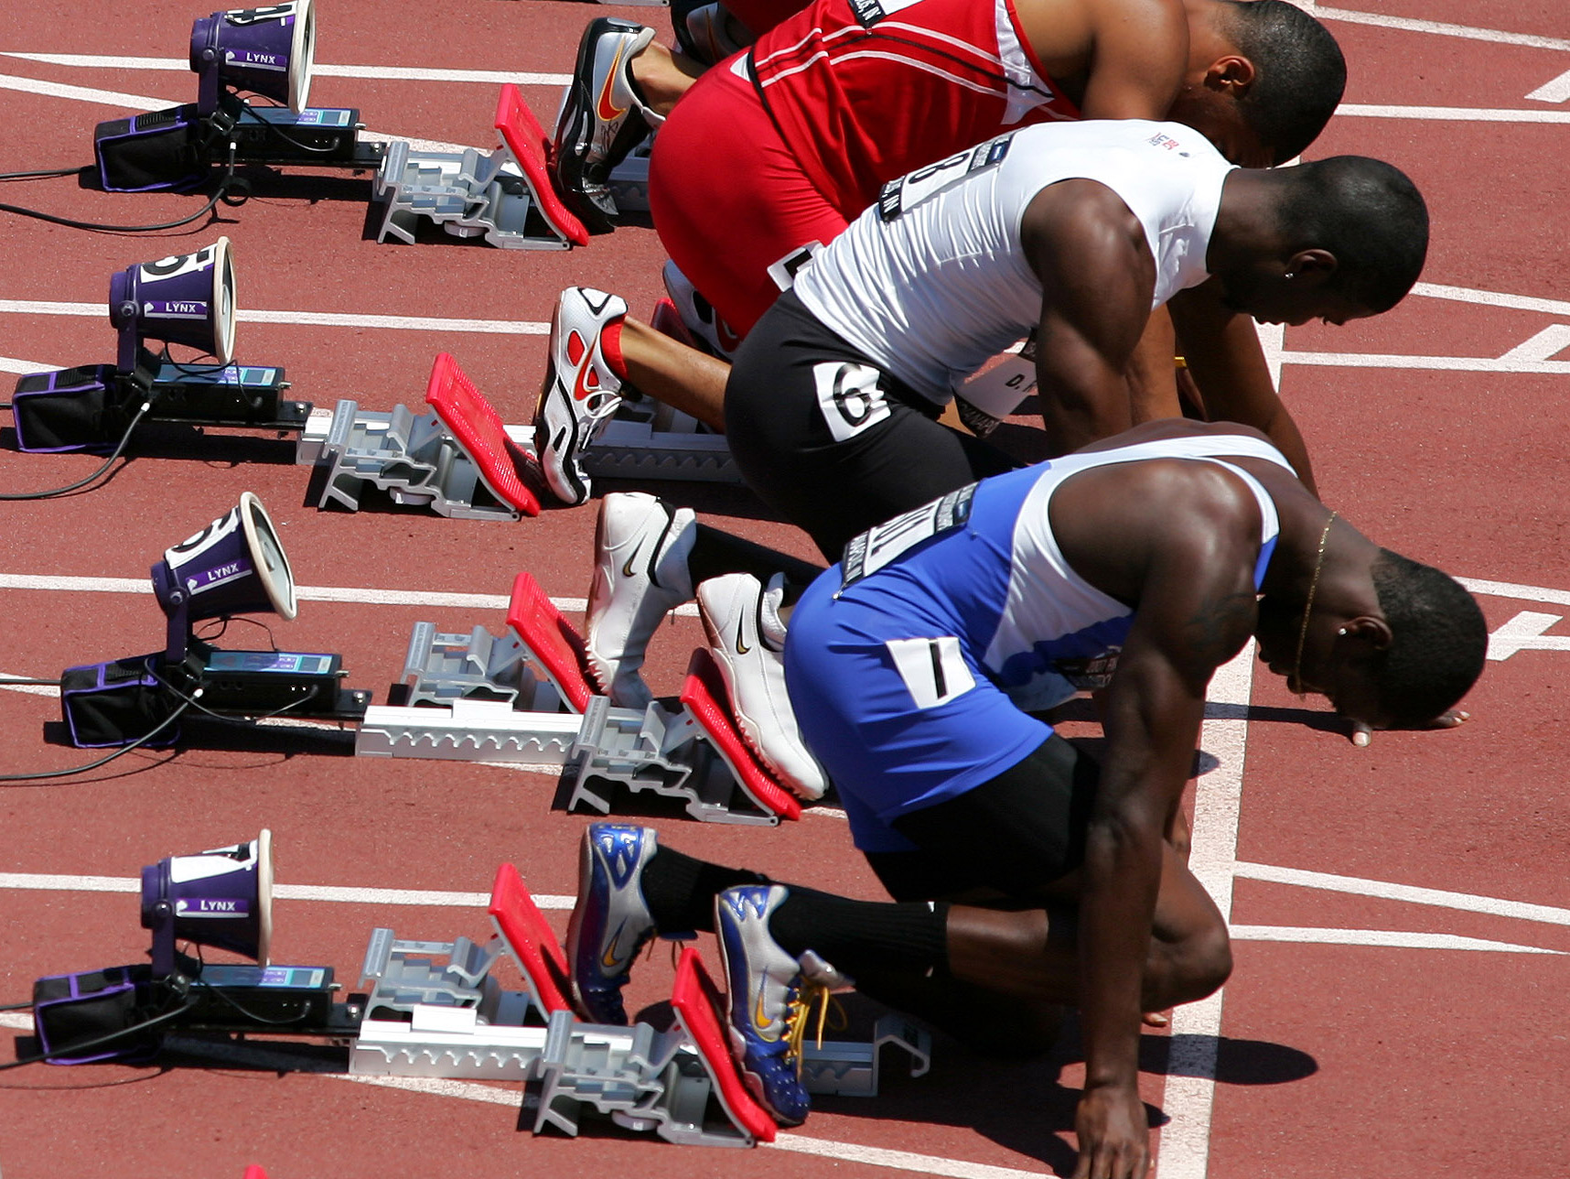
Professional Athletes Are Fast
ReacTime sensors measure force from runner’s foot…
…any push earlier than 0.1s after the start is considered a false start

Slide 12
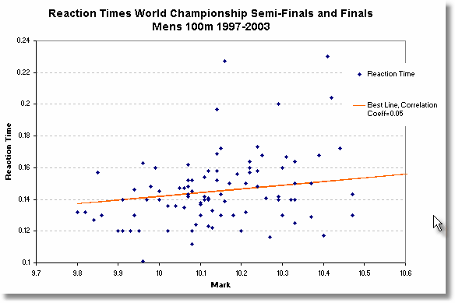
Image from https://condellpark.com/kd/reactiontime.htm

Slide 13
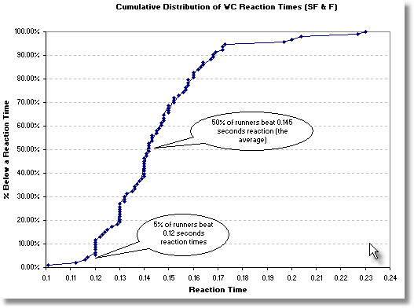
Image from https://condellpark.com/kd/reactiontime.htm

Slide 14
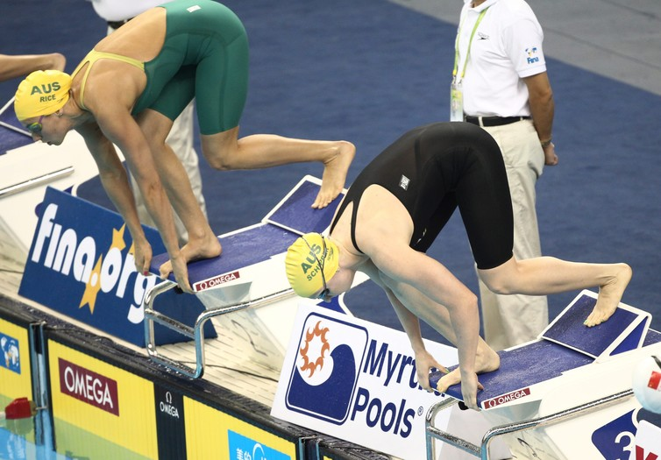
A typical Olympic swimmer’s feet leave the block 0.7s after the start ‘beep’

Slide 15
Reaction time is important but so is is entry technique (angle of entry, depth, etc.)

Slide 16
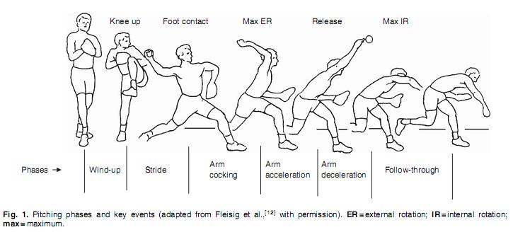
0.4 seconds is about as long as a baseball takes to reach home plate from the pitcher’s mound.

Slide 17
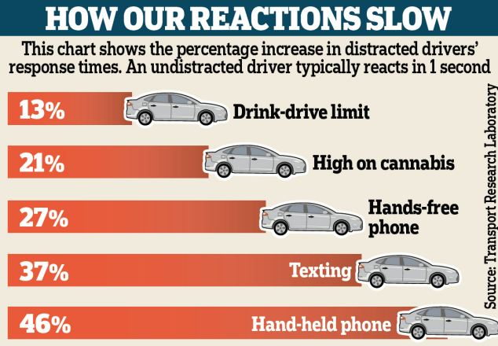
Many things affect our reaction time, let’s try to measure one of them as best we can…

Slide 18
Measuring the Speed of a Nerve Signal: Low Tech Version
(With much thanks to Dr. Deda Gillespie and Dr. Dan Goldreich, McMaster University who presented on the topic at the OAPT Conference 2011 and 2012 and provided this method)

Slide 19
Part One:
Arrange at least 10 people in a circle, facing outward, each with their right hand on the shoulder of the person beside them. One person will be the starter/timer and needs a stopwatch (in their left hand)
The starter begins timing and squeezes the shoulder of the person beside them.
Each person in the circle should squeeze the shoulder of the person beside them (gently but firmly!) when they feel their own shoulder squeezed.
The starter stops timing when they feel their shoulder squeezed.
Repeat the procedure a several times to establish a ‘fastest time’.

Slide 20
Part Two:
Same arrangement, but this time each person needs to squeeze the ankle of their neighbour.
Record the ‘fastest time’ after several trials.

Slide 21
The difference in times between Part One and Two results from the nerve signal having to travel further.
How much further?
More accurate, more work version:
Add up the distance from ankle to shoulder for all participants
Less accurate, less work version:
Add up everyone’s height, multiply by 0.82
I Am Super Pressed For Time Here version:
Multiply the number of people by 1.5m

Slide 22
Finding The Speed
v = speed,
Δd = extra distance traveled,
Δt = difference in time between part one and two
$$v=\frac{∆d}{∆t}$$

Slide 23
Good Result?
The speed of signals in the nervous system varies from 0.5 m/s to 100 m/s, with touch signals traveling the fastest

Slide 24
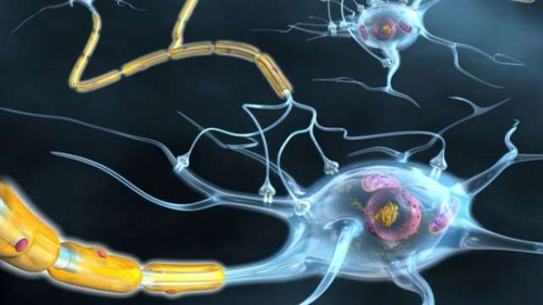
We need Neuroscience to explain what’s going on here

Slide 25
Biophysics Time

Slide 26
Neuron Structure
Dendrites receive impulses and carry them toward the cell body
Axons carry impulses away from the cell body

Slide 27
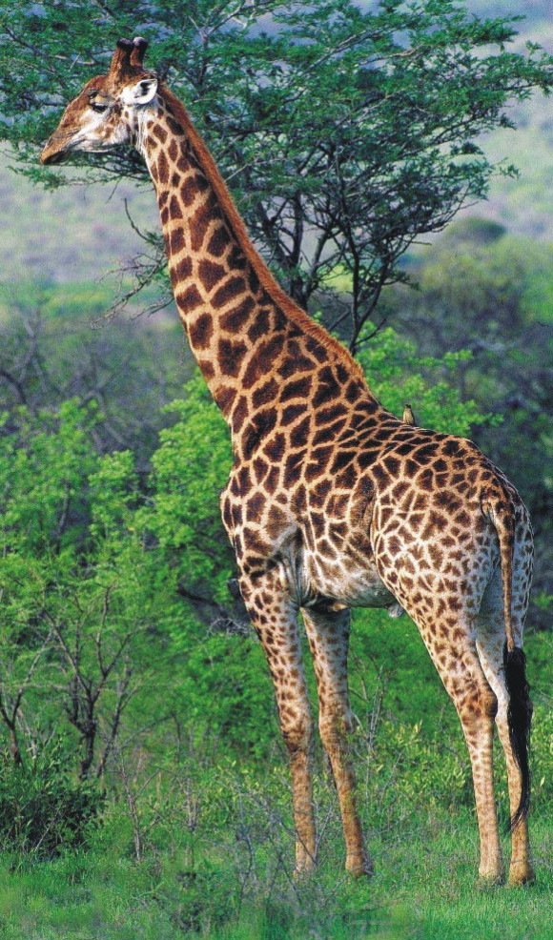
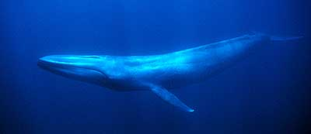
Neurons are… long!
They are the longest, most specialized cell in animals…
Human: 1-2 metres
Giraffe: 5 metres
Blue Whale: 10-30 metres

Slide 28
But what if neurons are slow?
If the signal only travels at 0.5m/s, how long will it take to travel…
Human head to toe: 1-2 metres?
Blue whale tail to head: 10-30 metres?

Slide 29
Electrical Physics to the Rescue
The nerve signal is essentially an electrical disturbance that travels down the length of the nerve.

Slide 30
How an impulse is transmitted
1. Resting: no impulse, cell is polarized ( + on outside, - on inside)
Sodium/Potassium pump in axon using ATP maintains this polarity

Slide 31
How an impulse is transmitted
2.Impulse: stimulus excites neuron
Na+ channels open
Na+ goes inside, therefore inside becomes more +
Depolarization occurs = a nerve impulse
Impulse moves in one direction
Depolarization works with concentration gradient

Slide 32
Now what? What affects the speed of this signal?
Two things:
neurons are both resistors and capacitators.

Slide 37
To make a long story short,
the speed of the signal depends on the resistance of the cell and the capacitance of the membrane surrounding it.

Slide 38
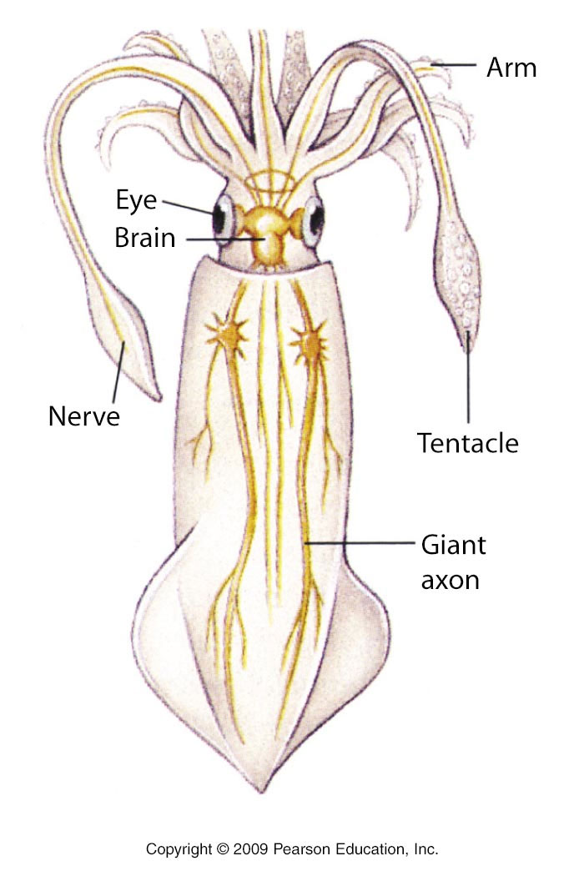
One ‘solution’, then is to make the entire axon larger in diameter
(larger diameter = lower resistance in a wire…)
The squid giant axon can be up to 1mm in diameter!

Slide 39
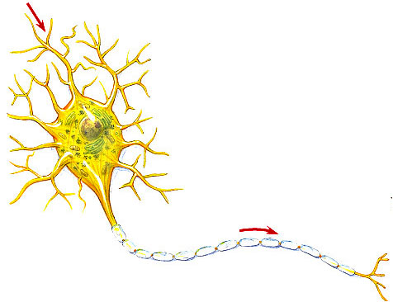
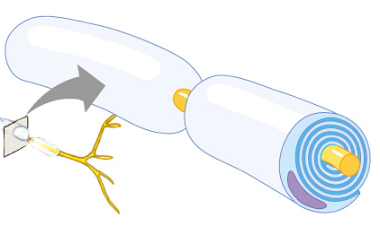
Or… insulation! Myelin sheath coating
signal
direction
Myelin cells wrap the axon to form insulation
signal hops from node to node
myelin coating

Slide 40
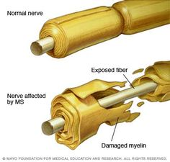
The importance of this coating can be seen in the case of Multiple Sclerosis, where the immune system T cells attack and destroy it. This causes slowing and/or loss of signal.

Slide 41
Taking Perception Further

Slide 42
Things You Can Ask Your Students to Consider
Related to the Reaction Time Lab:
What causes the difference in reaction times seen in the tactile, auditory and visual sections?
Do you think you could improve your reaction times significantly with practice?
What would happen if two of the sections were combined into one (e.g. the auditory and tactile were combined, so that you said ‘go’ *and* squeezed your partner’s shoulder at the same time)?

Slide 43
Things You Can Ask Your Students to Consider (2)
Related to the ‘Speed of a Nerve Signal’ Exercise:
3. What assumption did we make about nerve signals in choosing the equation we did for speed?
4. In both sections the nerve signal had to eventually travel to the brain, then the brain had to send a reaction signal, and the arm had to react to ‘squeeze’. Why did we not need to deal with all of this in finding our final answer for the speed of the nerve signal?

Slide 44
Things You Can Ask Your Students to Consider (3)
Related to the Nervous System in General:
5. Do all nerve impulses have to travel to the brain for ‘interpretation’ and acting on?

Slide 45
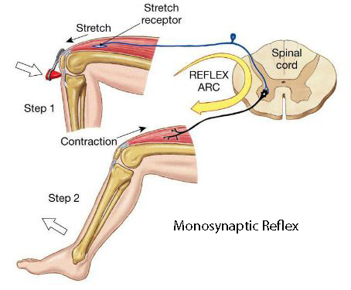
(answer: no, we have “reflex arcs”)

Slide 46
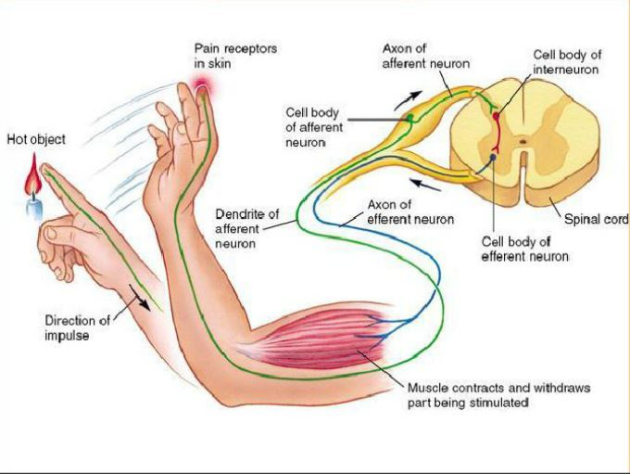

Slide 47
Things You Can Ask Your Students to Consider (3)
Related to the Nervous System in General:
6. Pain signals travel significantly slower than touch signals in the nervous system. Why do you not notice the difference in time that it takes for different senses to send a signal to the brain?

Slide 48
Things You Can Ask Your Students to Consider (4)
Related to Perception and ‘Now’:
7. A) Assuming it takes 0.1s for you to recognize a light signal once it hits your eye, how far does light travel in this time?
B) If a light source right next to you blinked on, and another one 10m away turned on 0.1s later, would you notice the difference?

Slide 49
Things You Can Ask Your Students to Consider (4)
Related to Perception and ‘Now’:
8. Based on #7, when you see two events happening at the same time, are they necessarily happening at the same time?

