Slide 1
SESSION C: Dave Doucette
UNPACKING CURRENT
& ELECTROMAGNETISM
In the learning journey from static to current electricity and to electromagnetism, there are several low-tech, high-concept activities which anchor pivotal student concepts. The accessibility of simple everyday materials and the robust mental models which emerge level the learning field and nurture 21st century competencies. Inquiry to Equity – yagottaloveit!
NB: the 60 min session restricted the topic to current!
OAPT 2019 Annual Conference: ENTANGLING LEARNING

Slide 2
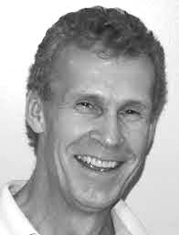
Dave Doucette, OCT
STEM consultant
STEM Education Director
FAST Motion Studios (2014-2019)
Teacher: physics, chemistry
YRDSB (1999-2014)
Richmond Hill HS
Dr. G.W. Williams SS
TDSB (1989-1999)
Agincourt CI
Cedarbrae CI
OAPT President 2009-2010
OAPT Vice-President 2011-2019
doucettefamily@sympatico.ca
Bridging research
into practice
OAPT 2019 Annual Conference: ENTANGLING LEARNING

Slide 3
Benefits of a Growth Mindset Classroom
improved resilience to socio-emotional disparities
reduced aggression in school
reduction in teen depression (-40%)
improved optimism about their future
improved self-worth
engages women, minority and low-socioeconomic students
Inquiry to Equity through Growth Mindset
The Remarkable Reach of Growth Mindset, Carol S. Dweck,
Scientific American, Special Edition, Winter 2019, 36-41.
Characteristics of a Growth Mindset Classroom
emphasizes understanding of concepts (session focus)
provide feedback to deepen understanding
allows revision for students to demonstrate enhanced understanding
advocates for hard-work as opposed to ‘talent’
OAPT 2019 Annual Conference: ENTANGLING LEARNING

Slide 4
Undergraduate electrical engineers
“….showed unclear understandings
of current & voltage…”
Tatiana V Goris, Purdue University
International Journal of Engineering Pedagogy, 2016
Graduate electrical engineers
“…agreed that current and voltage are related,
but frequently were not able to clarify how these
two phenomenon were related.”
OAPT 2019 Annual Conference: ENTANGLING LEARNING

Slide 5
“Electricity is the charge in electrons moving through some sort of vacuum”
“Charges are getting excited to produce energy…it goes through and produces electricity”.
“… Basically, back to chemical processes, and it is trying to even itself out, and so…it is going through a circuit…it wants to even out, and like the voltage wants to go from 12 to 0, and so it wants to flow down through that… and even itself out…”(sighs)
“Like the way a transistor works… They… you have to trigger the base in order for the power from the collector flows through the emitter.“
‘We haven’t really studied the physical properties of electricity”.
Purdue Electrical Engineering Students…what they said!
[NB: These are their answers. Can you even determine the questions asked??]
OAPT 2019 Annual Conference: ENTANGLING LEARNING

Slide 6
Helpful Analogies?
OAPT 2019 Annual Conference: ENTANGLING LEARNING

Slide 7
Helpful Analogies?
Can an analogy be helpful if the actual mechanism of the phenomenon is not known?
An analogy is intended to map features of an analogue (circuit) onto features of a comparable phenomenon (fluid system). How can students
compare the analogue to the analogy if they lack understanding of the analogue? We need to better establish understanding of current & voltage.
Surface charge distribution underlies the mechanism of voltage and current. We begin with a simple model, consistent with static electricity inferences, which can be refined as electric field concepts evolve.
Surface charge distribution produces informative circuit diagrams in which charge distribution correctly predicts voltage readings across leads and resistors in series, parallel and combination circuits. This is a visual & conceptual complement to the mathematics of Kirchoff’s Laws.
Dave Doucette
OAPT 2019 Annual Conference: ENTANGLING LEARNING

Slide 8
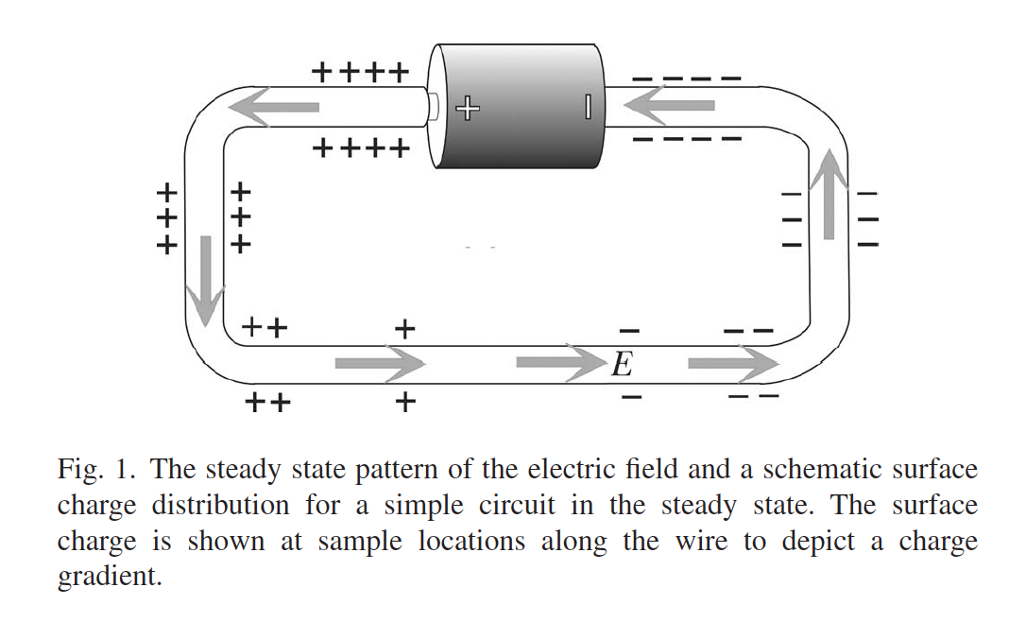
Early Pioneers of Surface Charge Distribution Modeling
Restructuring the introductory electricity and magnetism course
Ruth Chabay and Bruce Sherwood; Department of Physics, North Carolina State University, 2005
6.0 V
OAPT 2019 Annual Conference: ENTANGLING LEARNING

Slide 9
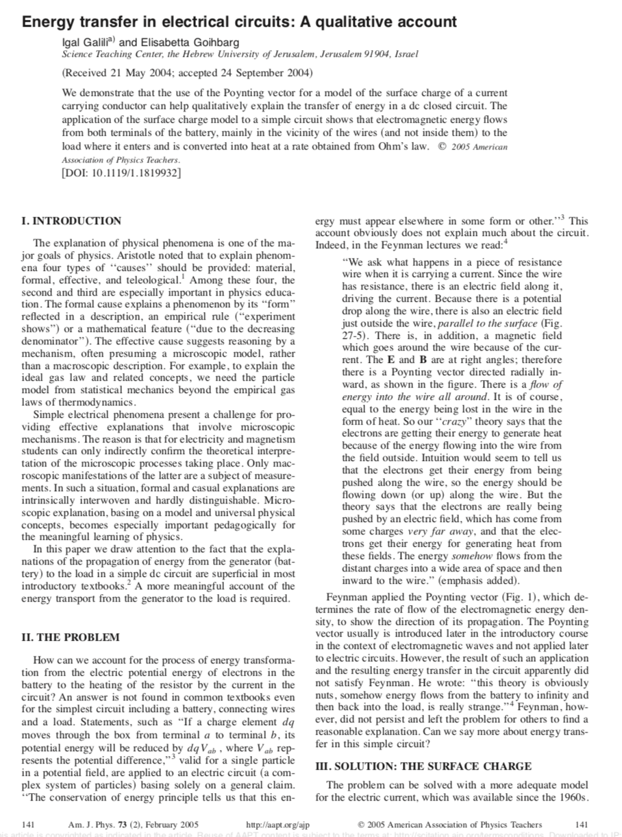
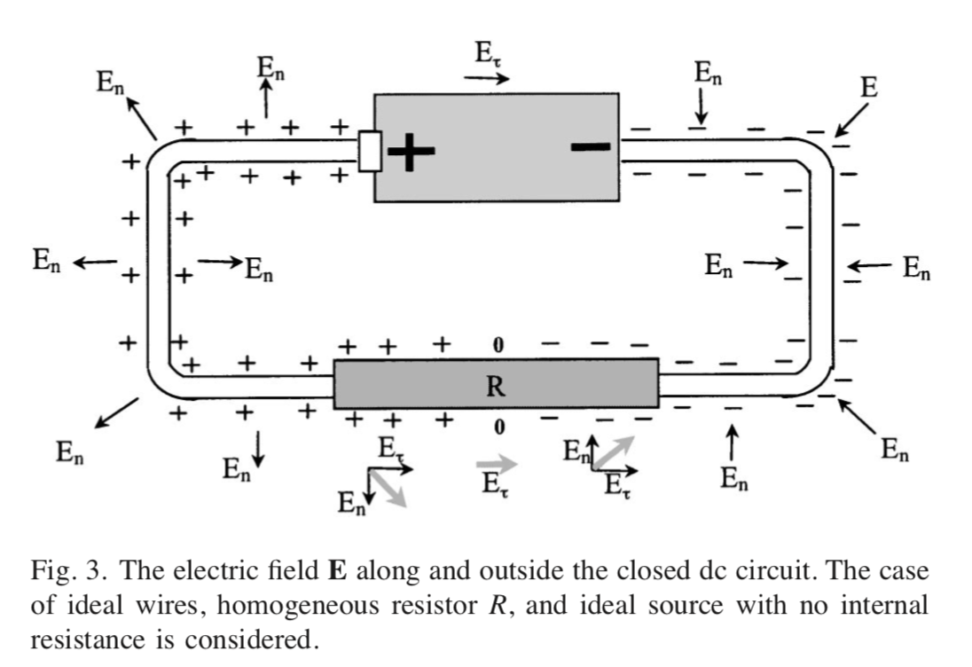
The Model Extends to a Correct Explanation of Energy Transfer
Energy transfer in electrical circuits: A qualitative account
Igal Galili, Elisabetta Golhbarg; The Hebrew University of Jerusalem,
American Journal of Physics, Feb 2005.
6.0 V
OAPT 2019 Annual Conference: ENTANGLING LEARNING

Slide 10
Importance of Visual Representations
Achieving Elusive Teacher Change through Challenging Myths about Learning, Education Sciences, Stanford University, 2018
“…when people work on mathematics, five different pathways of the brain are involved, and two of them are visual….teaching through different representations, including visuals, deepened understanding…”
Role-Playing to Facilitate Concept Attainment
Educators explore innovative theater as a way to learn physics
American Institute of Physics (AIP), July 15, 2013
“By role-playing how energy flows and changes, learners achieve rich insights about this central, globally relevant concept.”
OAPT 2019 Annual Conference: ENTANGLING LEARNING

Slide 11
STATIC to CURRENT ELECTRICITY
a selection of rich learning opportunities to build robust visual representations
Scotch Brand Magic Tape
Operationalize +, - , and neutral
Operationalize insulator & conductor
Roleplay #1: induction
Lighting LED: moving charges & energy transport
Roleplay #2: LED lighting
Wet Cell Battery
Roleplay #3: Wet Cell [optional]
Capacitor [optional]
Roleplay #4: Capacitor [optional]
OAPT 2019 Annual Conference: ENTANGLING LEARNING

Slide 12
STATIC to CURRENT ELECTRICITY
a selection of rich learning opportunities to build robust visual representations
NB: The session discussed hands-on static electricity activities to build a mental model of static ‘charge’ culminating in static charge lighting an LED. This develops a (naïve) inference of ‘moving charge carrying energy’.
The session broke into role-playing to establish a common visual representation of charge distribution on conducting surfaces (voltage).
See OAPT Newsletter article for details.
OAPT 2019 Annual Conference: ENTANGLING LEARNING

Slide 13
Electric Potential Gradient across Nichrome Resistor
-
-
-
0
+
+
+
-3.0 V
R
+3.0 V
NB: conducting wires acquire
the same electric potential as the battery terminal to which they are attached.
-
-
-
0
+
+
+
Where is
0.0 V
located?
-3.0 V
+3.0 V
-
-
-
+
+
+
-
+
-3.0 V
-
+
+3.0 V
-
+
-
-
+
+
6.0 V
-3.0 V
+3.0 V
OAPT 2019 Annual Conference: ENTANGLING LEARNING

Slide 14
-3.0 V
??
+3.0 V
-
-
-
+
+
+
R1=R2
+
-
-3.0 V
-
+
+3.0 V
-
+
-
-
+
+
+
+
+
6.0 V
-3.0 V
+3.0 V
OAPT 2019 Annual Conference: ENTANGLING LEARNING

Slide 15
Kirchoff’s Voltage Sum Law is confirmed
-3.0 V
0.0 V
+3.0 V
-
-
-
+
+
+
R1=R2
+
-
-3.0 V
-
+
+3.0 V
-
+
-
-
+
+
+
+
+
6.0 V
-3.0 V
+3.0 V
OAPT 2019 Annual Conference: ENTANGLING LEARNING

Slide 16
Kirchoff’s Voltage Sum Law is confirmed
??
-3.0 V
+1.0 V
+3.0 V
-
-
-
+
+
+
-
R1=4.0 ohm
R2=2.0 ohm
+
-3.0 V
-
+
+3.0 V
-
+
-
-
+
+
+
+
+
6.0 V
-3.0 V
+3.0 V
OAPT 2019 Annual Conference: ENTANGLING LEARNING

Slide 17
Kirchoff’s Voltage Sum Law is confirmed
??
??
-3.0 V
-1.0 V
+1.0 V
+3.0 V
-
-
-
-
+
+
+
+
-
+
R1=R2=R3
-3.0 V
-
+
+3.0 V
-
+
-
-
-
-
+
+
+
+
+
6.0 V
-3.0 V
+3.0 V
OAPT 2019 Annual Conference: ENTANGLING LEARNING

Slide 18
Kirchoff’s Voltage Sum Law is confirmed
??
??
-3.0 V
-1.0 V
0.0 V
+3.0 V
-
-
-
-
-
-
+
+
+
-
R1=2.0 ohm
R2=1.0 ohm
R3=3.0 ohm
+
-3.0 V
-
+
+3.0 V
-
+
-
-
-
-
+
+
+
+
+
6.0 V
-3.0 V
+3.0 V
OAPT 2019 Annual Conference: ENTANGLING LEARNING

Slide 19
+3.0 V
+
+
+
+
+
+
+
+
+
+
VT= 6.0 V
IT=
RT=
V1=
I1=
R1= 2 Ω
V2=
I2=
R2= 2 Ω
V3=
I3=
R3= 2 Ω
-
-
-
-
-
-
-
-
-
-
-3.0 V
6.0 V
OAPT 2019 Annual Conference: ENTANGLING LEARNING

Slide 20
Kirchoff’s Voltage Sum Law is confirmed
+3.0 V
+
+
+
+
+
+
+
+
+
+
VT= 6.0 V
IT =
RT=
V1= 6.0 V
I1=
R1= 2 Ω
V2= 6.0 V
I2=
R2= 2 Ω
V3= 6.0 V
I3=
R3= 2 Ω
-
-
-
-
-
-
-
-
-
-
-3.0 V
6.0 V
OAPT 2019 Annual Conference: ENTANGLING LEARNING

Slide 21
Ohm’s Law is applied to determine I₁, I₂,I₃.
+3.0 V
+
+
+
+
+
+
+
+
+
+
VT= 6.0 V
IT =
RT=
V1= 6.0 V
I1= 3.0 A
R1= 2 Ω
V2= 6.0 V
I2= 3.0 A R2= 2 Ω
V3= 6.0 V
I3= 3.0 A R3= 2 Ω
-
-
-
-
-
-
-
-
-
-
-3.0 V
6.0 V
OAPT 2019 Annual Conference: ENTANGLING LEARNING

Slide 22
+3.0 V
+
+
+
+
+
+
+
+
+
+
VT= 6.0 V
IT = 9.0 A
RT=
V1= 6.0 V
I1= 3.0 A
R1= 2 Ω
V2= 6.0 V
I2= 3.0 A R2= 2 Ω
V3= 6.0 V
I3= 3.0 A R3= 2 Ω
-
-
-
-
-
-
-
-
-
-
-3.0 V
6.0 V
OAPT 2019 Annual Conference: ENTANGLING LEARNING

Slide 23
Ohm’s Law is applied to determine R_{T}= VT/IT.
NB: the 1/R_{eq} equation produces the same result for R_{T}. It is helpful to
demonstrate a complementary mathematical procedure, reinforcing alternate approaches to problem-solving.
+3.0 V
+
+
+
+
+
+
+
+
+
+
VT= 6.0 V
IT = 9.0 A
RT= 2/3 Ω
V1= 6.0 V
I1= 3.0 A
R1= 2 Ω
V2= 6.0 V
I2= 3.0 A R2= 2 Ω
V3= 6.0 V
I3= 3.0 A R3= 2 Ω
-
-
-
-
-
-
-
-
-
-
-3.0 V
6.0 V
OAPT 2019 Annual Conference: ENTANGLING LEARNING

Slide 24
Unequal Resistors
+3.0 V
+
+
+
+
+
+
+
+
+
+
VT= 6.0 V
IT =
RT=
V1= 6.0 V
I1=
R1= 3.0 Ω
V2= 6.0 V
I2=
R2= 1.0 Ω
V3=6.0V
I3=
R3= 2.0 Ω
-
-
-
-
-
-
-
-
-
-
-3.0 V
6.0 V
OAPT 2019 Annual Conference: ENTANGLING LEARNING

Slide 25
Ohm’s Law is applied to determine I₁, I₂,I₃.
+3.0 V
+
+
+
+
+
+
+
+
+
+
VT= 6.0 V
IT =
RT=
V1= 6.0 V
I1 = 2.0 A
R1= 3.0 Ω
V2= 6.0 V
I2 = 6.0 A
R2= 1.0 Ω
V3=6.0V
I3 = 3.0 A
R3= 2.0 Ω
-
-
-
-
-
-
-
-
-
-
-3.0 V
6.0 V
OAPT 2019 Annual Conference: ENTANGLING LEARNING

Slide 26
+3.0 V
+
+
+
+
+
+
+
+
+
+
VT= 6.0 V
IT = 11 A
RT=
V1= 6.0 V
I1 = 2.0 A
R1= 3.0 Ω
V2= 6.0 V
I2 = 6.0 A
R2= 1.0 Ω
V3=6.0V
I3 = 3.0 A
R3= 2.0 Ω
-
-
-
-
-
-
-
-
-
-
-3.0 V
6.0 V
OAPT 2019 Annual Conference: ENTANGLING LEARNING

Slide 27
Ohm’s Law is applied to determine R_{T}= VT/IT.
NB: the 1/R_{eq} equation produces the same result for R_{T}. It is helpful to
demonstrate a complementary mathematical procedure, reinforcing alternate approaches to problem-solving.
+3.0 V
+
+
+
+
+
+
+
+
+
+
VT= 6.0 V
IT = 11 A
RT= 6/11 Ω
V1= 6.0 V
I1 = 2.0 A
R1= 3.0 Ω
V2= 6.0 V
I2 = 6.0 A
R2= 1.0 Ω
V3=6.0 V
I3 = 3.0 A
R3= 2.0 Ω
-
-
-
-
-
-
-
-
-
-
-3.0 V
6.0 V
OAPT 2019 Annual Conference: ENTANGLING LEARNING

Slide 28
Combination Circuits
Kirchoff’s Laws are applied to determine the total resistance and the current through each
20 ohm resistor. Voltage across each is found by V=I.R and the circuit diagram can be illustrated:
6.0 V
OAPT 2019 Annual Conference: ENTANGLING LEARNING

Slide 29
Combination Circuits
More complex circuits require mathematical determination of regional potential differences
before a visual representation can be drawn. Students now have a visual representation providing a causative mechanism for current flow through each resistor and the circuit.
+5.0 V
+1.60 V
+1.60 V
+1.60 V
-5.0 V
-1.60 V
-1.60 V
-1.60 V
6.0 V
OAPT 2019 Annual Conference: ENTANGLING LEARNING

Slide 30
Inquiry to Equity through Growth Mindset
GO INSPIRE!
The Remarkable Reach of Growth Mindset
Carol S. Dweck
Stanford University
6.0 V
OAPT 2019 Annual Conference: ENTANGLING LEARNING

