Slide 1

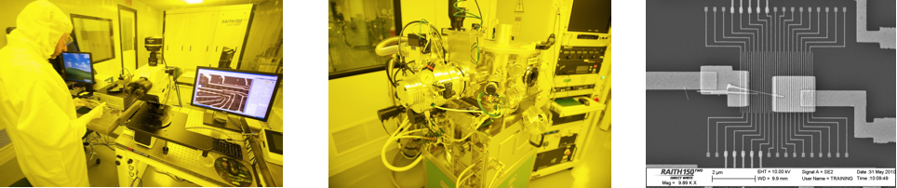

Wave-Particle Duality and Simple Quantum Algorithms
Dr. John Donohue, Scientific Outreach Manager
Adaptation of materials by M. Laforest & E. Eleftheriadou

Slide 2

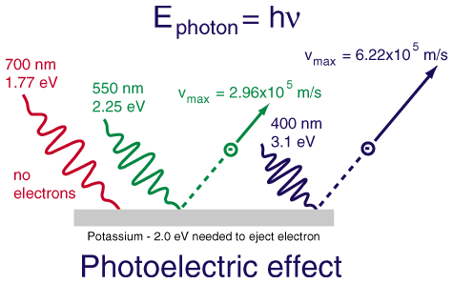
Waves and Particles
Wave
Particle
Notes:
Use to explicitly note that these two experiments, while both influential, are difficult to conceptually link; could conclude that light behaves like a wave sometimes, particle others. Here, we’ll go through a setting where wave and particle behaviours show up in the SAME setting, i.e. polarization and qubits.

Slide 3
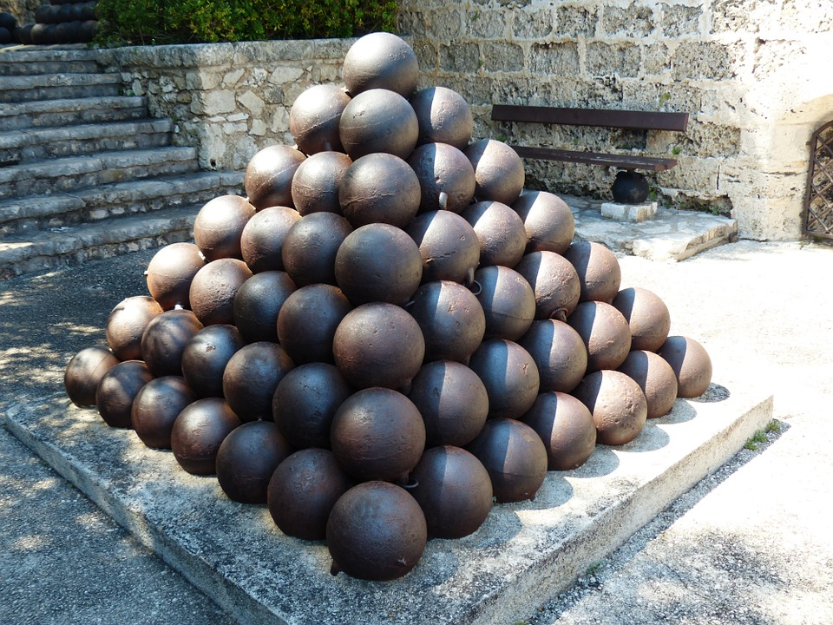

Wave-particle duality
Particle | Wave
Only exists at one place (localized) | Exists over a large space (delocalized)
Has a mass and volume | Has a wavelength and frequency
Kinetic collisions | Wave interference
Countable | Continuous

Slide 4



The Two Golden Rules of Quantum Mechanics
Rule #1
Superposition
Rule #2
Measurement uncertainty
A particle can behave
as if it is both
“here” and “there”
When asked where it is,
the particle will be found either
“here” or “there”
Wave behaviour
Particle behaviour

Slide 5
Wave-Particle Duality Revisited
Wave and particle picture of a beamsplitter
Interferometry and wave-particle behaviour
Implementing quantum algorithms in the beamsplitter picture
Splitting indivisible particles

Slide 6
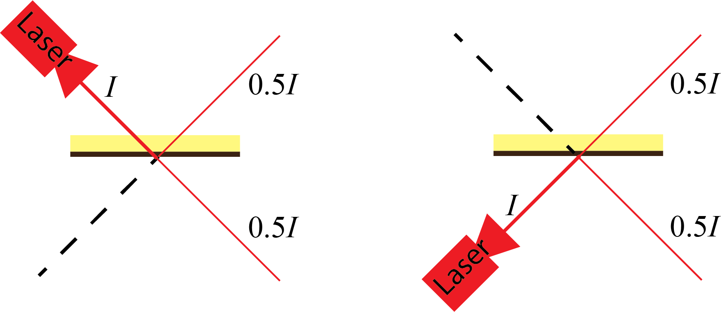
Optical Beamsplitters

Slide 7
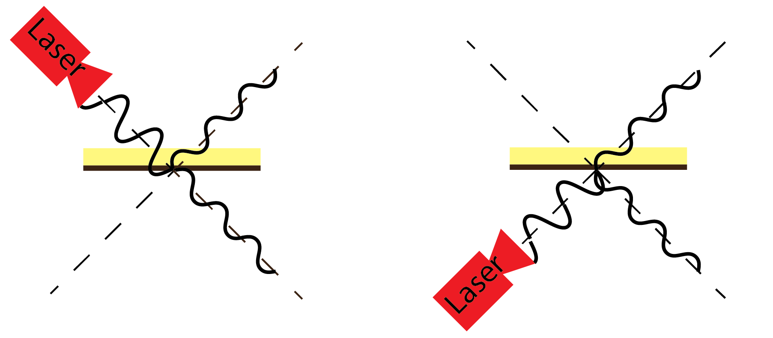
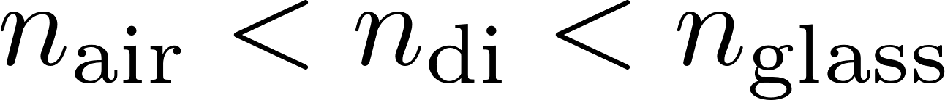
Waves on a Beamsplitter
Glass
Coating
Phase jump when reflection is from higher to lower index

Slide 8
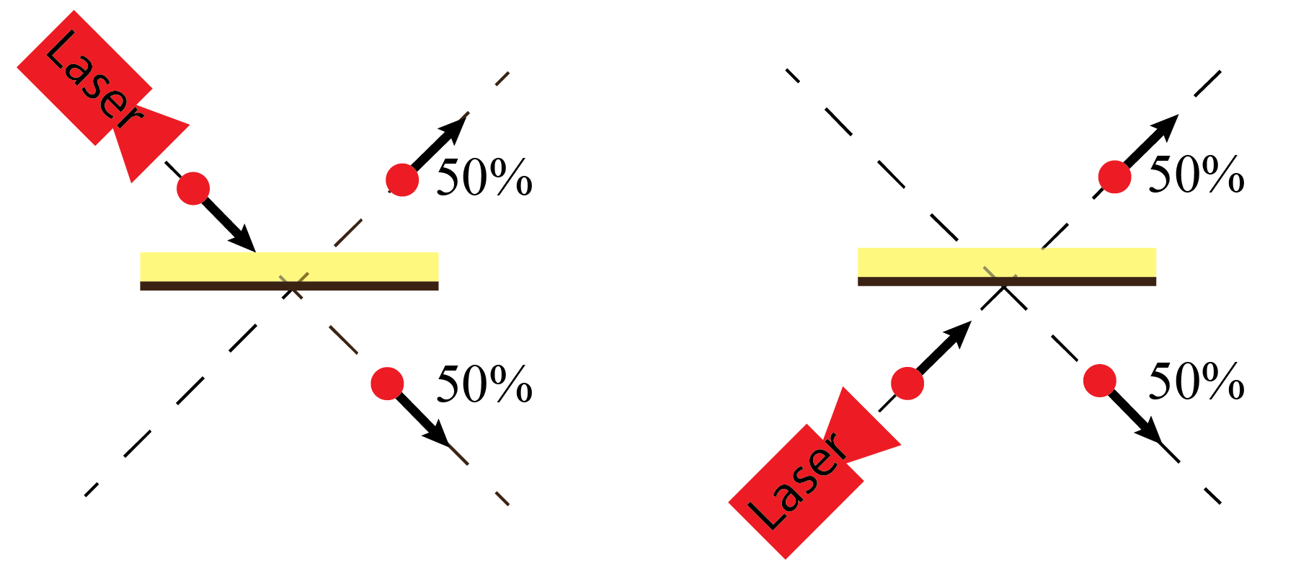
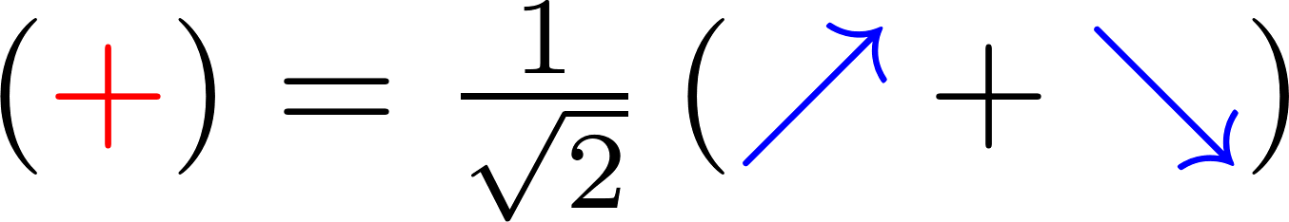
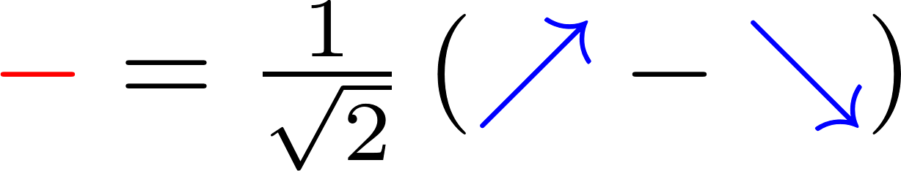
Photons on a Beamsplitter

Slide 9
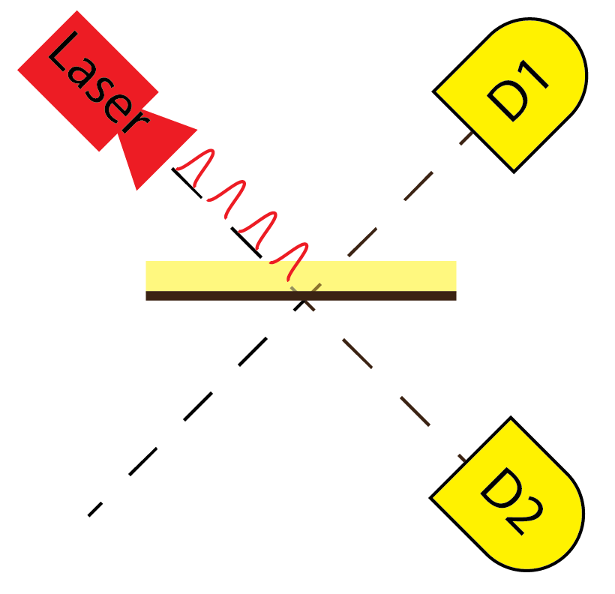
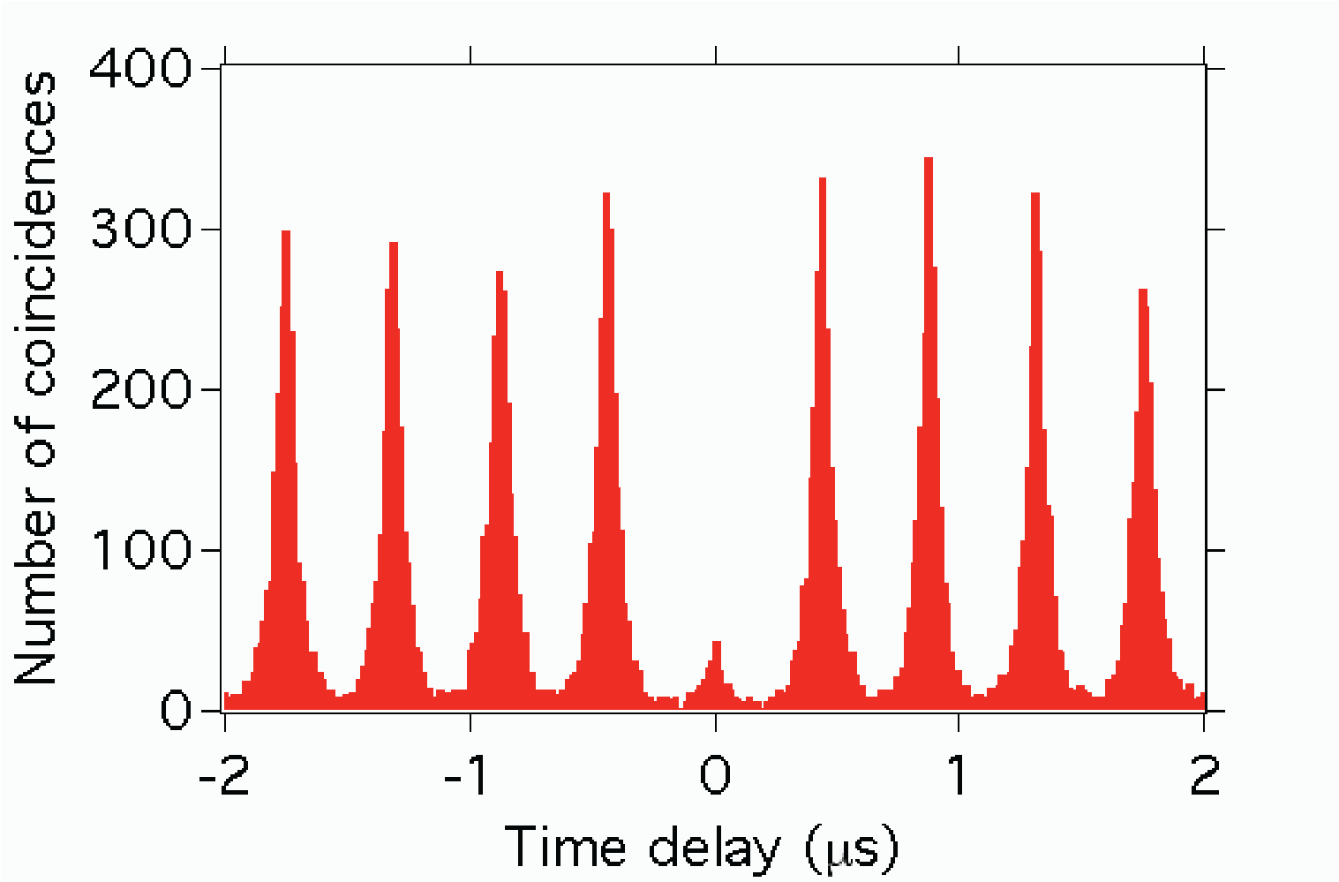
Photons on a Beamsplitter

Slide 10
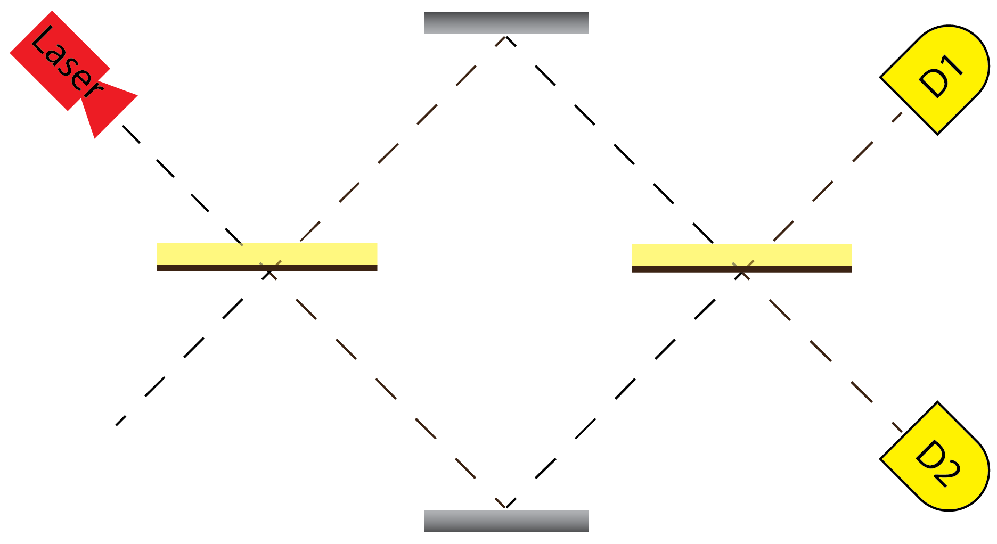
The Mach-Zehnder Interferometer

Slide 11
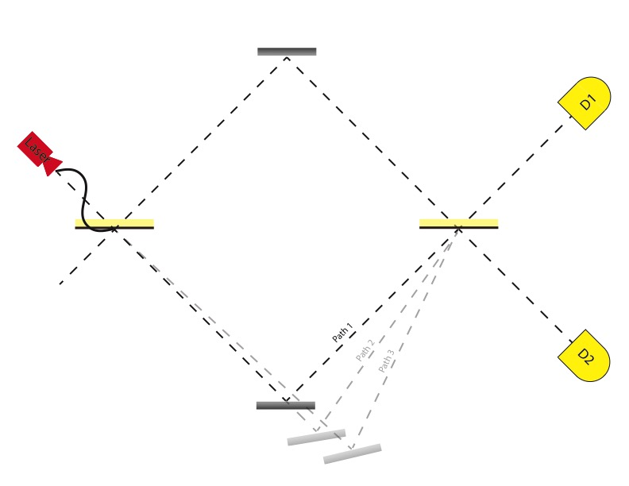
The Mach-Zehnder Interferometer
Constructive
Destructive

Slide 12
Constructive
Destructive

Slide 13
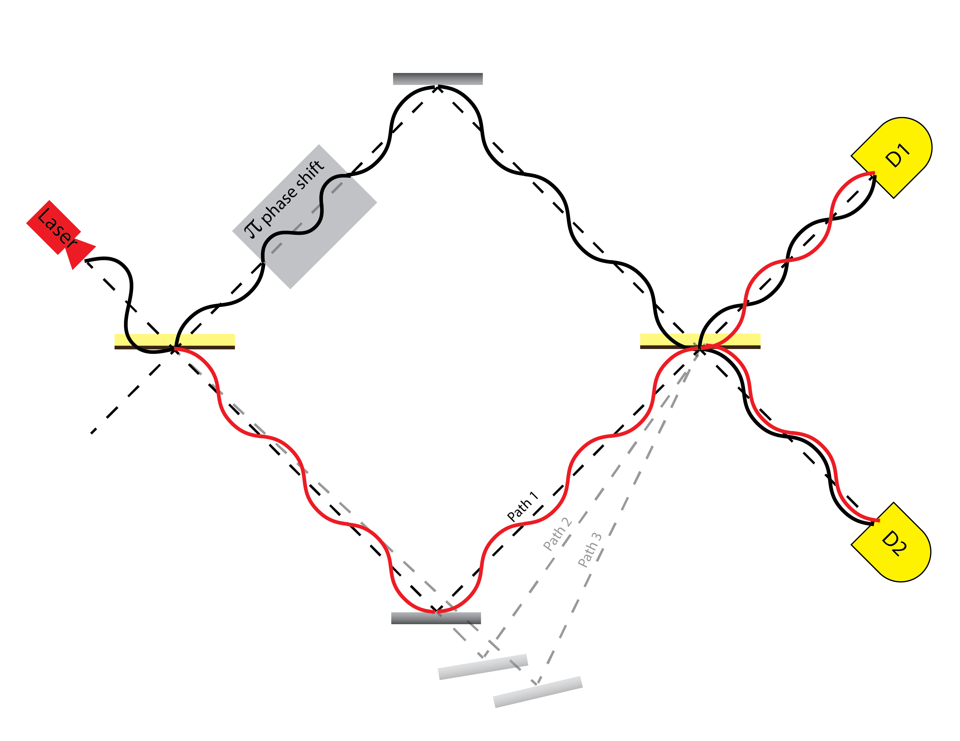
Constructive
Destructive

Slide 14
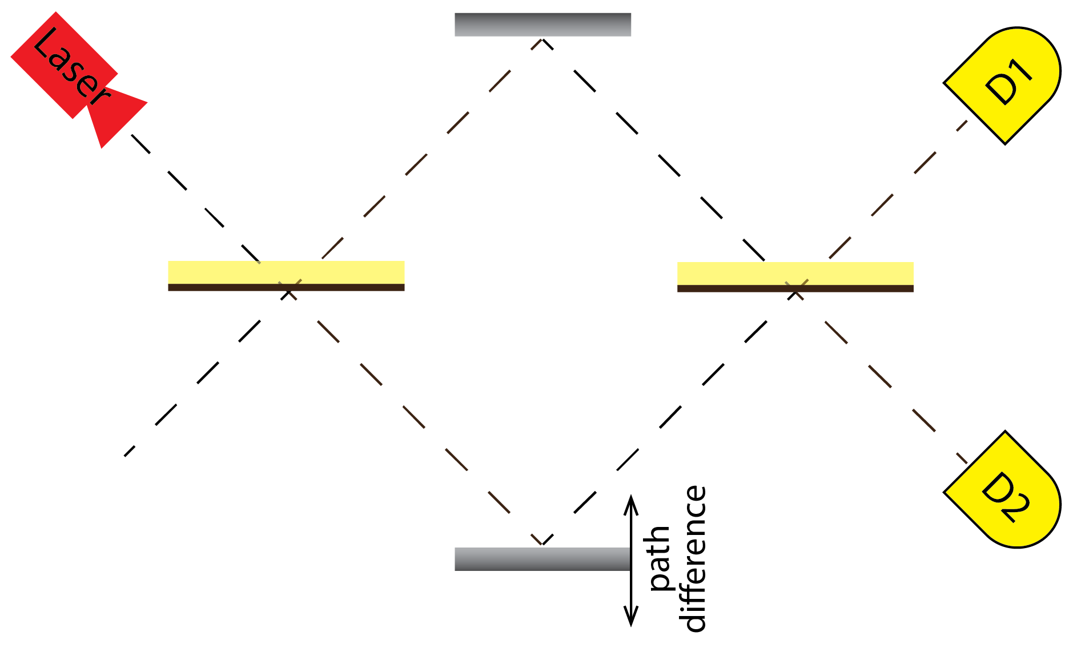
Photons in an MZI
Individual Photon Detections
Path Difference
Wave-Particle Unity

Slide 15
Quantum Algorithms
Algorithms run on quantum machines can have incredible speedups over classical computers
But there’s no “recipe” for what problems a
quantum computer can help with
* P. Kaye, R. Laflamme, M. Mosca. An Introduction to Quantum Computing (2007).
Notes:
The big issue with teaching quantum algorithms: they are somewhat-necessarily put in a CS/math language.
Initially, quantum computers were expected to only help with simulations of q physics. David Deutsch and Richard Josza found a problem that was clearly stated as a CS/functional analysis problem that Qcomputers would be able to solve more quickly. It’s useless, but as an idealogical spark, it led to potentially useful algorithms such as Grover‘s and Shor’s.

Slide 16
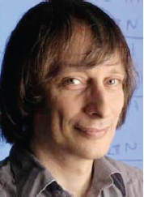
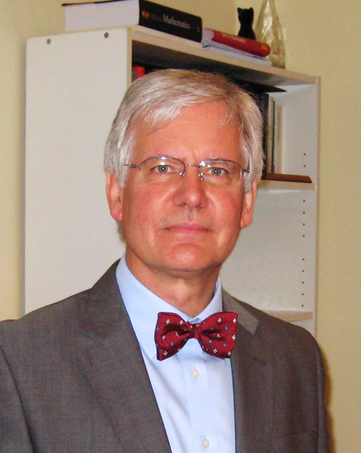
The Deutsch-Josza Algorithm
Give a binary function f(x),
-> two possible inputs (0 or 1)
-> two possible outputs (0 or 1)
Determine whether f(x) is constant!
Four possible functions:
x | f₁(x) |  | x | f₂(x) |  | x | f₃(x) |  | x | f₄(x)
0 | 0 |  | 0 | 1 |  | 0 | 0 |  | 0 | 1
1 | 0 |  | 1 | 0 |  | 1 | 1 |  | 1 | 1

Slide 17
The Deutsch-Josza Algorithm
x | f₁(x) |  | x | f₂(x) |  | x | f₃(x) |  | x | f₄(x)
0 | 0 |  | 0 | 1 |  | 0 | 0 |  | 0 | 1
1 | 0 |  | 1 | 0 |  | 1 | 1 |  | 1 | 1
How many tests do I need to run to know if f(x) is constant?
Classically: How many values of f(x) do I need to know?

Slide 18
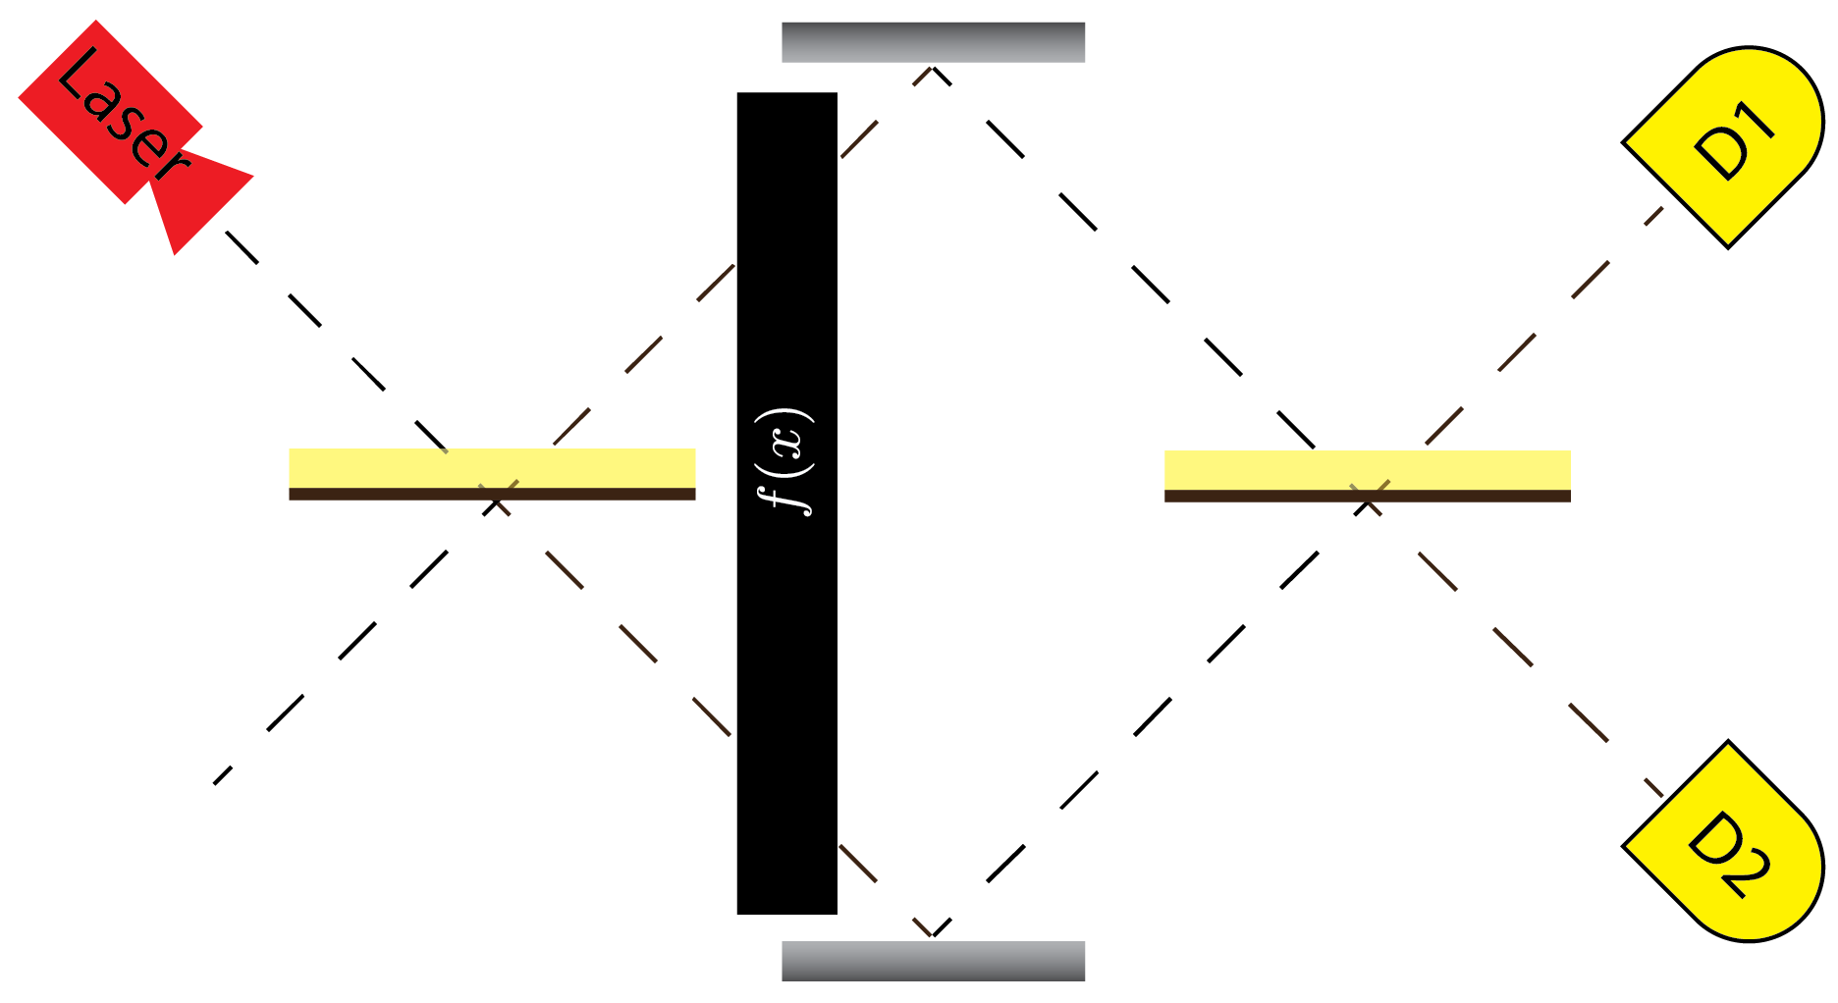
The Deutsch-Josza Algorithm

Slide 19
The Deutsch-Josza Algorithm
x | f₁(x) |  | x | f₂(x) |  | x | f₃(x) |  | x | f₄(x)
0 | 0 |  | 0 | 1 |  | 0 | 0 |  | 0 | 1
1 | 0 |  | 1 | 0 |  | 1 | 1 |  | 1 | 1
f₁
f₂
f₃
f₄

Slide 20
Wave-Particle Duality Revisited
Why does the Deutsch-Josza algorithm work?
We send in one particle,
but because of its wave nature,
we effectively probe multiple paths*.
*Requires both superposition state as input AND measurement in the superposition basis

Slide 21
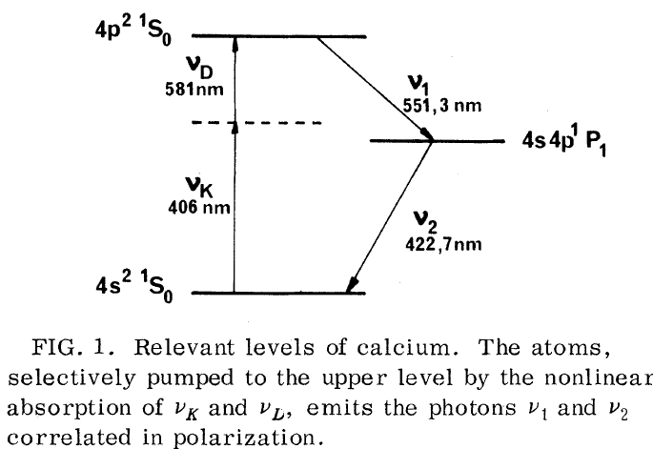

Final Thought: Actually Splitting Photons
A. Aspect et al. PRL 47, 460–463 (1981)

Slide 22
Final Thought: Actually Splitting Photons
Pump
laser pulse
Nonlinear
crystal

Slide 23
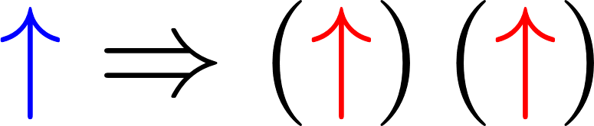
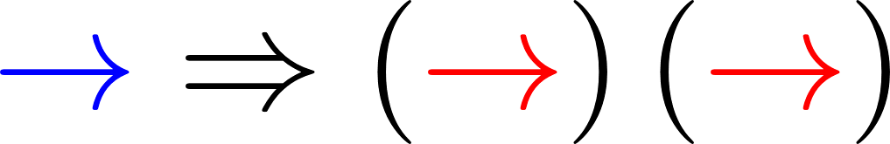
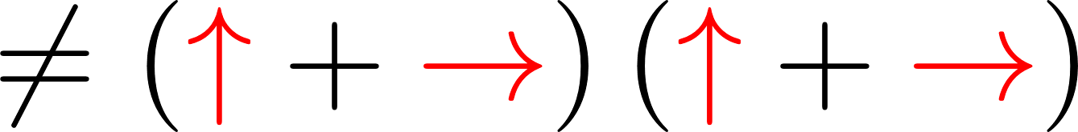
The No-Cloning Theorem
“Cloner”

Slide 24






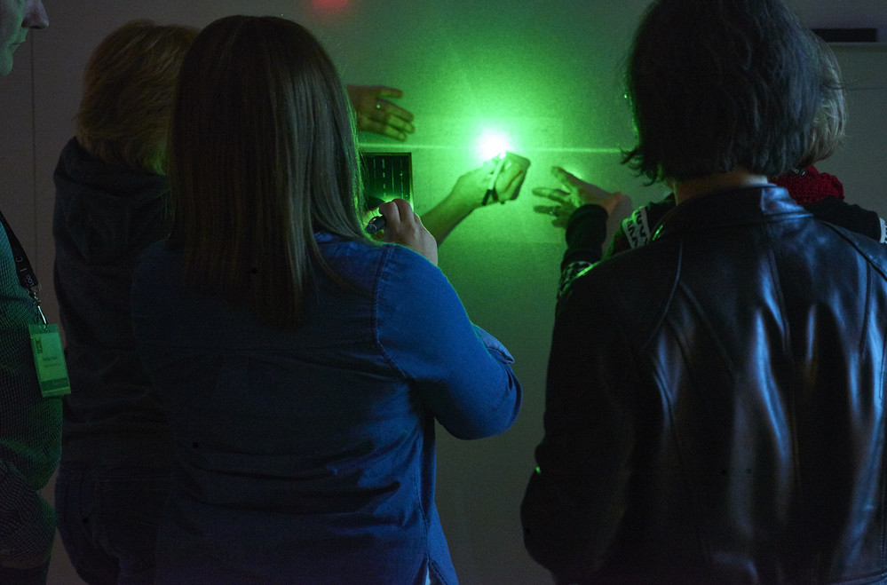
Thanks!
@QuantumIQC
@quantum_iqc
QuantumIQC
QuantumIQC
For materials, contact iqc-outreach@uwaterloo.ca
2019 applications
open now
Three-day PD workshop for Grade 11/12 science teachers.
Accommodations, travel, and meals included.

