Slide 1
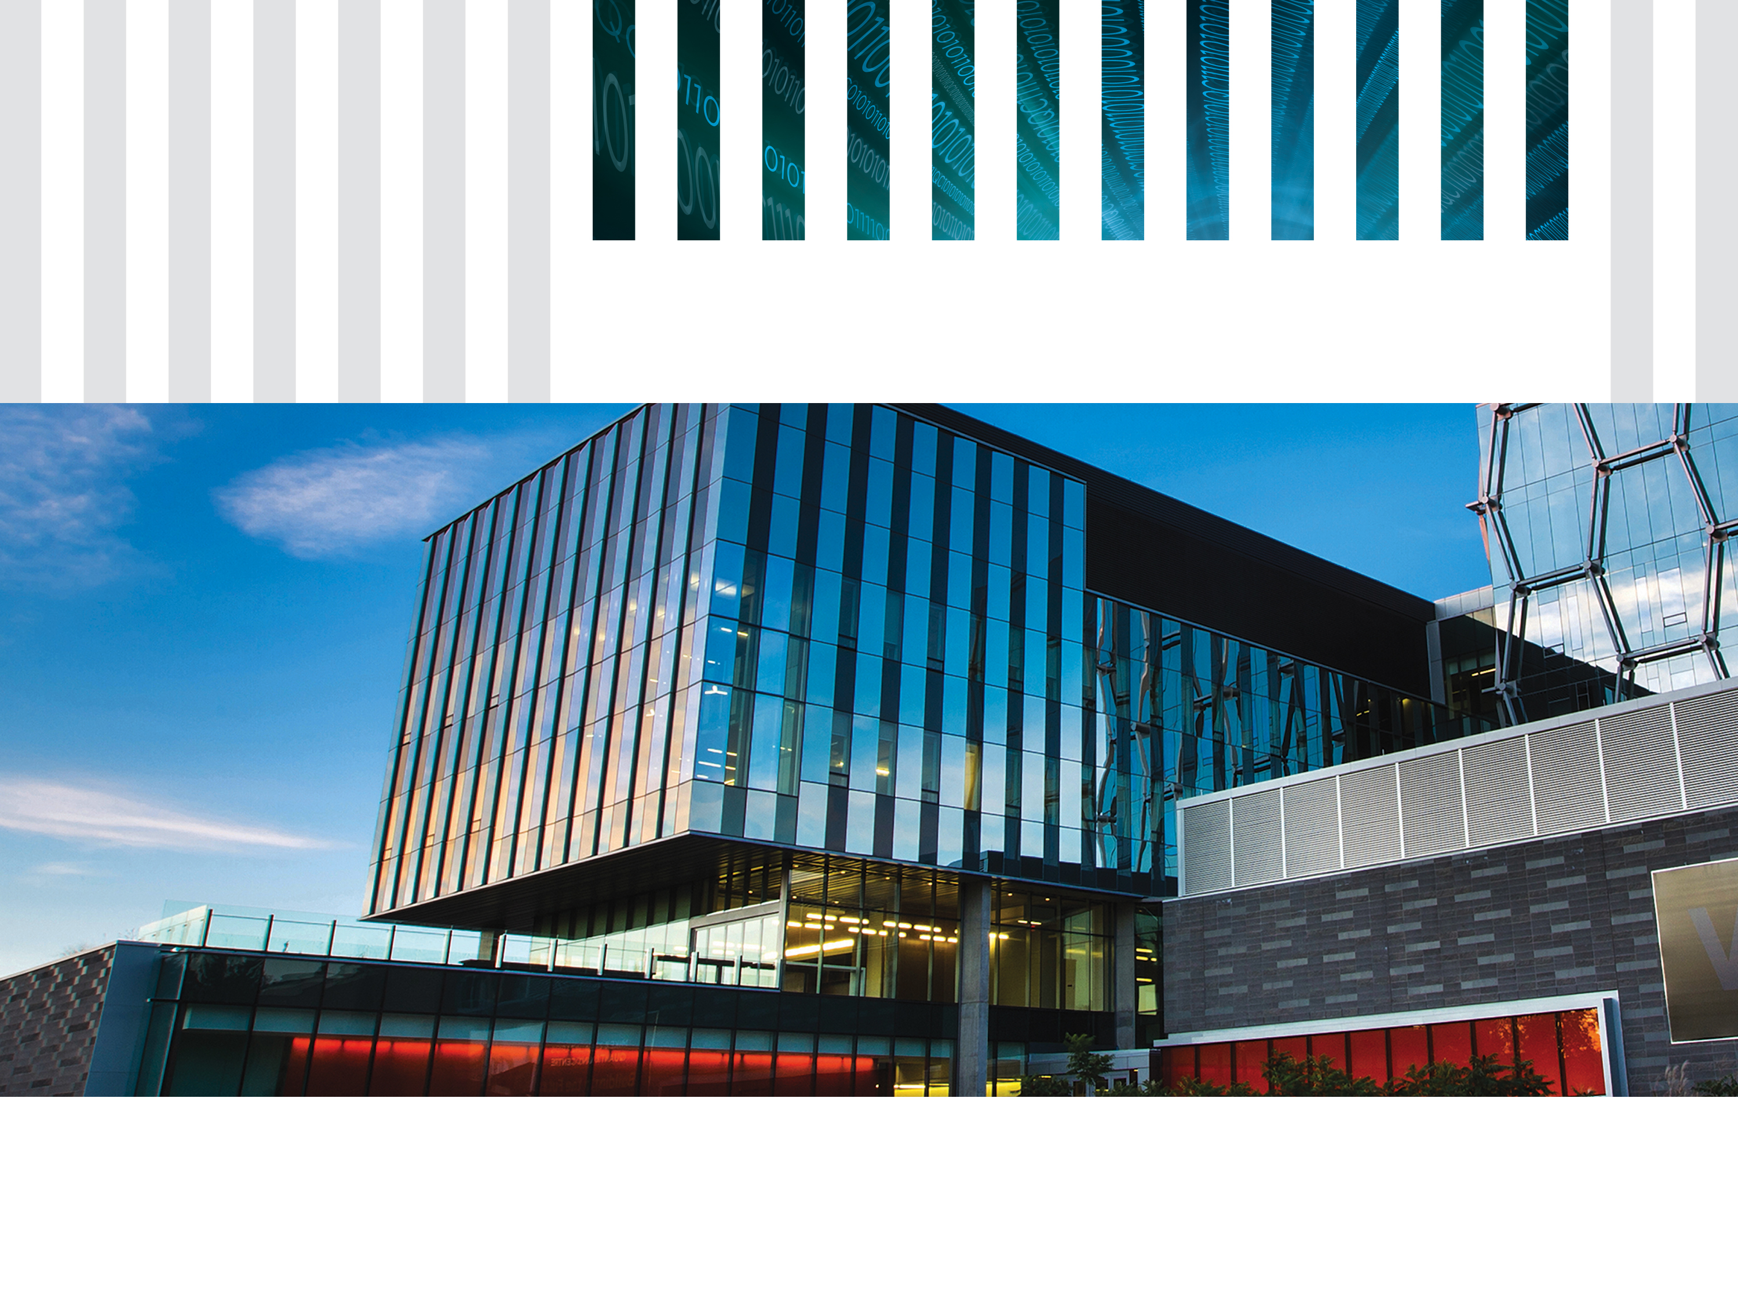
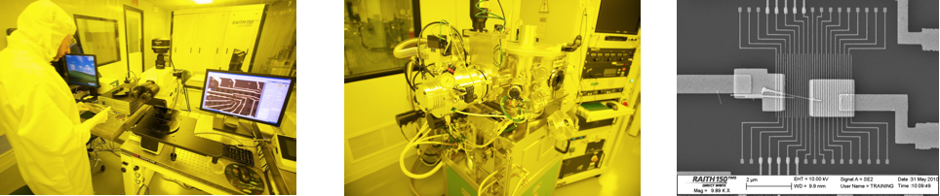

The Two Golden Rules
of Quantum Mechanics
Dr. John Donohue, Scientific Outreach Manager
Adaptation of materials by Martin Laforest

Slide 2
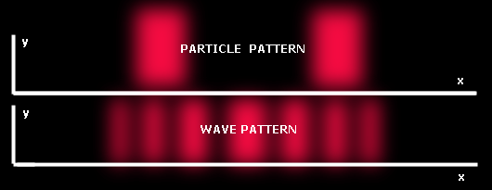
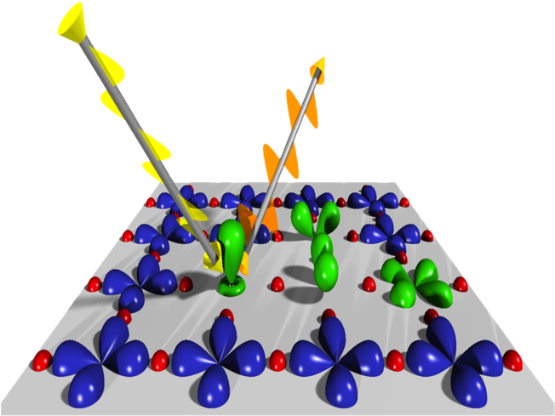


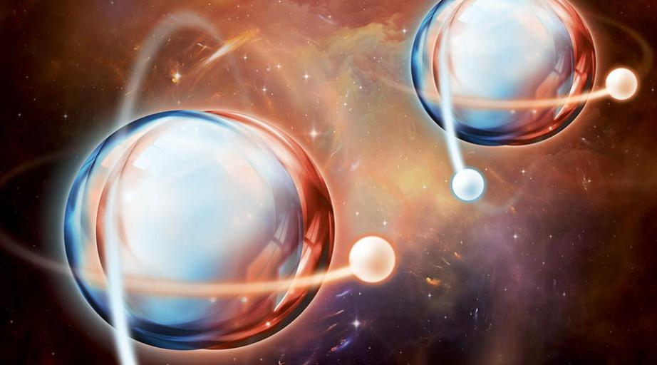
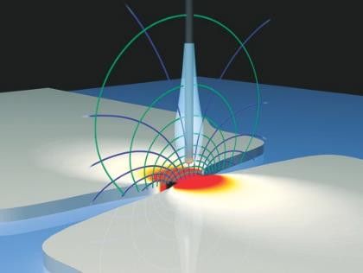
Why bother teaching quantum?
Conceptually exciting
Powerful future applications
“Observation”
Quantum Computing
Superposition
Quantum
Materials
Entanglement
Quantum Sensors

Slide 3

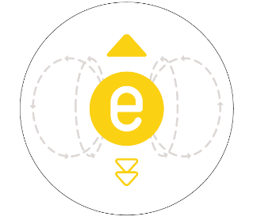

Why is teaching quantum difficult?
Reason #1: It’s hard to “see”
Classical Physics
Quantum Physics
The ball is directly above me and moving to the left with momentum p
The electron is probably somewhere above me and moving to the left or right with momentum p ± Δp,
but if I look at it,
it’ll change

Slide 4
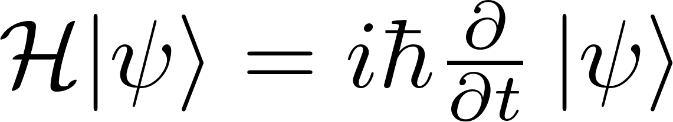
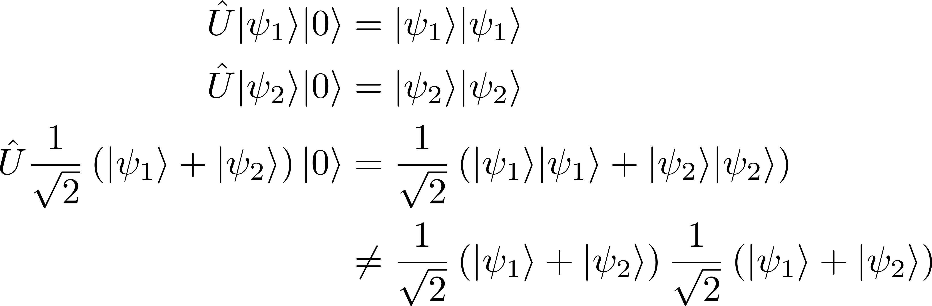
Why is teaching quantum difficult?
Reason #2: It involves math
Too advanced
Too much jargon

Slide 5
The Two Golden Rules of Quantum Mechanics
Superposition and mutually exclusive states
Interpreting superposition using polarization
Using measurement disturbance for safe communications
Interpreting the “wave function”

Slide 6


The Two Golden Rules of Quantum Mechanics
Rule #1
Superposition
Rule #2
Measurement uncertainty
A particle can behave
as if it is both
“here” and “there”
When asked where it is,
the particle will be found either
“here” or “there”

Slide 7

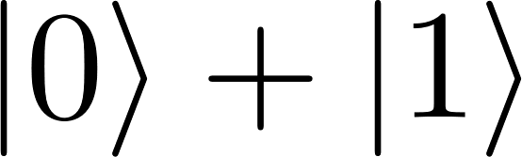
Superposition
Superposition is a relative concept,
dependent on a set of “mutually exclusive states”
e.g.
“Here” vs. “There”
“Alive” vs. “Dead”
Spin-Up vs. Spin-Down
“0” vs. “1”

Slide 8
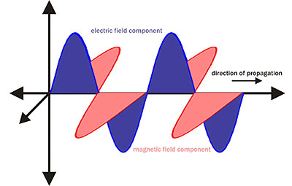
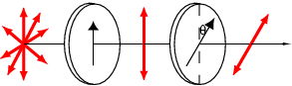
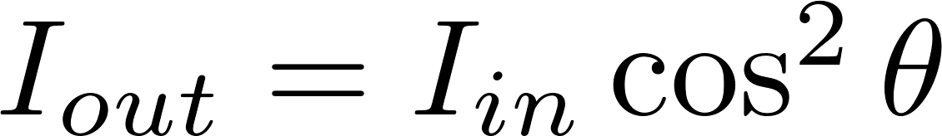
Light polarization: Wave picture
Malus’ Law
polarizer
analyzer

Slide 9
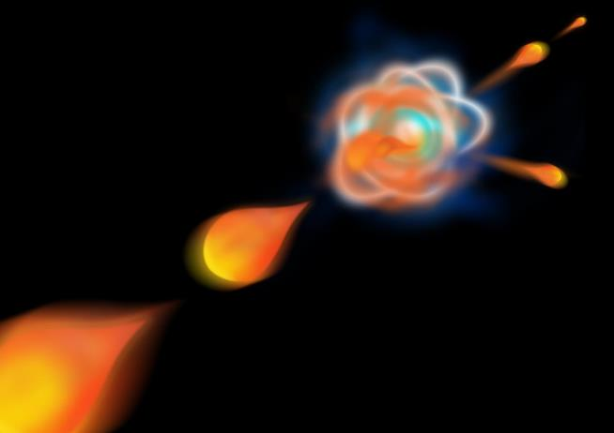
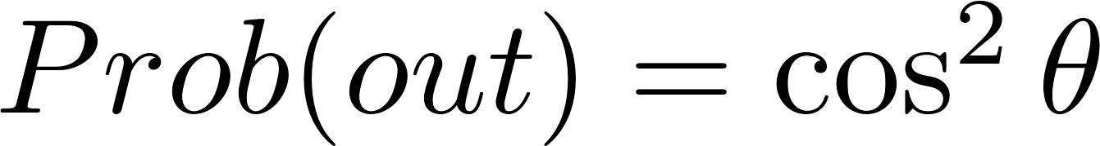
Light polarization: Photon picture
Malus’ Law
polarizer
analyzer
Two Possibilities:
Photon goes through or is absorbed
Notes:
Same math, different interpretation

Slide 10
Light polarization: Photon picture
The polarizer asks the photon a question:
What happens
if I ask the
“wrong” question?
Are you
horizontally
or vertically
polarized?
Are you
diagonally or
anti-diagonally
polarized?

Slide 11

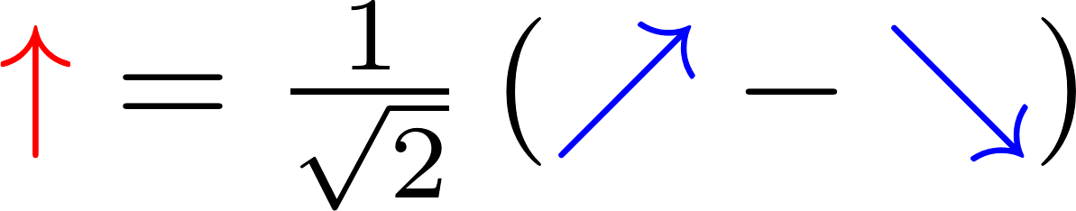
Light polarization: Photon picture
50%
Transmitted
50%
Absorbed
Notes:
50% transmitted and 50% absorbed; can think about as 50% intensity, or 50% probability per photon of being absorbed/transmitted
But this doesn’t need the superposition/measurement concept, we just have Malus’ law! Can we go

Slide 12
Light polarization beyond Malus’ law
+45°
90°
-45°

Slide 13
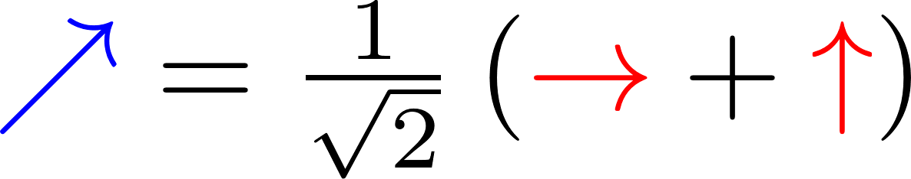
Superposition and Measurement

Slide 14
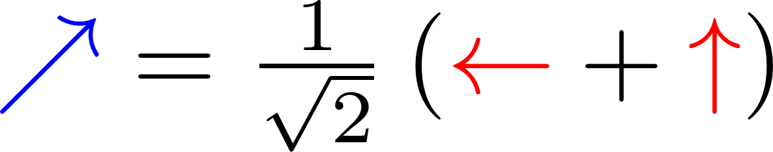
Superposition and Measurement

Slide 15
Superposition and Measurement

Slide 16
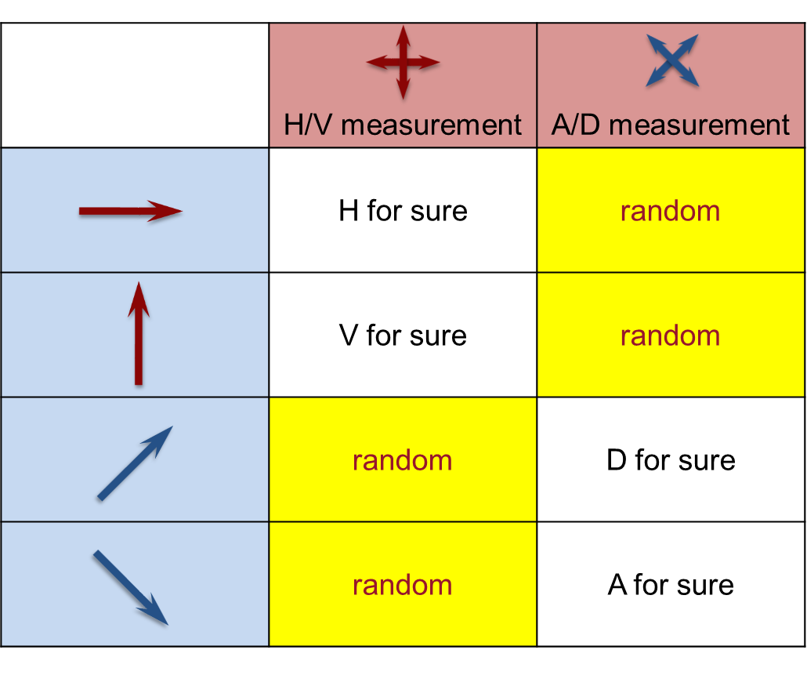
Superposition and Measurement
Whether a measurement disturbs a quantum state depends on the question.
“Superposition” is relative to the measurement
being performed.

Slide 17
Quantum Cryptography
If the “wrong” measurement is made,
the quantum state is disturbed.
Can we use this to detect an intrusive presence?

Slide 18


Quantum Cryptography: The Punchline
Alice
Bob
Notes:
(very briefly mention the idea of how this can be used, don’t go into the details)
This can be used to guarantee secure communication…

Slide 19

Quantum Cryptography: The Punchline
Alice
Bob
EVE
Notes:
(very briefly mention the idea of how this can be used, don’t go into the details)
However, if an eavesdropper tries to listen to the communication by measuring the photons, they’ll change the signal. If Alice and Bob are clever, they can detect that something’s amiss!

Slide 20



Quantum Cryptography: The Details
Secure
Alice
Bob
Notes:
First, let’s back up a second: what’s cryptography?

Slide 21
Quantum Cryptography: The Details
The One-Time Pad
(Vernam Cipher)
Message
10101110
Ciphertext
11011101
Key
01110011
Key
01110011
Ciphertext
11011101
Message
10101110

Slide 22


Quantum Cryptography: The Details
Quantum Key Distribution (QKD)
Alice
Bob
EVE

Slide 23
Quantum Key Distribution
0:
or
1:
or
Alice choose a RANDOM bit
Alice encodes it in a RANDOM basis
Alice sends the bit to Bob
Bob measures in a RANDOM basis
Bob records the bit
Reset and repeat

Slide 24
Quantum Cryptography: Summary
Why does Quantum Key Distribution work?
The key itself contains no secrets
Measurement in the wrong basis
provides no information
Subsequent measurements in incompatible bases disturb the quantum state
A single photon cannot be cloned or copied

Slide 25
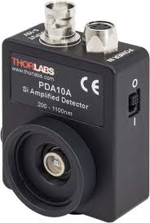
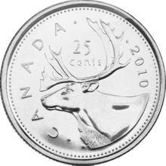
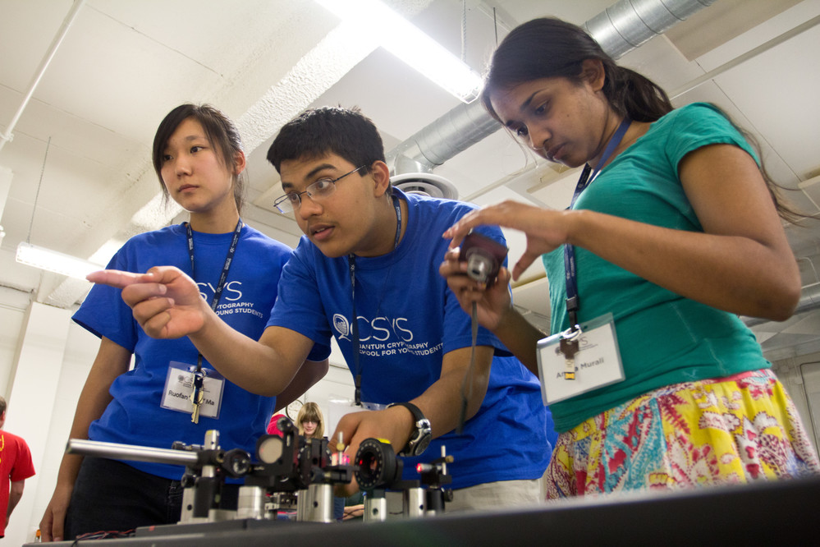
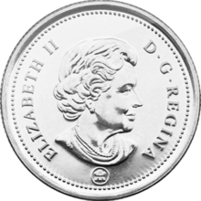
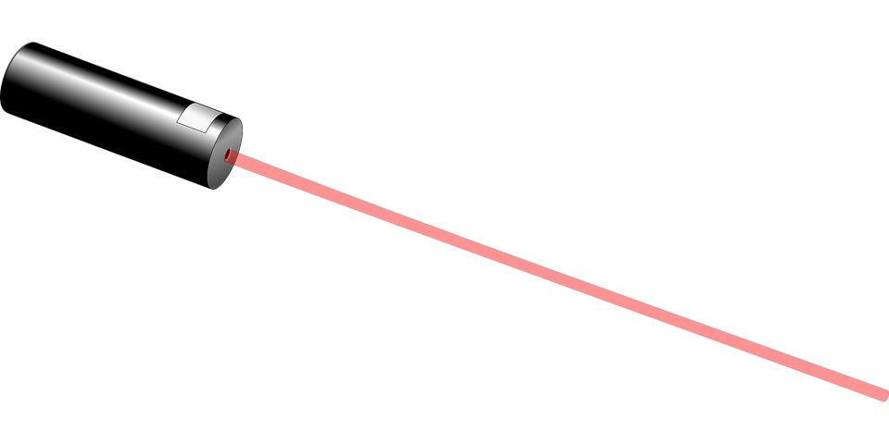

Quantum Cryptography in Class
Laser-based
polarization-encoded
demo kit
Group activity
“Quantum Coins”

Slide 26
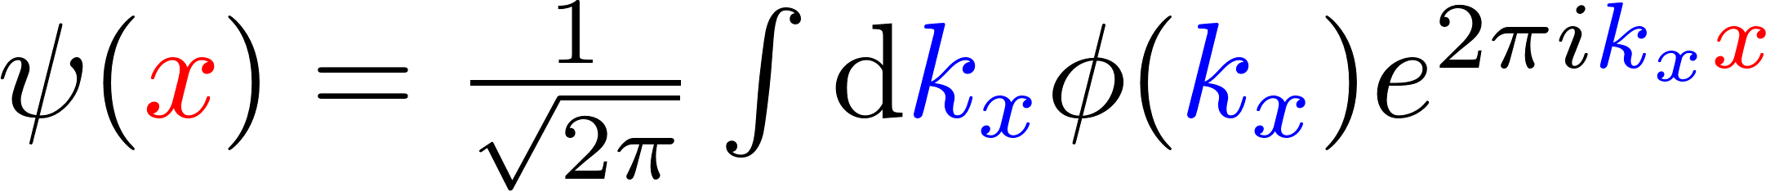
The Quantum Wavefunction
Wave amplitudes relate to the probability of measuring an outcome,
and the amplitudes can interfere

Slide 27





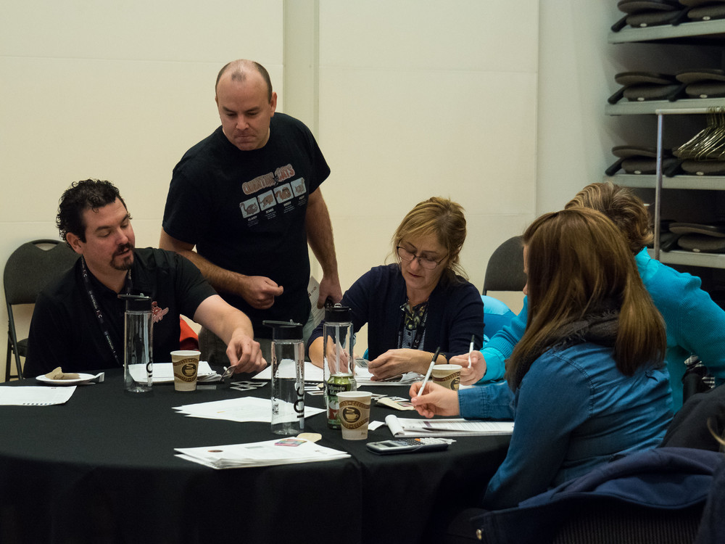
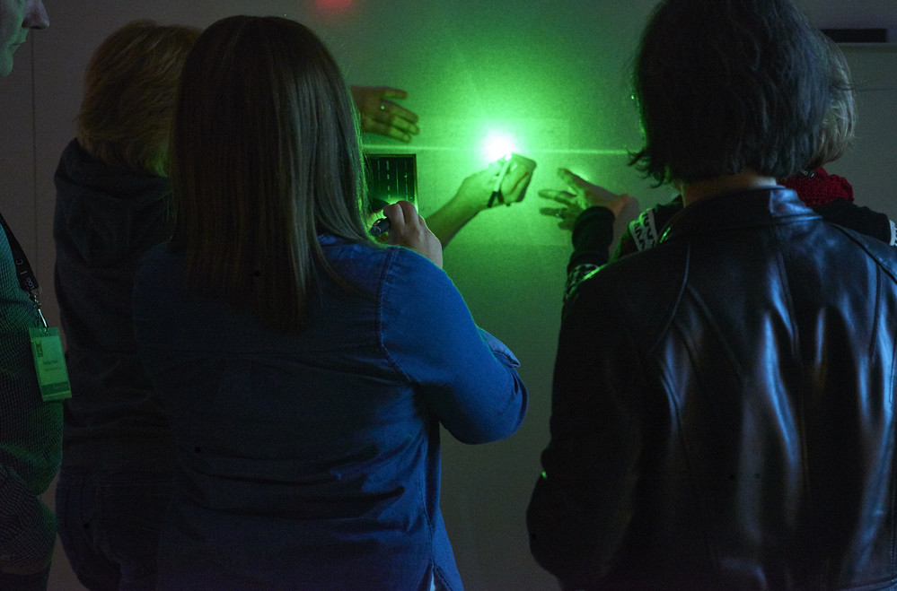
Thanks!
@QuantumIQC
@quantum_iqc
QuantumIQC
QuantumIQC
For materials, contact iqc-outreach@uwaterloo.ca
2019 applications
open now
Three-day PD workshop for Grade 11/12 science teachers.
Accommodations, travel, and meals included.

Slide 28
0
1
0
1
1
0
0
1
1
1.
Alice choose a RANDOM bit
2.
Alice choose a RANDOM basis
3.
Alice send the state to Bob
4.
Bob measure in a RANDOM basis
R
R
R
R
5.
Bob records the bit
0
R
0
1
R
0
0
R
R
6.
Notes:
Bringing people, build the infrastructure
Needs to have a logic to go around.. Maybe the iqc story start with theory, move to light experiment (optics/nmr and go to the heavier stuff cleanr room superconducting qubits

Slide 29
0
1
0
1
1
0
0
1
1
1.
2.
3.
4.
R
R
R
R
5.
0
R
0
1
R
0
0
R
R
6.
Notes:
Bringing people, build the infrastructure
Needs to have a logic to go around.. Maybe the iqc story start with theory, move to light experiment (optics/nmr and go to the heavier stuff cleanr room superconducting qubits

Slide 30
0
1
0
1
1
0
0
1
1
1.
2.
3.
R
R
R
R
4.
R
R
R
R
R
R
R
5.
R
R
R
1
R
0
R
R
R
6.
Notes:
Bringing people, build the infrastructure
Needs to have a logic to go around.. Maybe the iqc story start with theory, move to light experiment (optics/nmr and go to the heavier stuff cleanr room superconducting qubits

Slide 31
0
1
0
1
1
0
0
1
1
1.
2.
3.
R
R
R
R
4.
R
R
R
R
R
R
R
5.
R
R
R
1
R
0
R
R
R
6.
Notes:
Bringing people, build the infrastructure
Needs to have a logic to go around.. Maybe the iqc story start with theory, move to light experiment (optics/nmr and go to the heavier stuff cleanr room superconducting qubits

Slide 32
0
1
0
1
1
0
0
1
1
1.
2.
3.
R
R
R
R
4.
R
R
R
R
R
R
R
5.
R
R
R
1
R
0
R
R
R
6.
Notes:
Bringing people, build the infrastructure
Needs to have a logic to go around.. Maybe the iqc story start with theory, move to light experiment (optics/nmr and go to the heavier stuff cleanr room superconducting qubits

