Slide 1
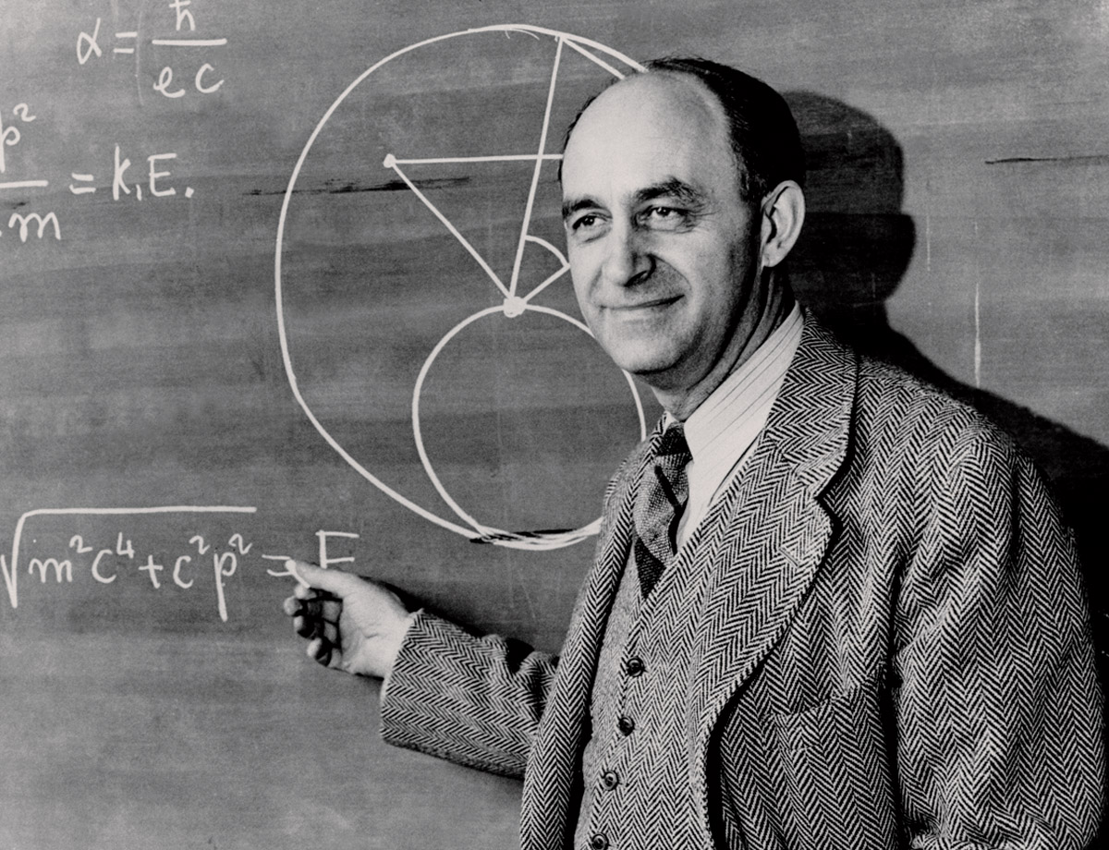
FERMI PROBLEMS
Photo: U. of Chicago

Slide 2
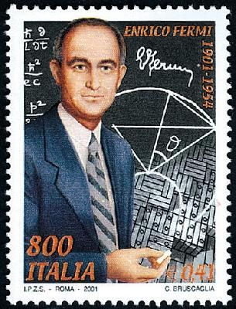
Enrico Fermi
Won the 1938 Nobel Prize for his work on radioactivity
Led the team that created the first nuclear reactor
Proposed the existence of the neutrino
Did very important work in particle physics, especially pions, muons and cosmic rays
Associate Director of the Manhattan Project

Slide 3
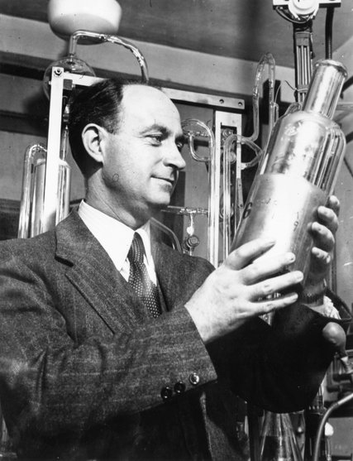
Fermi Problems are Estimation Problems
Fermi was an excellent theoretical and experimental scientist…
…and so he was extremely good at figuring out problems in his head, using reasonable assumptions to arrive at an approximate answer.

Slide 4
We Don’t Need Exact Solutions
The idea is to make educated guesses at each stage of the problem, to reach an approximate result
How many question marks should we have in a stock photo?
1? 7? 50?

Slide 5
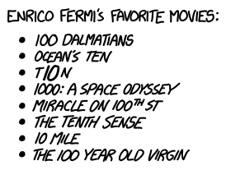
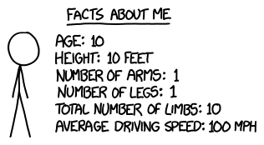
Within An Order of Magnitude? Good Enough!
Courtesy of XKCD: ‘Paint the Earth” https://what-if.xkcd.com/84/

Slide 6
Why Would You Use Them in the Classroom?

Slide 7
Several Reasons!
Allows students to take on ‘impossible’ problems and succeed
Practices/reinforces estimation skills
Draws on students’ prior knowledge
Can use the method to ‘pre-check’ the answer for other question types
Can feel less ‘constrained’ than problems where an exact answer is required

Slide 8
Let’s Try It!

Slide 9
QUESTION 1:
The Ontario government decides that winter is too depressing and that what is really needed is to turn all of Lake Ontario into one giant mug of hot chocolate.
a) Find the number of packets of hot chocolate powder required to make this much hot chocolate.
b) Find the number of large marshmallows required to float on top of the hot chocolate.
DATA:
Lake Ontario is 245 km by 85 km wide, and holds 1610 cubic kilometres of water
One packet of hot chocolate makes 175mL
1 mL = 1 cubic centimetre
A large marshmallow is about 3cm in diameter

Slide 10
What Type of Answer Are We Looking For?
Exact?
volume of Lake Ontario = 1610 km³ = 1.61 x 10¹² m³ = 1.61 x 10¹⁵ L
1 hot chocolate= 175mL = 0.175 L
So 1.61 x 10¹⁵ L / 0.175 L = 9.2 x 10¹⁵ packages
Order of magnitude-ish?
175mL is about 200cm³
= 2 x 10² cm³
1610 km³ is about 2000 x 10¹² m³ = 2 x 10¹⁸ cm³
2 x 10¹⁸ cm³ / 2 x 10² cm³
= 2 x 10¹⁶ packages

Slide 11
What Type of Answer Are We Looking For?
Exact-ish because… marshmallows?
Assuming the marshmallows don’t melt, and are stacked long-axis down…
Area of a marshmallow = 7 x 10⁻⁴ m²
area of Lake Ontario = 245km x 85km =20825 km²
= 20825 (1 x 10⁶ m² )= 2.1 x 10¹⁰ m²
So 2.1 x 10¹⁰ m² / 7 x 10⁻⁴ m² = 3 x 10¹³ marshmallows

Slide 12
But… was the question even a good Fermi Problem?
Were there lots of ways to approach the problem?
Did it require prior knowledge that a student could be reasonably expected to have?
Did it generate a lot of discussion for the group?
A few….but not really
Yes – metric volume conversions
Possibly? Hopefully?

Slide 13
What are we looking for in a good Fermi Problem?

Slide 14
My Own List:
Process is more important than the product
Talking through the answer with others is important
Students need to have enough prior knowledge to make a reasonable assumption at each step
Communication of what assumptions/steps were made is essential

Slide 15
And Now…
EVALUATION

Slide 16
Assuming We Are Assigning a Grade/Mark Here… How Are We Doing It?
Here are some ideas:
Binary marking: 1 mark for the correct answer, 0 for a wrong answer.
Top marks for the fastest answer regardless of accuracy
Top marks for the student who brought you coffee
These are terrible ideas ☹

Slide 17
One idea: Assign a mark but give a range
Suppose that the question is "What is the mass of Lake Erie", and that the judges' best estimate is 10^15 kg
An Answer within a factor of | i.e.: an answer in the range: | Marks
5 | 2 X 10^14 - 5 X 10^15 | 5
10 | 4 X 10^13 - 2 X 10^16 | 3
100 | 8 X 10^12 - 1 X 10^17 | 1
http://www.physics.uwo.ca/science_olympics/events/puzzles/fermi_questions.html

Slide 18
One idea: Assign a mark but give a range (2)
You could also ask for a three-part answer: give the minimum possible value, the best estimate, and the maximum possible value in your answer. Each answer receives a mark based on how accurate it is.
http://www.physics.uwo.ca/science_olympics/events/puzzles/fermi_questions.html

Slide 19
Some Ideas?
Rubric with categories for detailing assumptions made, good estimating, etc
Base mark for a ‘good effort’ answer, even if result isn’t very accurate (say 3/5 for example)
Marks for working with other group members and contributing to discussion of final answer

Slide 20
Some Hazards
How to mark individual effort in a group setting
If the process is important, how to make the mark scheme reflect that (instead of ‘all product’ marking)
How much is having a good base of prior knowledge worth? More than process?

Slide 21
Some Further Hazards
What *is* the right answer? Might rely on teacher’s abilities of estimation!

Slide 22
Some Opportunities
Internet provides lots of ‘facts n’ figures’ if needed for filling in gaps in prior knowledge
Could do them with any grade level, if difficulty is adjusted: for example, Grade 9 Astronomy deals with many ‘order of magnitude’ issues

Slide 23
Some Opportunities
Could do them with other *subject areas*, especially math: Grade 9 curriculum has a large section of exponents and powers of ten which this fits nicely

