Slide 1
Hands-On Fields Roberta Tevlin roberta@tevlin.ca
All materials are available at roberta.tevlin.ca

Slide 2
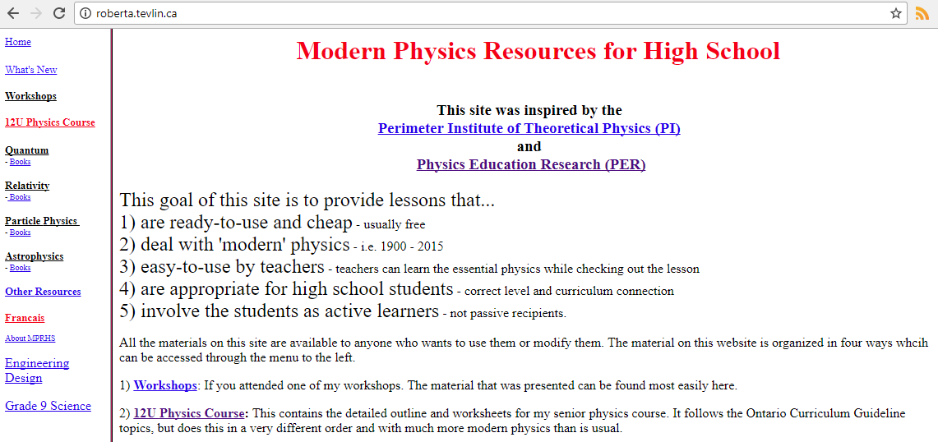
Hands-On Fields
All materials are available at roberta.tevlin.ca

Slide 3
The Problem with F_{g} = GMm/r²
This equation suggests that the Sun exerts a force on the Earth, across almost a billion kilometers, without any contact.

Slide 4
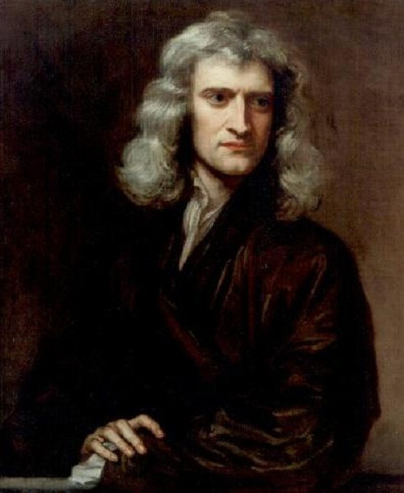
The Problem with F_{g} = GMm/r²
"That one body may act upon another at a distance through a vacuum without the mediation of anything else, by and through which their action and force may be conveyed from one another, is to me so great an absurdity that, I believe, no man who has in philosophic matters a competent faculty of thinking could ever fall into it."
upload.wikimedia.org/wikipedia/commons/8/83/Sir_Isaac_Newton_%281643-1727%29.jpg

Slide 5
The Problem with F_{g} = GMm/r²
“Hitherto we have explained the phenomena of the heavens and of our sea by the power of gravity, but have not yet assigned the cause of this power … I have not been able to discover the cause of those properties of gravity from phenomena, and I frame no hypotheses; … To us it is enough that gravity does really exist, and acts according to the laws which we have explained, and abundantly serves to account for all the motions of the celestial bodies, and of our sea.”
upload.wikimedia.org/wikipedia/commons/8/83/Sir_Isaac_Newton_%281643-1727%29.jpg

Slide 6
The Solution: Fields
Replace F_{g} = GMm/r²
with F_{g} = mg = m (GM/r²)
Does that satisfy you? Does that get rid of the spooky action-at-a-distance? Isn’t it just some mathematical sleight of hand? Q#1

Slide 7
The Solution: Fields
Fields are also used to explain the mysterious action-at-a-distance that occurs with electric and magnetic forces.

Slide 8
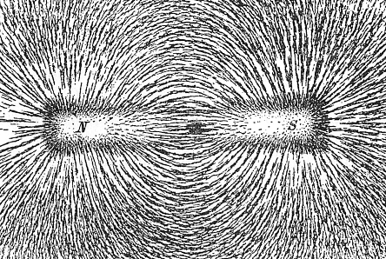
Visualizing Magnetic Fields
Place a piece of paper over the magnet.
Shake some iron filings over top.
Tap the paper gently to make the field clearer.
Draw a simplified diagram of the pattern. Q#2a
https://upload.wikimedia.org/wikipedia/commons/5/57/Magnet0873.png

Slide 9
Visualizing Magnetic Fields
Predict what the field in between two similar poles will look like. Observe.
What about opposite poles? Q#2b
N
N
N
S

Slide 10
Visualizing Gravitational Fields
Which pair of magnetic poles will provide a field that is similar to that between 2 stars?
Two north poles
Two south poles
One north and
one south pole
S
S
S
S

Slide 11
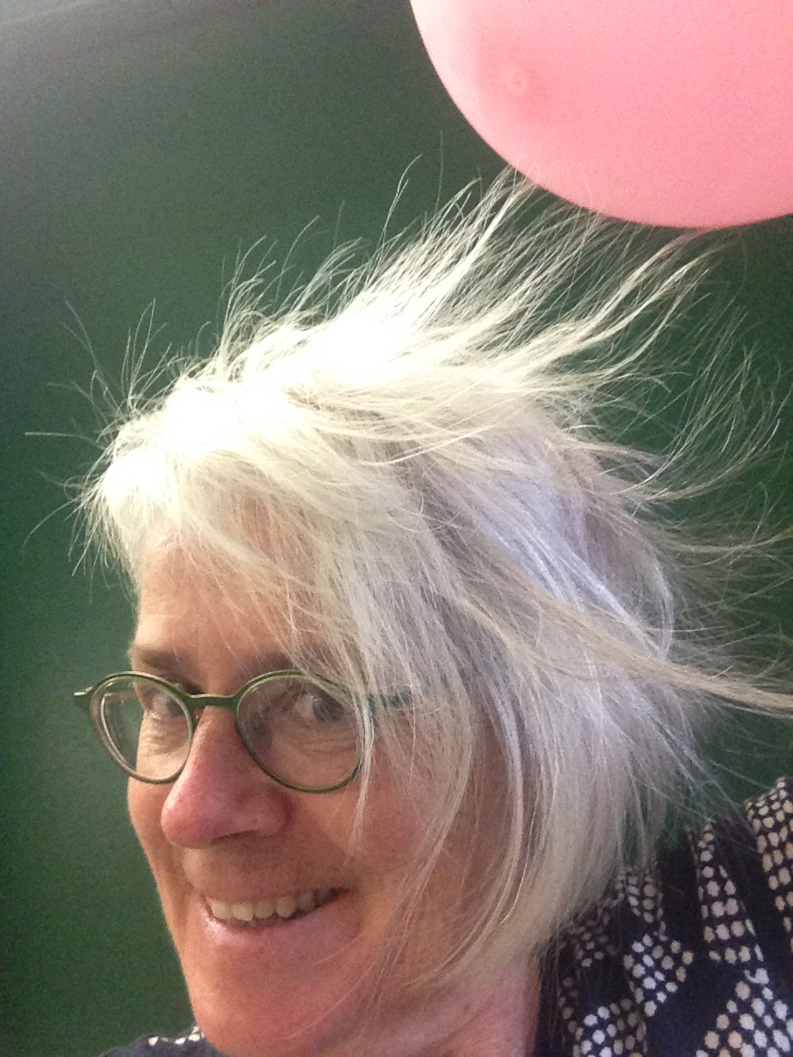
Visualizing Electric Fields
How can you make the electric field around a charged sphere visible using the materials at your table? Q #3a

Slide 12
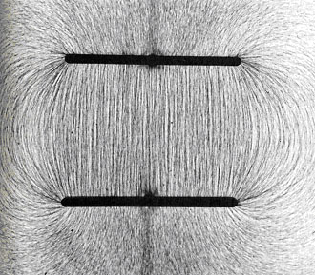
Visualizing Electric Fields
What is the field like between oppositely charged parallel plates? Q#3b
https://vignette.wikia.nocookie.net/cphysics/images/1/1b/Charged_plates.jpg/revision/latest?cb=20111201170455

Slide 13
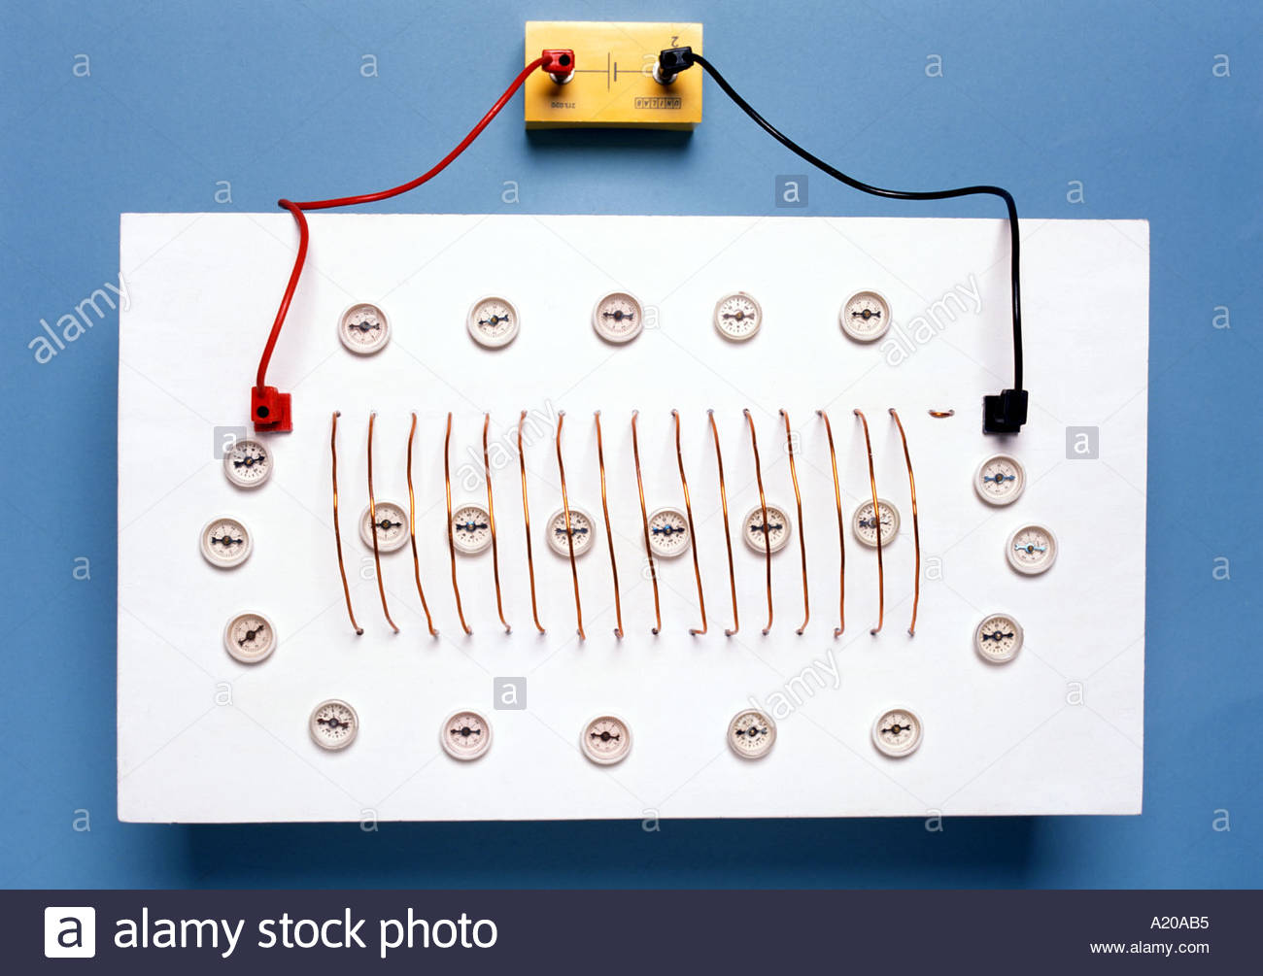
Visualizing Magnetic Fields
Where can you find a similar magnetic field?
http://c8.alamy.com/comp/A20AB5/magnetic-field-around-and-inside-a-solenoid-shown-by-plotting-compasses-A20AB5.jpg
Notes:
Have plexiglas demo available

Slide 14
Visualizing Gravitational Fields
What is the gravitational field in this classroom like? How can you make it visible?
http://www.lovethispic.com/uploaded_images/34325-Falling-Rain.gif?1

Slide 15
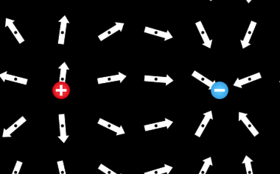
Simulating Electric Fields
How do you simulate an electric field that is similar to a bar magnet? Q #7a
https://phet.colorado.edu/en/simulation/charges-and-fields

Slide 16
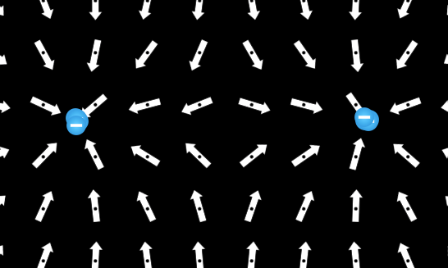
Simulating Electric Fields
How do you simulate an electric field that is similar to a binary star system? Q# 7b
https://phet.colorado.edu/en/simulation/charges-and-fields

Slide 17
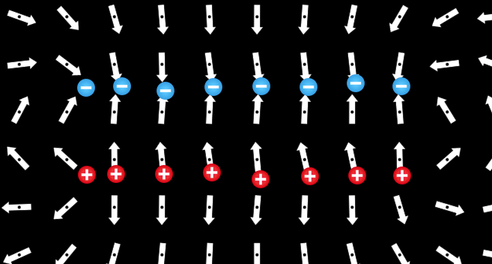
Simulating Electric Fields
How do you simulate an electric field of a parallel plate capacitor? Q# 7c
https://phet.colorado.edu/en/simulation/charges-and-fields

Slide 18
Modelling Fields with Fabric
Fabric can model the field in a very tangible, 3-D way. It can also show the motion of particles in a field. The effect is easier to control if the fabric is stretched over a hoop – but it is not as tangible.
Model an electron orbiting the nucleus, an asteroid spiralling into the Earth and alpha particles deflected by a gold nucleus. Q#8

Slide 19
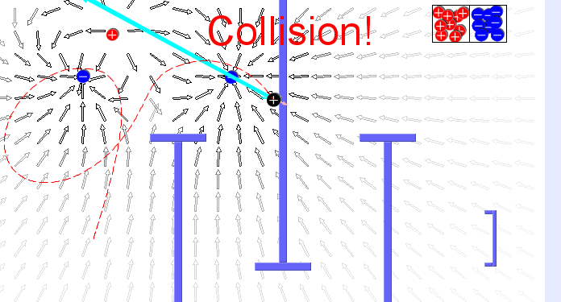
Simulating Motion in Electric Fields
Electric Field Hockey!!! Q# 9a
https://phet.colorado.edu/en/simulation/legacy/electric-hockey

Slide 20
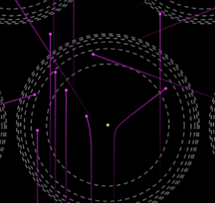
Simulating Motion in Electric Fields
Rutherford Scattering Q# 9b
How do you calculate the maximum size of the gold nucleus?
½ m_{alpha} v² = KQq/r²
½ m_{gold} v² = KQq/r
C) ½ m_{alpha} v² = KQq/r²
D) ½ m_{gold} v² = KQq/r
https://phet.colorado.edu/en/simulation/rutherford-scattering

Slide 21
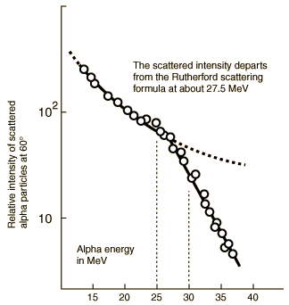
Motion in Electric Fields
How does the physics change if you hit the nucleus?

Slide 22
Applying Electric and Magnetic Fields
Physics in Action: Electromagnetism and Circular motion in a Cyclotron Q# 10a
What type of field is used to accelerate ions?
A) gravitational B) electrical C) magnetic
Gravity is much too weak.
Electric fields can turn and speed up ions.
Magnetic fields can only turn, but it can turn really fast ions more easily because F=qvB
http://www.triumf.ca/home/for-media/publicationsgallery/videos/e-m-and-circular-motion

Slide 23
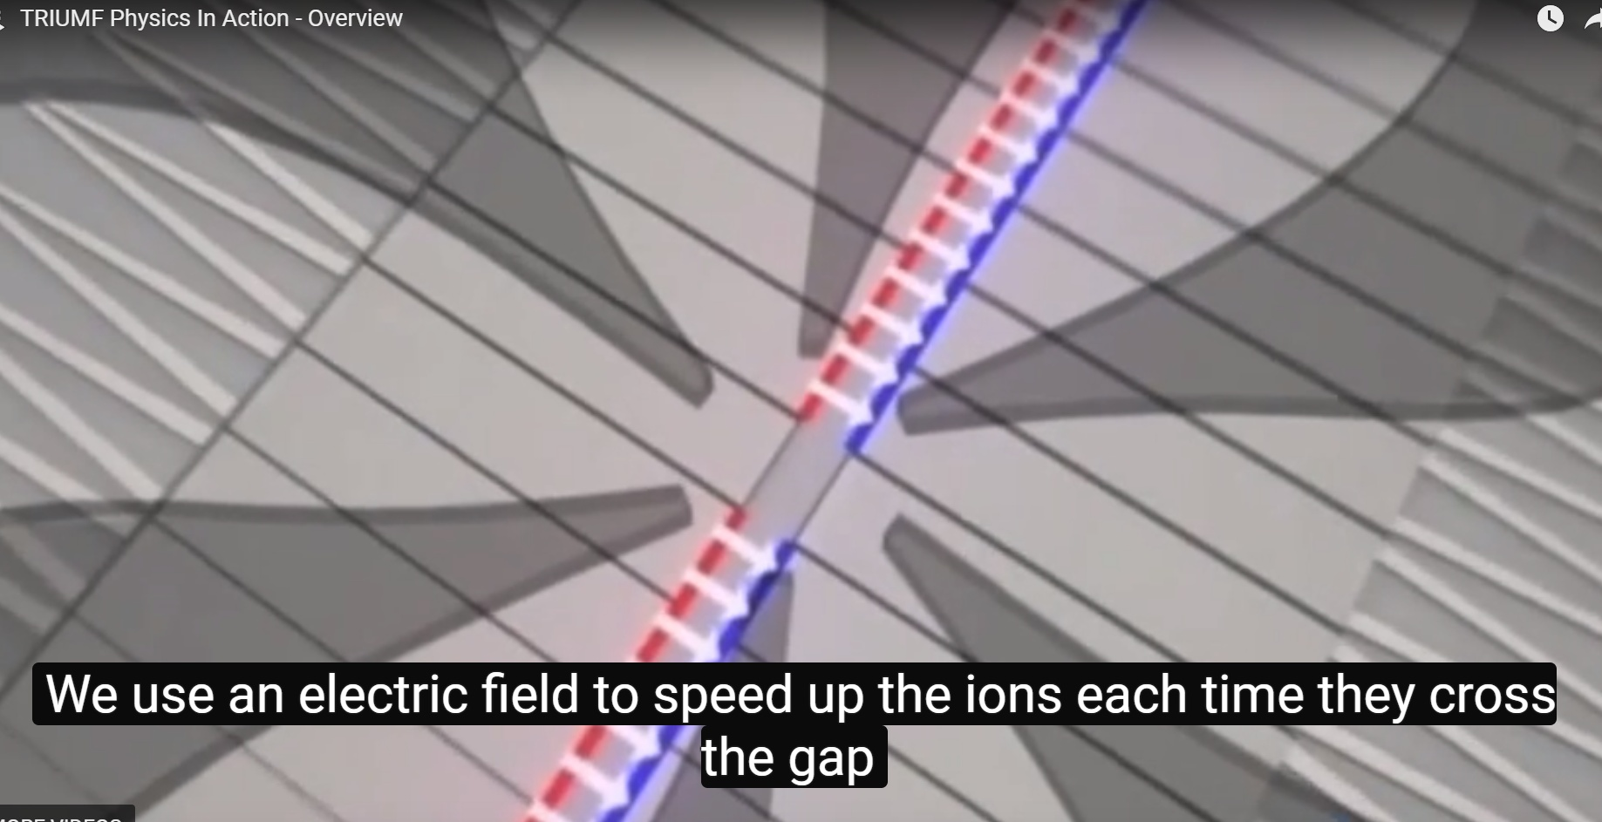
Applying Electric and Magnetic Fields
Why must the electric field switch every ½ a period?
http://www.triumf.ca/home/for-media/publicationsgallery/videos/e-m-and-circular-motion

Slide 24
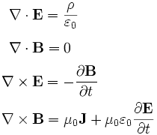
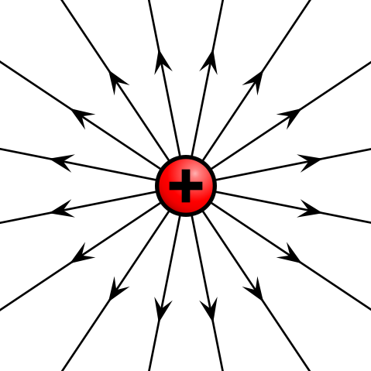
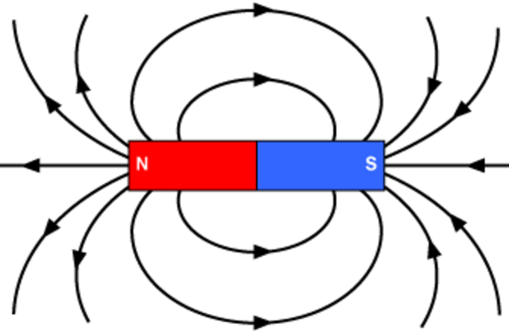
Maxwell’s Equations Q# 11a
https://s3-us-west-2.amazonaws.com/courses-images/wp-content/uploads/sites/1989/2017/06/13225904/pg1kemuormcxyvjslyvu.png

Slide 25
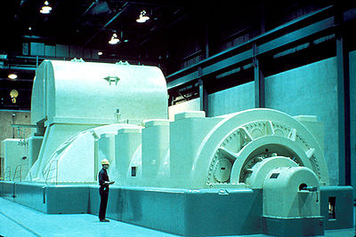
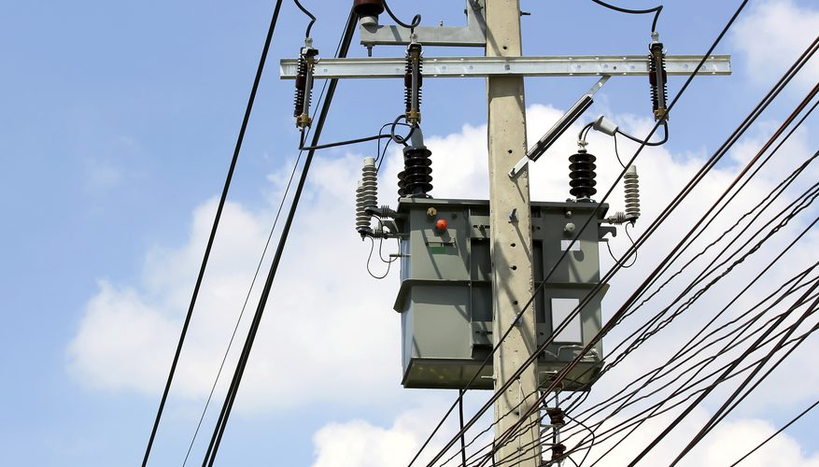
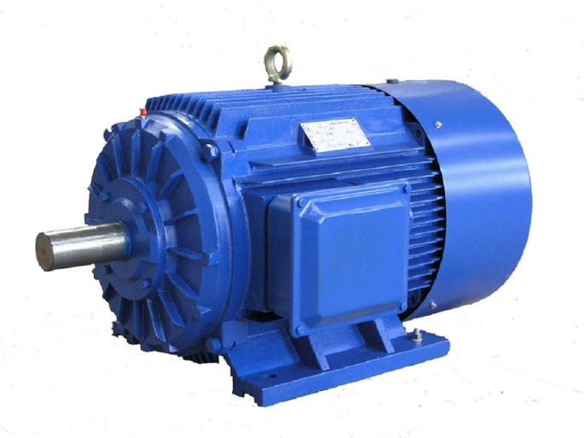
Maxwell’s Equations Q#11b, c

Slide 26
Maxwell’s Equations and Fields
Maxwell added an extra term to the fourth equation.
A changing electric field will induce a magnetic field.
This new magnetic field will induce an electric field.

Slide 27
Maxwell’s Equations and Fields
Maxwell predicted that these changing electric and magnetic fields will propagate at a speed given by sqrt (1/μ_{o}ε_{o});
μ_{o} = 1.257 x 10⁻⁶ mkg/s²A²,
the magnetic constant
ε_{o} = 8.854 x 10⁻¹² A²s⁴/m³kg,
the electric constant
Calculate the speed. Q# 11d

Slide 28
Maxwell’s Equations and Fields
sqrt (1/μ_{o}ε_{o})
= sqrt (1/(1.257 x 10⁻⁶ mkg/s²A²)(8.854 x 10⁻¹² A²s⁴/m³kg) )
= sqrt (8.985 x 10¹⁶ m²/s²)
= 2.998 x 10⁸ m/s

Slide 29
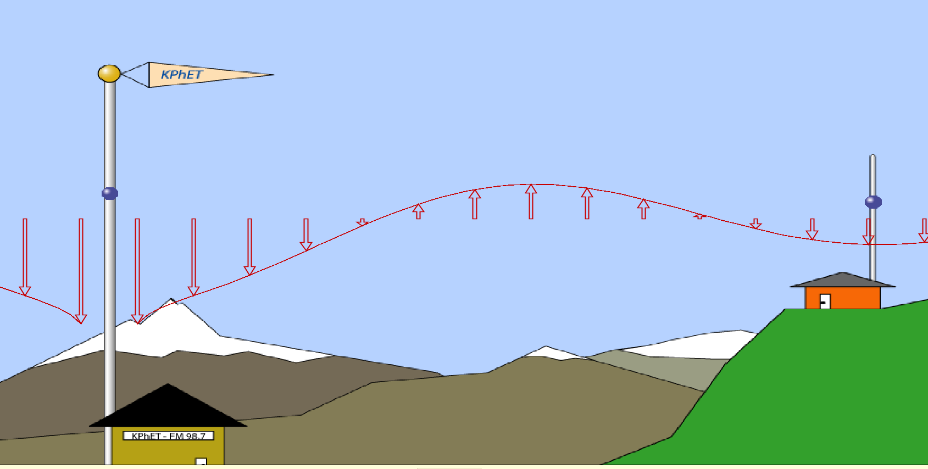
Maxwell’s Equations and Fields
Light is electromagnetic radiation!
https://phet.colorado.edu/en/simulation/legacy/radio-waves

Slide 30
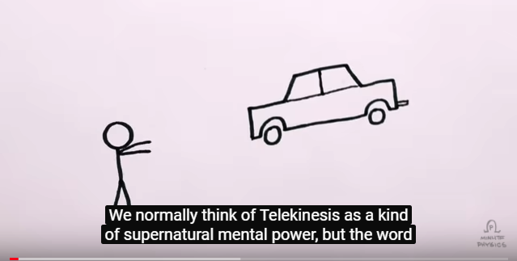
Summarizing Fields
Minute Physics: Real World Telekinesis
https://www.youtube.com/watch?v=NMgcX8UNIGY

Slide 31
Fields and Special Relativity 1905
The velocity of EM radiation was calculated from two universal constants which are the same in all reference frames.
Suppose a space ship is travelling towards you at ½ c. The light from its headlights approaches you at _____ Q#13a
A) ½ c B) c C) 1 ½ c

Slide 32
Fields and Special Relativity 1905
Einstein used the invariant speed of the electromagnetic fields to predict that time and space would change with one’s frame of reference. Q# 13b
Special relativity is at work in
A) PET scans B) the GPS
C) nuclear power plants D) all three

Slide 33
Fields and General Relativity (1915)
GR says that gravity is a fictitious force – a result of the curvature of space time. Masses curve spacetime and this curved spacetime tells masses how to move.
Its predictions have been confirmed for gravitational Q#14
A) red shift B) lensing C) waves D) all three

Slide 34
Fields and the Standard Model 1970’s
A field (a continuous model) is just a result of the exchange of particles (a discrete model).
Like charges repel by exchanging virtual photons.

Slide 35
Fields and the Standard Model 1970’s
Opposite charges attract by exchanging virtual photons that carry ‘backwards’ momentum.

Slide 36
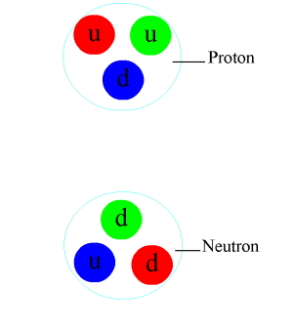
Fields and the Standard Model 1970’s
The strong nuclear force holds the protons and neutrons together in the nucleus. This is done by exchanging gluons

Slide 37
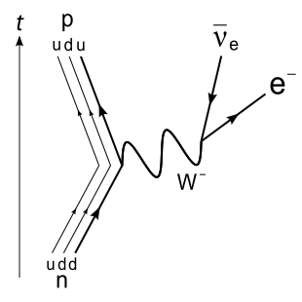
Fields and the Standard Model 1970’s
The weak force uses the exchange of W and Z particles. This force doesn’t push or pull, it just determines how particles decay.
The diagram shows β ⁻decay, where a neutron changes into a proton and ...?

Slide 38
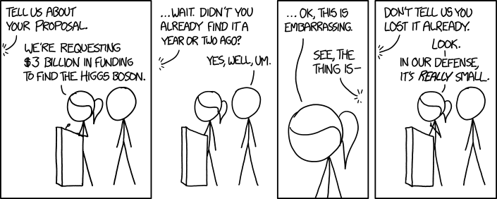
Fields and the Standard Model 1970’s
The Higgs field was proposed to explain why elementary particles have mass. It was confirmed by the discovery of its exchange particle, the Higgs boson.
https://imgs.xkcd.com/comics/higgs_boson.png

Slide 39
Fields and the Standard Model 1970’s
The Higgs Field, explained – Don Lincoln https://www.youtube.com/watch?v=joTKd5j3mzk

Slide 40
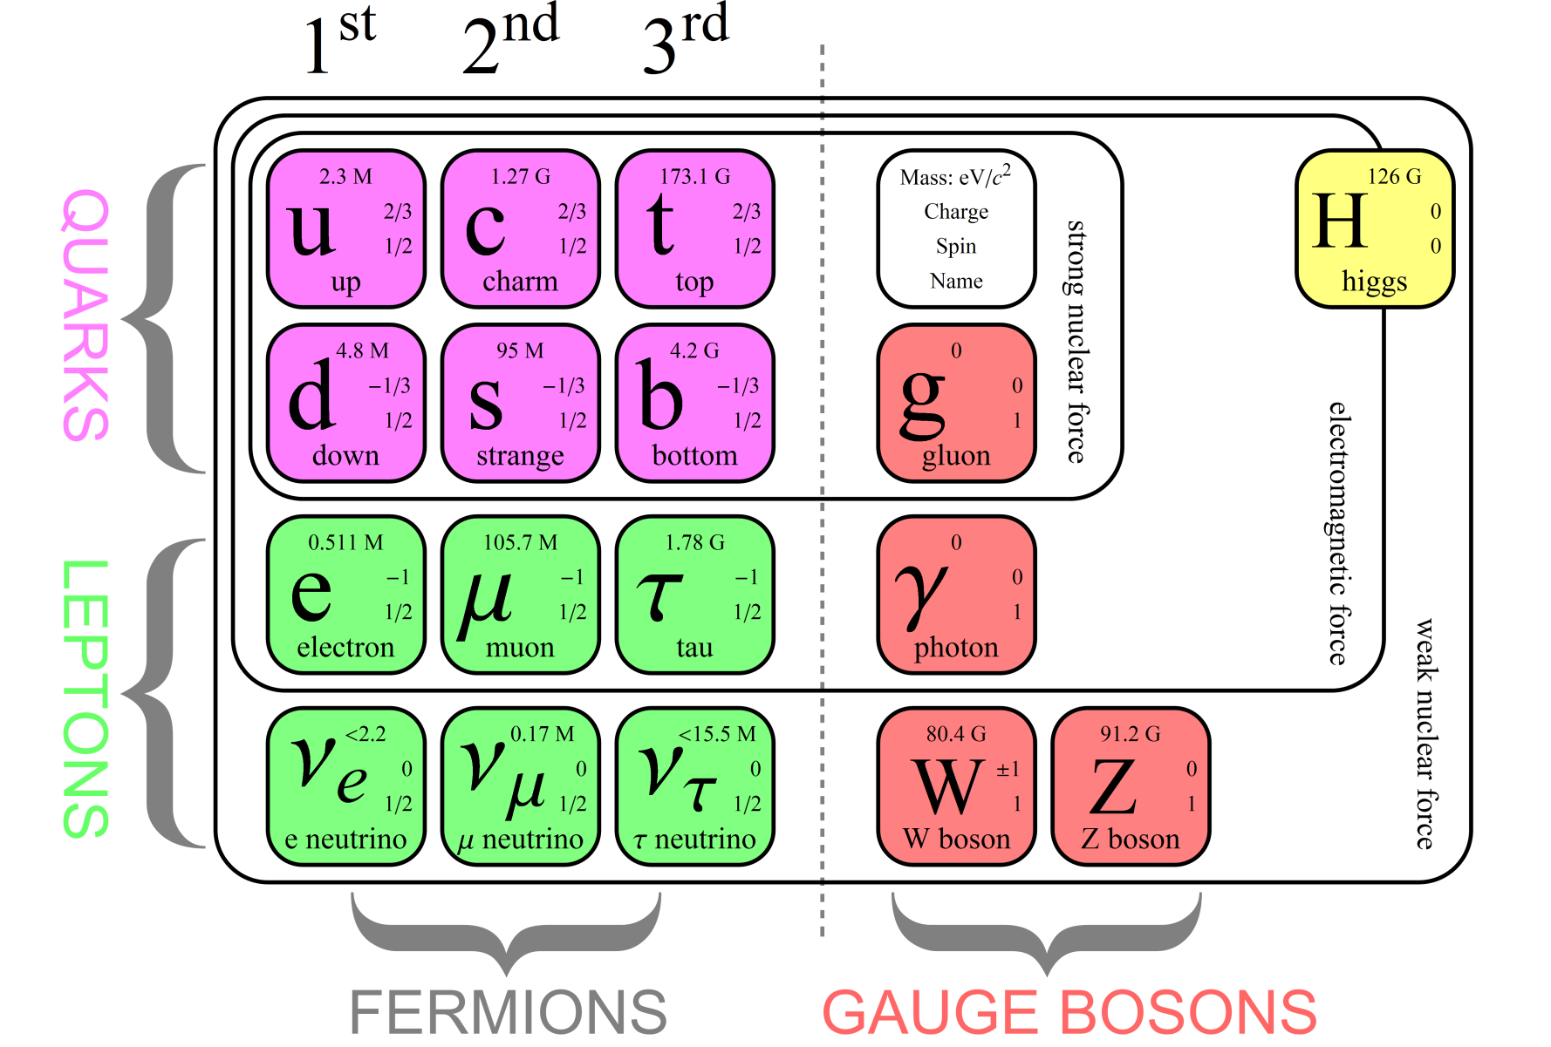
Fields and the Standard Model 1970’s

Slide 41
Fields are a very subtle and fundamental concept in physics. This is a topic that I still find challenging – and fascinating. Thank you

