Slide 1
Teaching Technology and Physics
Richard Taylor
Merivale High School, Ottawa
Richard.Taylor@MerivaleHS.org

Slide 2
Curriculum Expectations
All three high school Physics courses include curriculum expectations to analyse technologies:
SPH3U - “B1. analyse technologies that apply concepts related to kinematics, and assess the technologies’ social and environmental impact;”
SPH4U - “D1. analyse the operation of technologies that use gravitational, electric, or magnetic fields, and assess the technologies’ social and environmental impact;”
SPH4C – “F1. analyse the development of technological applications related to hydraulic and pneumatic systems, and assess some of the social and environmental effects of these systems;”

Slide 3
Why is this needed?
we need more people who understand how machines work
we need to prepare more Canadians to build and repair the machines we use
skills with tools and machines help people earn more and save more when they can do simple repairs for themselves
understanding why things work allows innovation and creativity
our students are more likely to become engineers and technicians than scientists

Slide 4
Practical Physics: topics
Investigation skills
Position and Motion
Mechanics
Electricity
Energy
Fluids

Slide 5
Skills: more practical, less academic
Measuring
Drawing to scale
Directions and vector components
Using tools to build things
Understanding graphs
Feeling relationships and connections
Making use of available parts

Slide 6
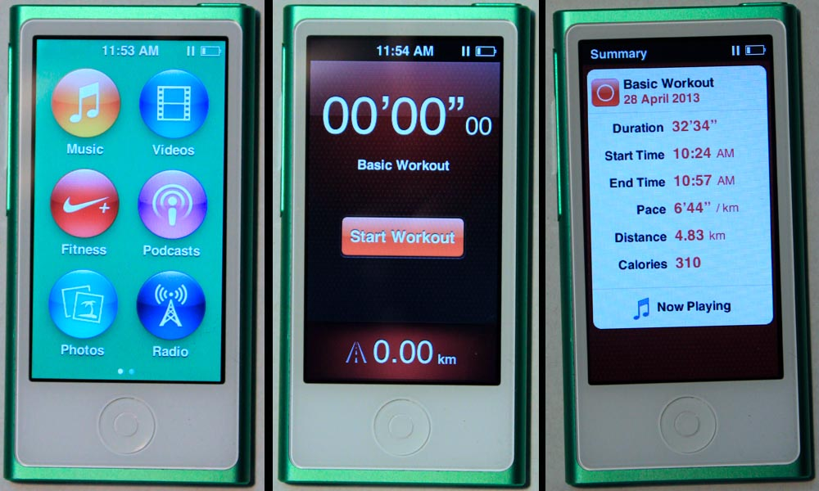
Distance, time, speed
I-Pod app by Nike uses a built-in accelerometer to detect and count steps
Built-in clock counts elapsed time
Investigate if conversion from steps to distance is accurate. What happens if you enter your height? Is it better when you calibrate one run?

Slide 7
Force and Motion
Motion was dropped from the grade 10 Science curriculum and moved into SPH3U. This means that most students do not get taught the Physics of movement, speed, acceleration and forces before learning how to drive.
More young drivers should learn:
Force acting for a time changes velocity.
Force acting over a distance changes energy.
Force hurts. Too much force kills.

Slide 8
The Physics of Car Crashes
Excellent video and teacher workbook by Griff Jones and the Insurance Institute for Highway Safety:
“Understanding Car Crashes: It’s Basic Physics”
http://www.youtube.com/watch?v=yUpiV2I_IRI
http://web.cvcaroyals.org/~rheckathorn/documents/ physicsofcarcrashesteachersguide.pdf
Also many videos by the Mythbusters

Slide 9
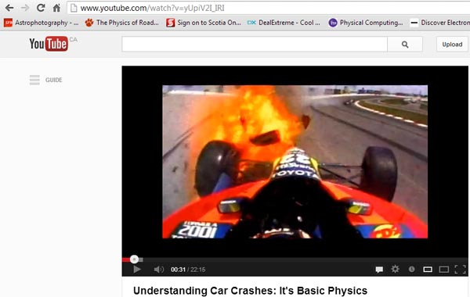

Slide 10
Simple machines
With all the modern electronic machines, people forget just how useful and ubiquitous the simple machines are:
wheels
levers
wedges, ramps and screws
gears
pulleys

Slide 11
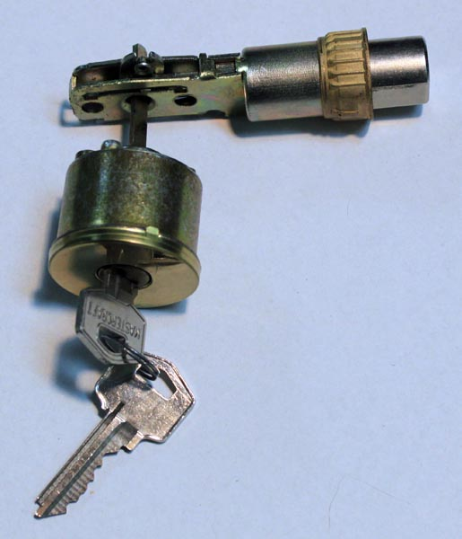
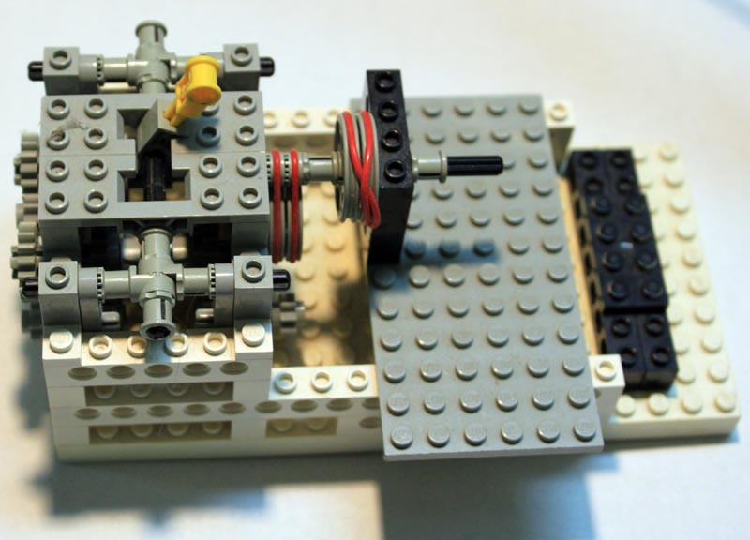
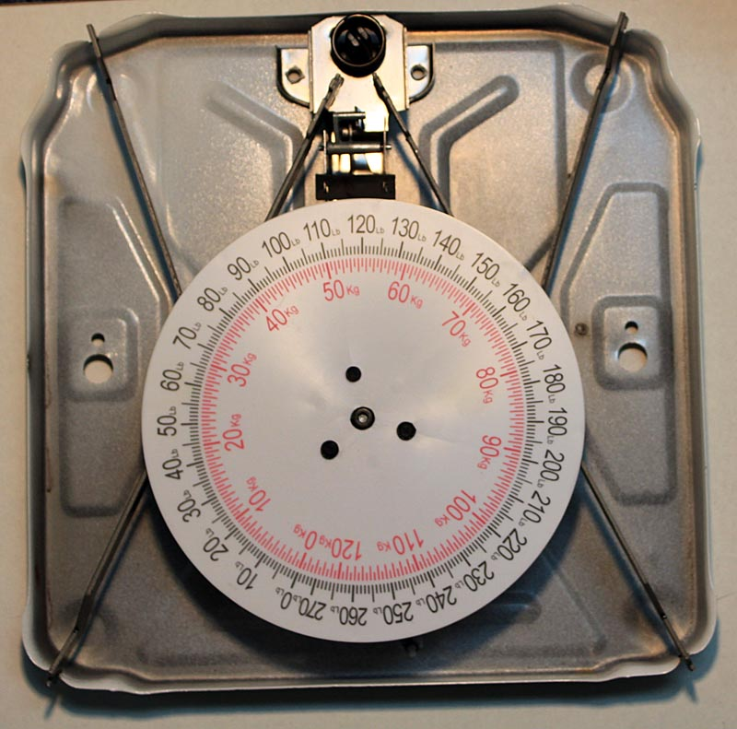
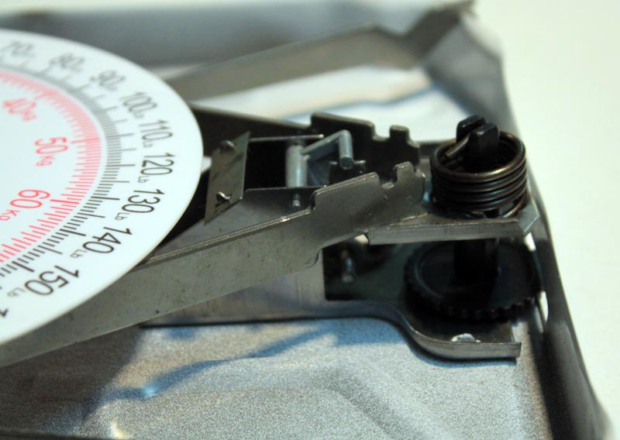
Case studies:
Door deadbolt
Lego gear shift
bathroom scale

Slide 12
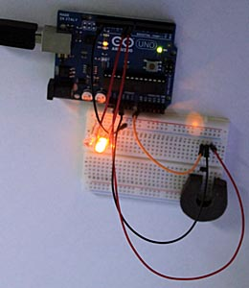
Electrical machines
teach circuits using household wiring and actual parts - cheap at hardware stores
electronics using breadboards LEDs and jumpers
demo Arduino microcontroller

Slide 13



Arduino is a simple, inexpensive (<$30) microprocessor board with multiple inputs and outputs
“Processing” is a simple programming language for graphical displays, built up by interactive trial and error
Both use similar commands and can be made to communicate with each other via USB

Slide 14
Example: Arduino light meter
Read the voltage caused by a photoresistor
Divide by 4 to decrease the range from 1046 to one byte
Send one byte out on the USB
Read one byte
Turn it into a vertical line
Move right one place
At far right clear the display and restart at left

Slide 15
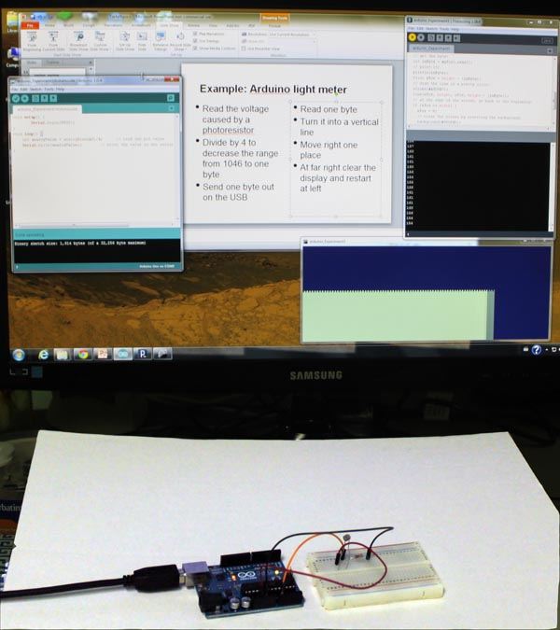
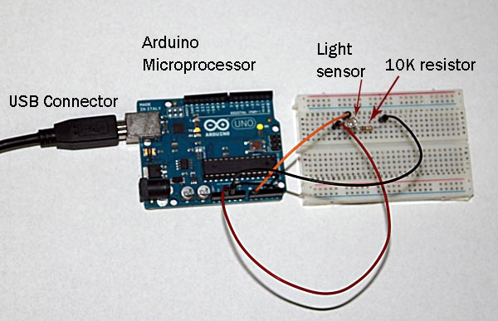
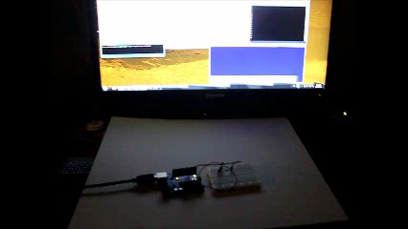

Slide 16
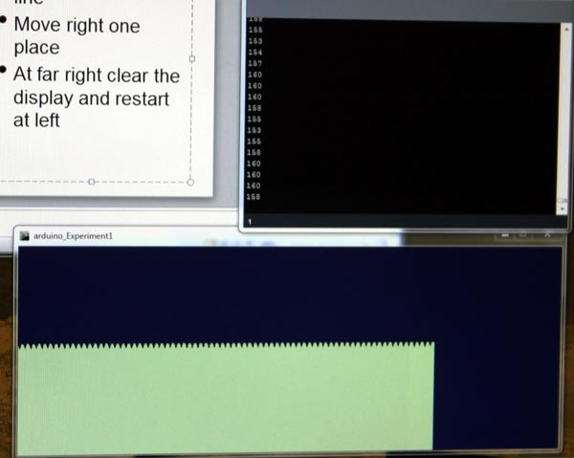
Light meter shows flicker of fluorescent lights

Slide 17
Magnetic “Hall Effect” sensor
Very inexpensive electronic sensor detects how much a known current is deflected by a magnetic field
Connect to Arduino or build a simple circuit to change the output into a voltage that can be measured with a multimeter
https://sites.google.com/a/cloud.ocdsb.ca/physics-by-simulation/Topics/teslameter

Slide 18
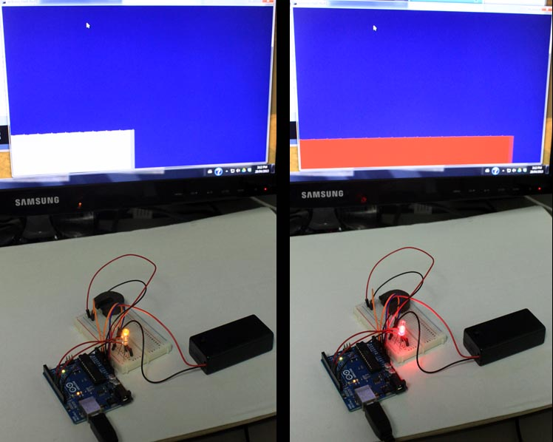

Slide 19

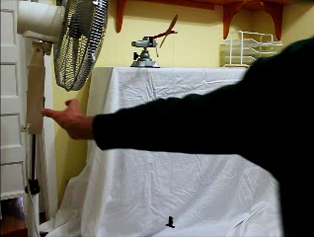
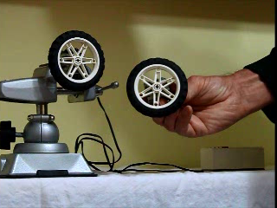
Energy machines
solar power producing
electricity
windpower windlass
to raise weights
Lego motors are
generators

Slide 20
Hydraulic and Pneumatic machines
A recent CBC Marketplace episode http://www.cbc.ca/marketplace/2012/
whentherepairmanknocks/
demonstrated how a very simple plumbing problem with a toilet or dishwasher can lead to outrageous estimates for unnecessary repairs or replacements. Understanding of how these common machines work, and skill with simple plumbing tools can save you lots of money and trouble.

Slide 21


Slide 22
Practical plumbing and hydraulics
Demonstrate siphon
Demonstrate model toilet
Demonstrate hydraulic piston using syringes
Mechanical advantage when using cylinders of different sizes

Slide 23
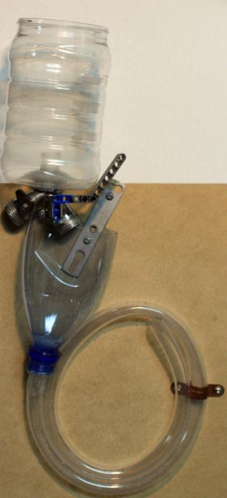
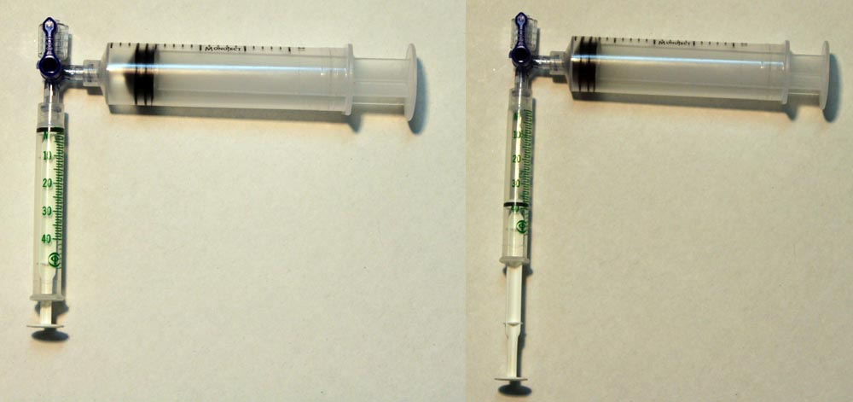

Slide 24
Resources
Make magazine:
http://makezine.com/
Arduino:
http://arduino.cc/en/
Processing:
http://processing.org/
Inventables - weird and wonderful materials:
http://www.inventables.com/
Sparkfun - electronics equipment and kits:
http://www.sparkfun.com/

Slide 25
More resources
Skills Canada - Ontario:
http://www.skillsontario.com/
Ontario Colleges:
http://www.ontariocolleges.ca/ontcol/home.html
Human Resources and Skills Development Canada
http://www4.hrsdc.gc.ca/d.4m.1.3n@-eng.jsp?did=5

