Slide 1
On-Line Research Co-op
Sparking new interest in innovation and research
Teaching professional e-communication, e-etiquette, on-line collaboration and problem solving.

Slide 2
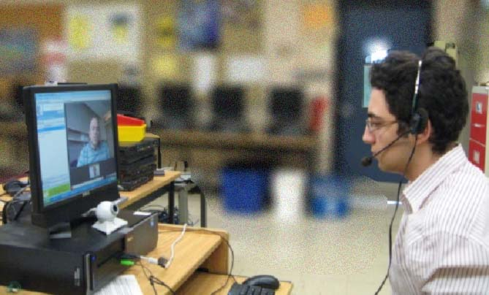
The On-line Research Co-op Program gives senior students much sought-after opportunities to work with leading national academics and R&D teams.
Skype Interview with professor
Students research results and achievements lead to high school credit, academic connections and possible scholarly publication.

Slide 3
Cyber format of the Program eliminates the necessity for commute and could be offered as a one-credit co-op course that fits well into the busy timetables of senior high school students including those who participate in special programs like Specialist High Skills Major, TOPS and others.

Slide 4
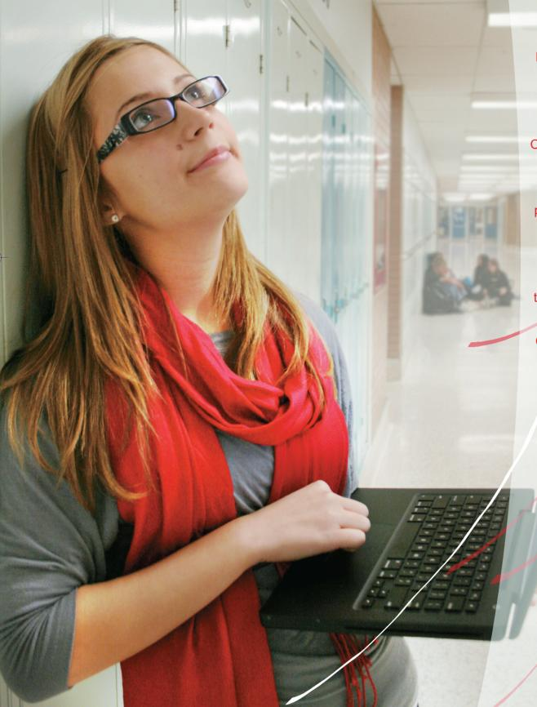
Subject teachers recommend their students for the Program based on students’ demonstrated interest in research, necessity to be challenged in science and engineering courses, as well as their ability to work independently.
Based on teacher recommendations or students’ interests, selected candidates are referred to the co-op department to pick a research field they could be interested in.

Slide 5
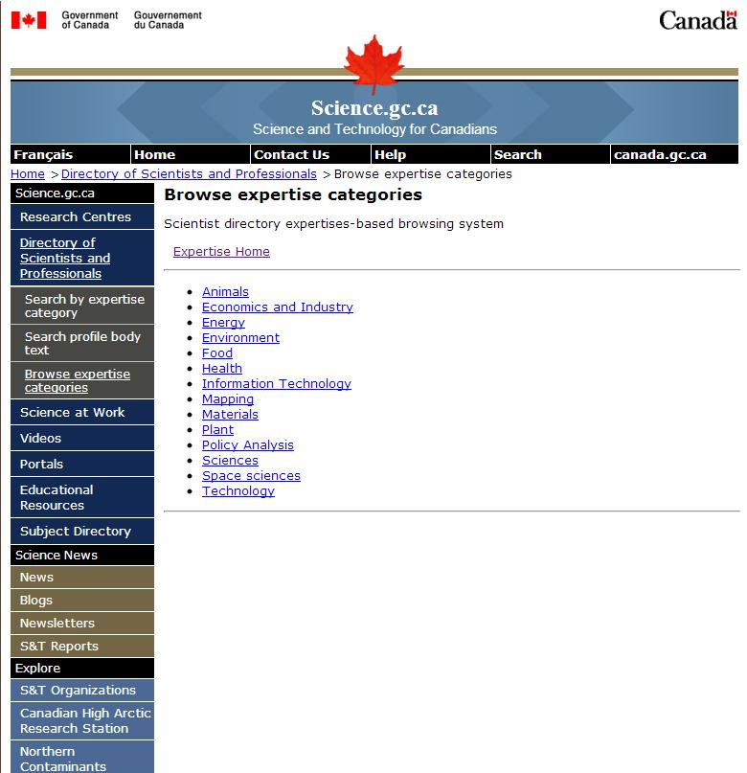
The program is offered to grade 11 and 12 students as a co-op course connected to a previous or current course, such as a science or computer class.
Students are offered research placements through Science.gc.ca’s database of scientists.
http://science.gc.ca/Directory_of_Scientists_and_Professionals/Browse_expertise_categories-WSA2829F91-1_En.htm

Slide 6
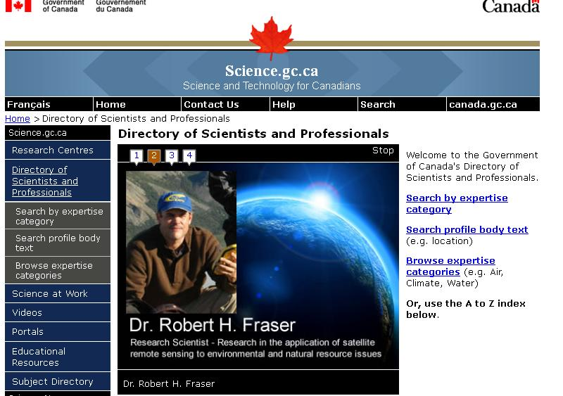
Journal liaison connects to research groups and individual scientists to identify mentors in the student’s field of interest.
Liaison sets up SharePoint accounts for each co-op student connecting student with mentor-scientist.
liaison@cysjournal.ca

Slide 7
Students will work on-line as research assistants and investigators in the leading national academic teams. At the end of the course they will have an opportunity to publish their results in the Canadian Young Scientist Journal.

Slide 8
Traditional Co-op Curriculum with a 21st century placement
One-on-one tutelage from leading Canadian scientist in chosen field of current research
No routine assignments for students at a work place
Development of scientific article writing & reviewing skills
Familiarity with format for both scientific articles and scientific reviews
A possibility of One semester/1 High School Credit

Slide 9
Pre-placement phase with an electronic twist (résumé; cover-letter; job interview; workplace safety & etiquette instruction; etc.)

Slide 10
Liaison (Lauren Sykes- liaison@cysjournal.ca): - mediates initial communication between Students and Mentor - monitors SharePoint site interactions together with local school Co-op teacher - escalation contact person

Slide 11
School CO-OP Teacher: - recruits students - receives initial information from students (résumé/cover-letter/etc.) and passes it on to Liaison - supervises occasional cooperative meetings between students - Supervises SharePoint interactions - Assesses student progress

Slide 12
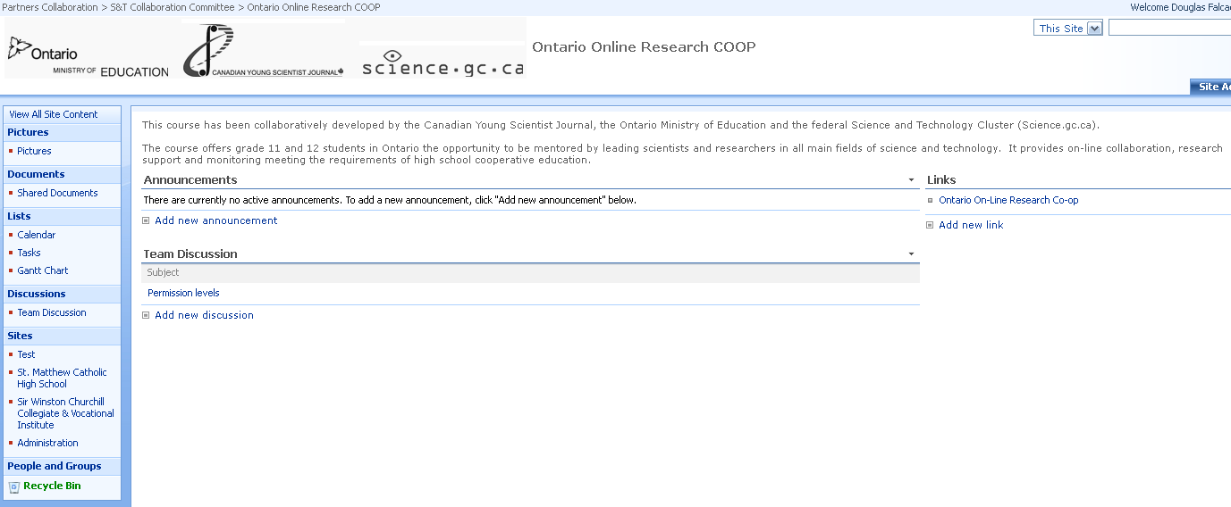
Mentor Tutelage – SHAREPOINT SHAREPOINT Log in page

Slide 13
The Program has been developed to support students’ transition from high school into postsecondary institutes with a focus on 21st century careers in science and technology.

