Slide 1
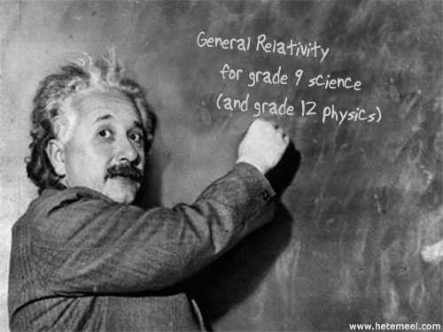

Slide 2
General Relativity is a surprisingly good fit for grade-9 Astronomy. It explains and gives depth to many standard topics like....
What causes orbits?
What is a black hole?
What is the big bang?

Slide 3
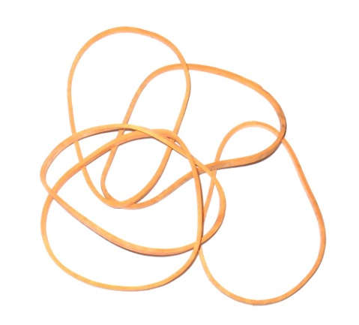
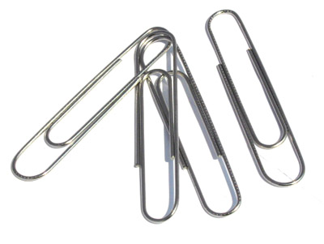
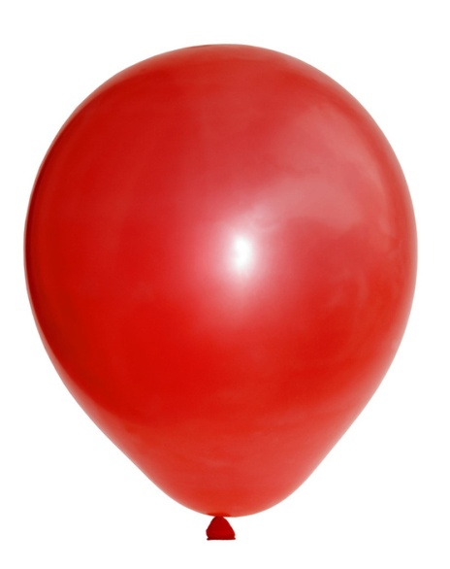
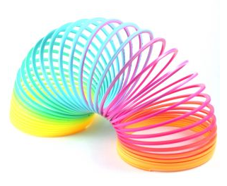
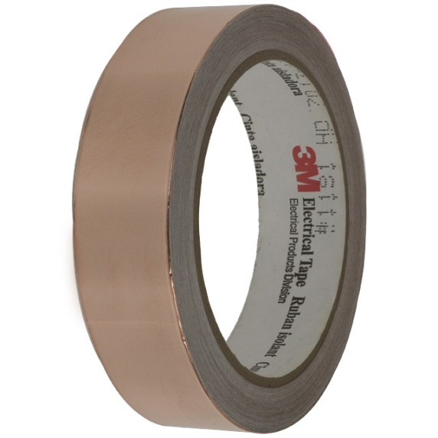
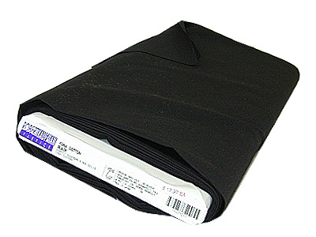
General Relativity lends itself to many hands-on models and opportunities for students to actively explore physics using materials like ...

Slide 4
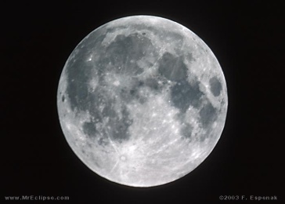
Part 1: Orbits
Why Doesn’t the Moon Fall Down?
http://www.perimeterinstitute.ca/Outreach/Alice_and_Bob_in_Wonderland/Alice_and_Bob_in_Wonderland/

Slide 5
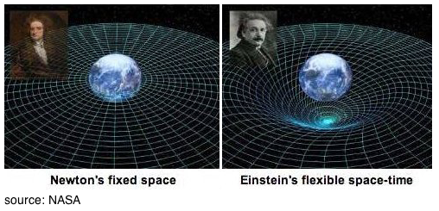
How can gravity make things fall
and orbit without touching them?

Slide 6
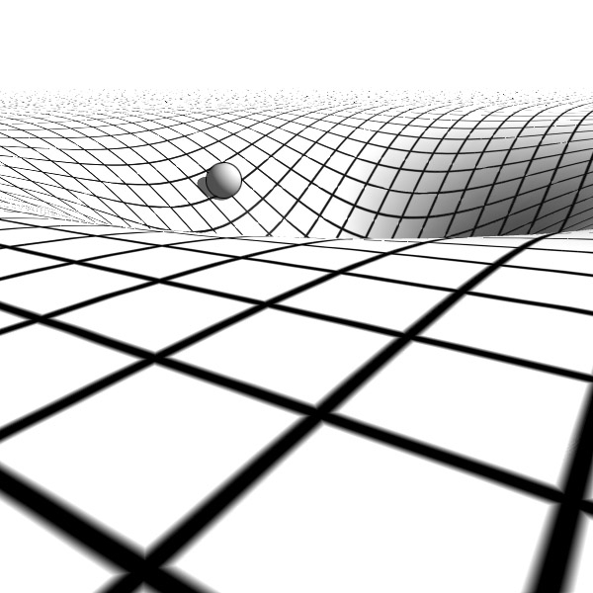
Masses cause spacetime to curve and the curve in spacetime tells other masses how to move.

Slide 7
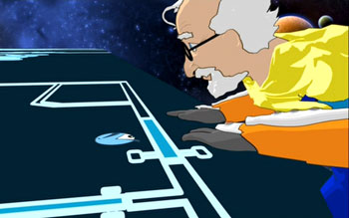
We live in a 3-D space that curves into a 4th dimension which we can’t see. Why not?
http://www.youtube.com/watch?v=BWyTxCsIXE4

Slide 8
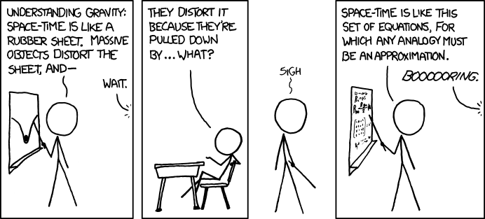
We can’t see curved spacetime so we are going to use some simple physical models.
Aren’t all analogies and physical models of curved spacetime wrong?

Slide 9
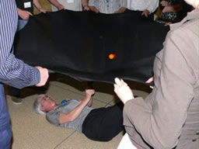
How would an ant on this surface explain orbits?

Slide 10
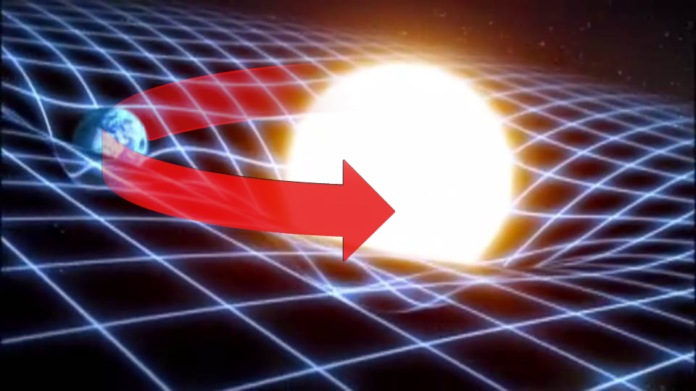
Orbiting objects bend spacetime as they move through it and this should generate gravitational waves which will radiate energy. Orbiting objects should spiral into the center – just like they did with the spacetime fabric.

Slide 11
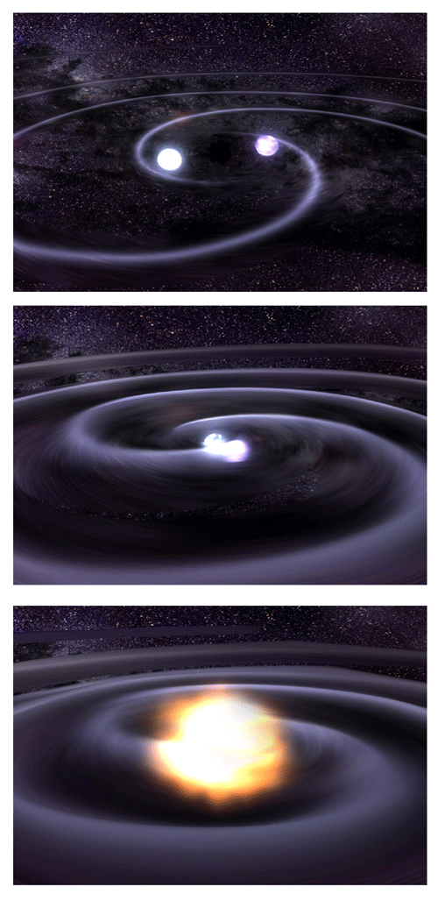
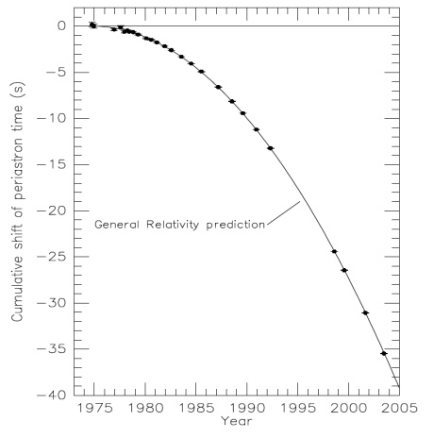
They do! This is happening to two neutron stars orbiting each other.

Slide 12
In flat space, the orbit of a planet is an ellipse. Einstein predicted something else. Take the cardboard ‘orbit’ and carefully trace it on the curved surface of a balloon. What happens?

Slide 13
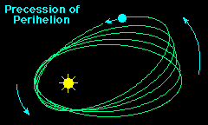
Einstein’s equations predict this pattern and measurements of the orbits of Mercury, Venus and the Earth have confirmed his predictions.

Slide 14
Why hasn’t this pattern been confirmed for the other planets?
The effect is too small because the other planets are too
Small
Large
Low density
Far from the sun

Slide 15
PART 2: Light
What effect will gravity have on light? A piece of masking tape will represent a beam of light passing near a large mass - an upturned bowl. Aim the light so it passes onto the edge of the bowl, smoothly along the surface and off again.

Slide 16
What will happen to the path if the bowl is right-side up, so it forms a trough into the surface instead of a bump up? It will bend
in the same direction, toward the bowl
in the opposite direction, away from the bowl

Slide 17
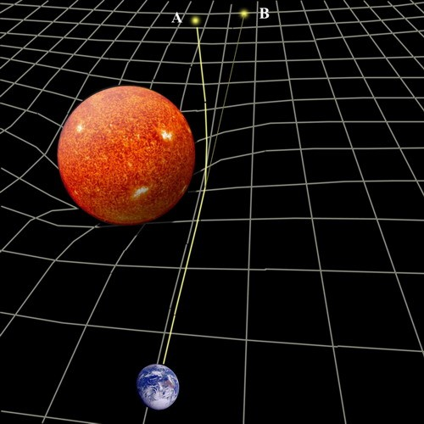

Slide 18
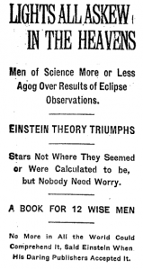
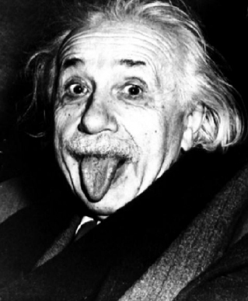
This was tested during an eclipse of the sun in 1919. Einstein’s prediction was correct and he became famous.

Slide 19
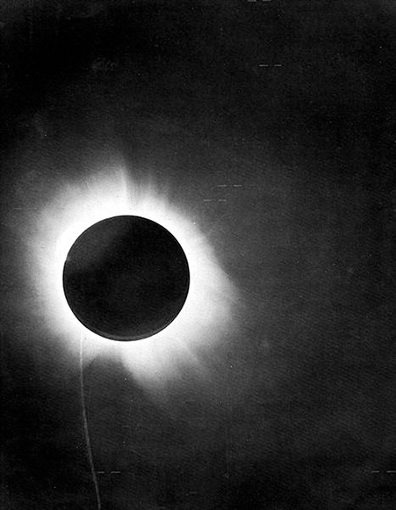
Why was the test done during an eclipse?

Slide 20
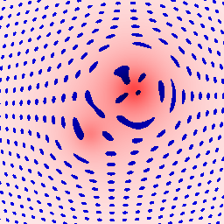
If gravity can bend light, it can act as a lens.

Slide 21
Take a wine glass. Look down the stem at a black circle. Try different positions. What different shapes can you see? Sketch 3 types.

Slide 22
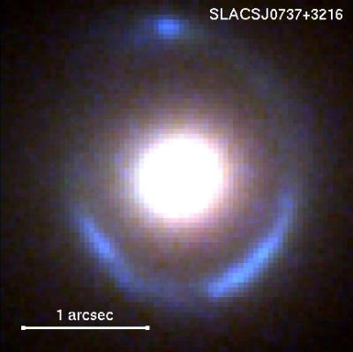
The white circle is a massive galaxy and the blue ring is the warped image a galaxy further away.

Slide 23
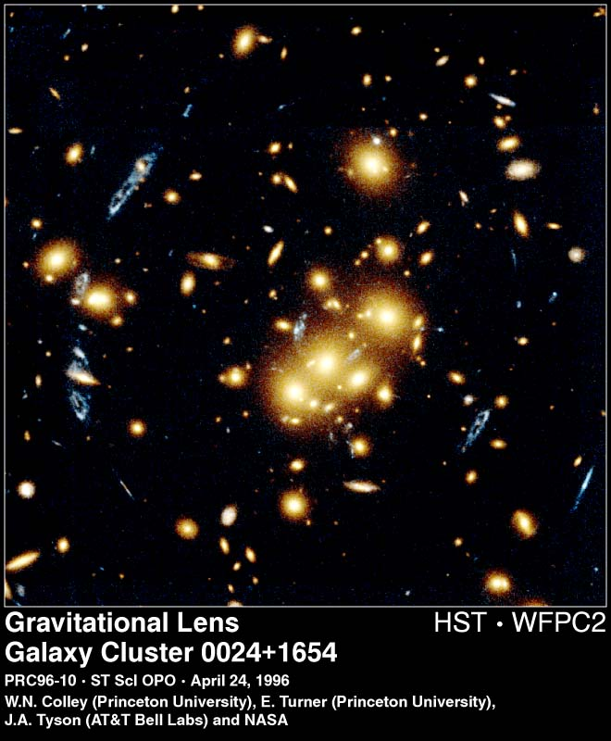
The yellow cluster is 5 billion light-years away and it is causing multiple images of a blue galaxy that is twice as far away.
.

Slide 24
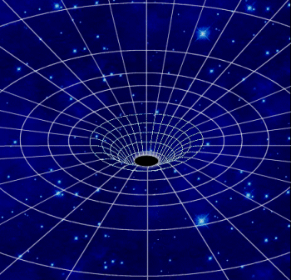
Part 3: Black Holes
Black holes are regions where space time is infinitely curved and light cannot escape.

Slide 25
What would happen to the Earth if the Sun suddenly became a black hole? It would
fall straight in
spiral in
orbit faster
not change

Slide 26
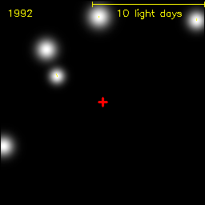
There is a black hole at the centre of our galaxy.
It has a mass of 4 million suns within
a space the size of our solar system.
Black holes do not let light escape.
How can they be detected and measured?

Slide 27
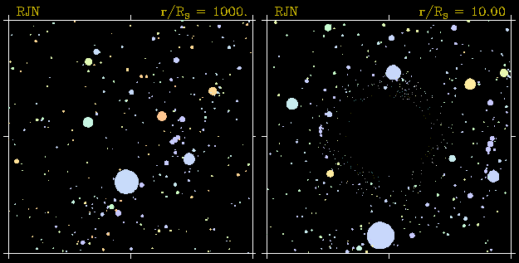
Black holes can also be detected by lensing.
How can lensing be a tool for astronomers?

Slide 28
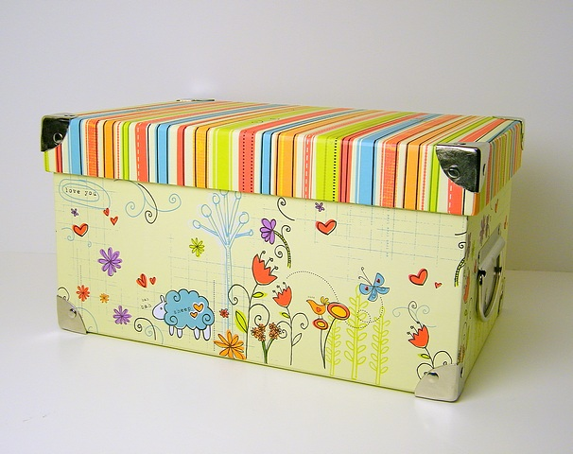
What will a black hole look like from the other side?

Slide 29
What would the Earth look like if it were orbiting a black hole?
http://jila.colorado.edu/~ajsh/insidebh/lensearth_640x480.gif

Slide 30
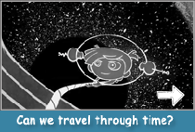
Near a black hole time passes more slowly.
http://www.perimeterinstitute.ca/en/Outreach/Alice_and_Bob_in_Wonderland/Alice_and_Bob_in_Wonderland/

Slide 31
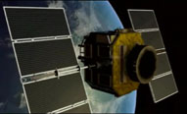
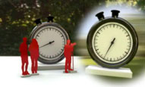
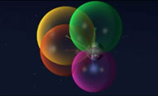
Why doesn’t time pass slower on the Earth?
It does. The GPS must take this into account. Time travels slower on Earth than on the satellites by a half a nanosecond every second. It may seem small, but if not corrected, your position would be off by 14 kilometers per day.
http://www.perimeterinstitute.ca/en/Perimeter_Inspirations/General/Perimeter_Inspirations/

Slide 32
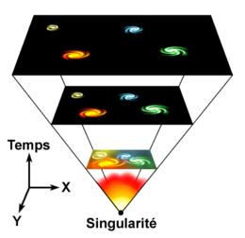
PART 4: The Big Bang
How do we know the universe started in a Big Bang?

Slide 33
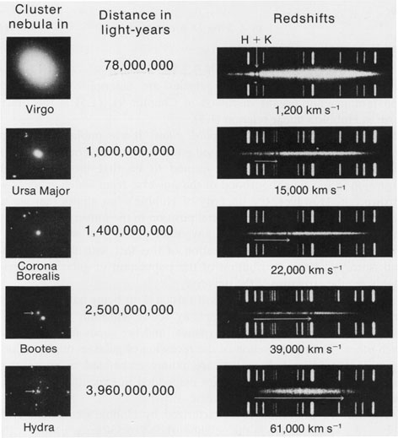
The galaxies are moving away from us and the more distant ones are moving faster.

Slide 34
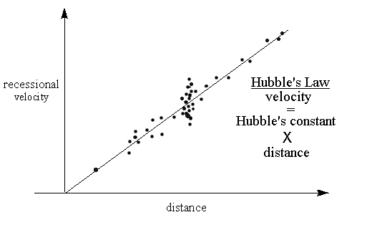
There is a simple relationship between velocity and distance. This suggests that everything was once gathered in one point that exploded around 13.8 billion years ago – the Big Bang.

Slide 35
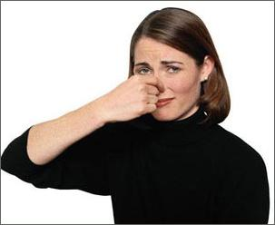
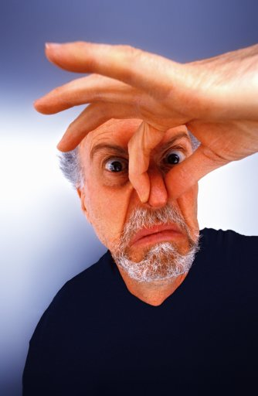
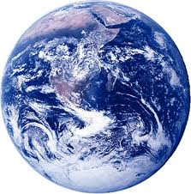
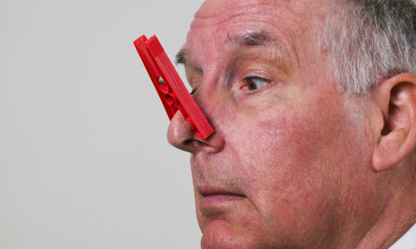
Why is everything moving away from us?

Slide 36
Let a colored paper clip represent our galaxy and the plain ones will be other galaxies. The space in between can stretch and so is made of elastic bands. What parts of our astronomical observations can this model?

Slide 37
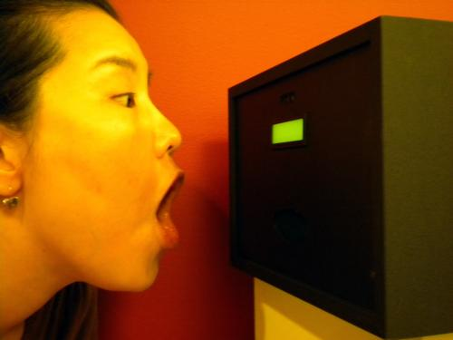
As the universe expanded - it cooled. Experience something similar by blowing with an open mouth and then with pursed lips onto your hand.

Slide 38
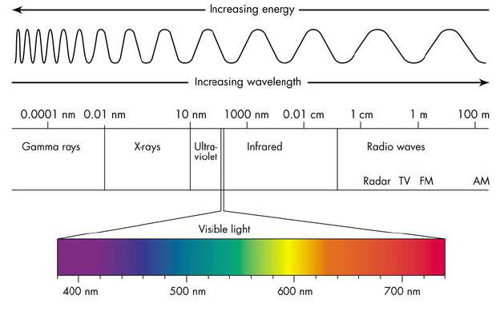
Why does the expansion of space cause cooling?

Slide 39
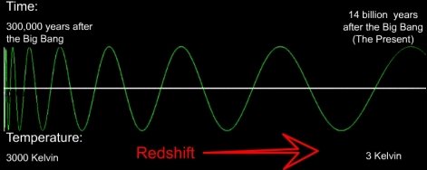
The universe is now glowing with microwave radiation of 2 mm corresponding to a temperature of -270 C or 3 degrees above absolute zero.

Slide 40
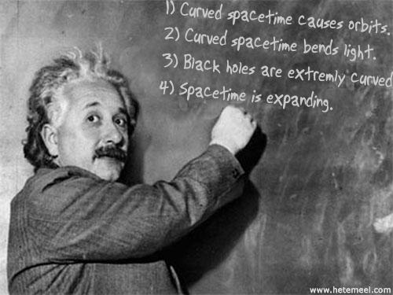

Slide 41
